Slide 1
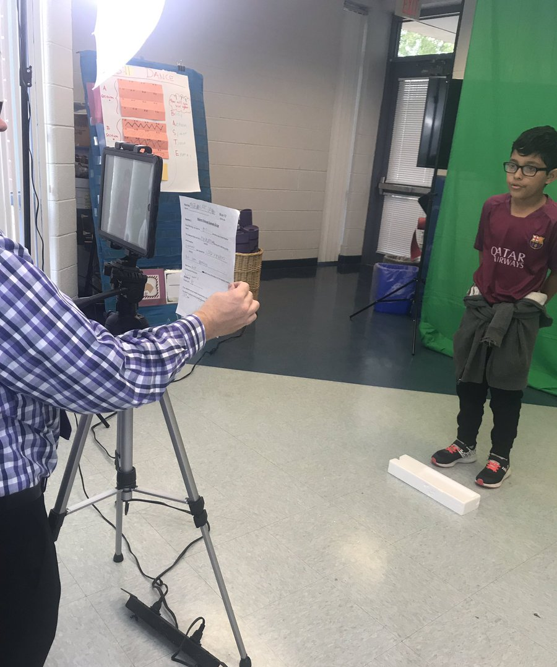
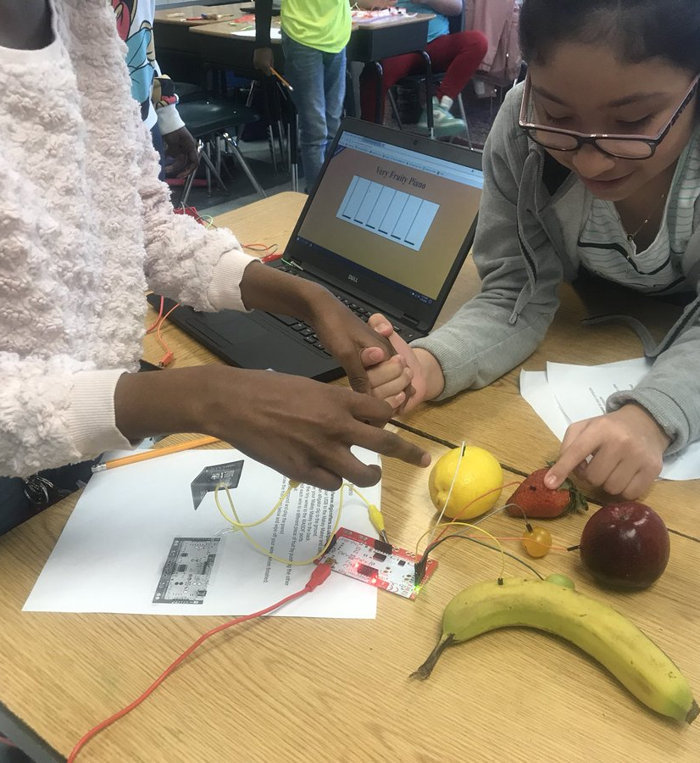
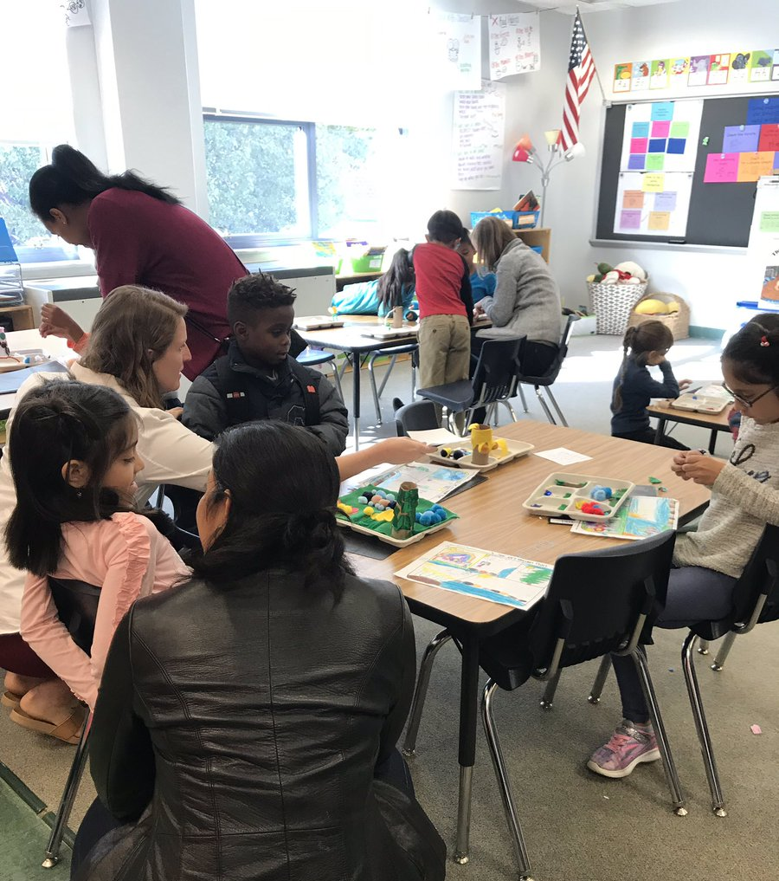
Instructional Focus and Exemplary Program—Science, Technology, Engineering, Arts and Mathematics (STEAM)
Building Our School Community
February 5, 2019

Slide 2
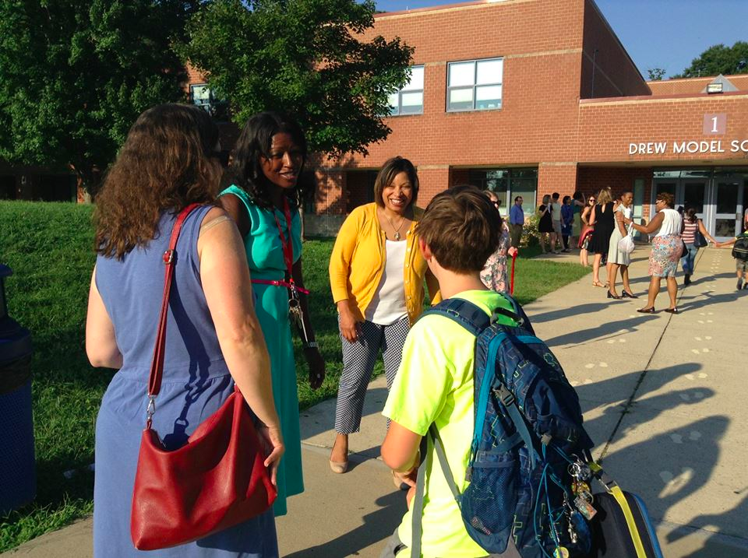
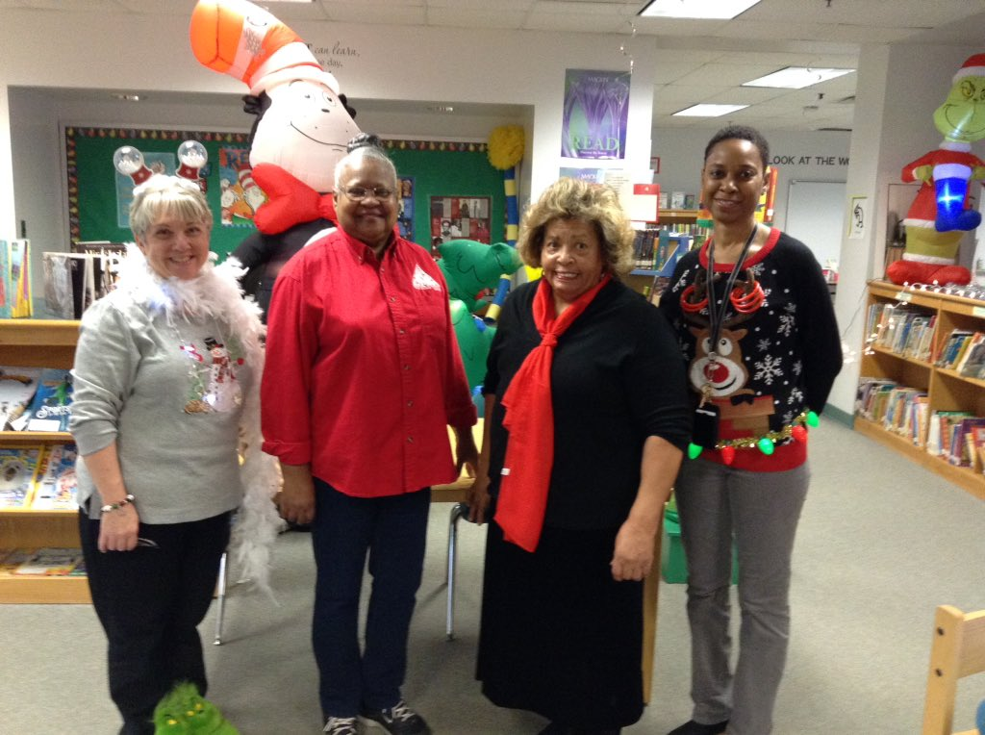
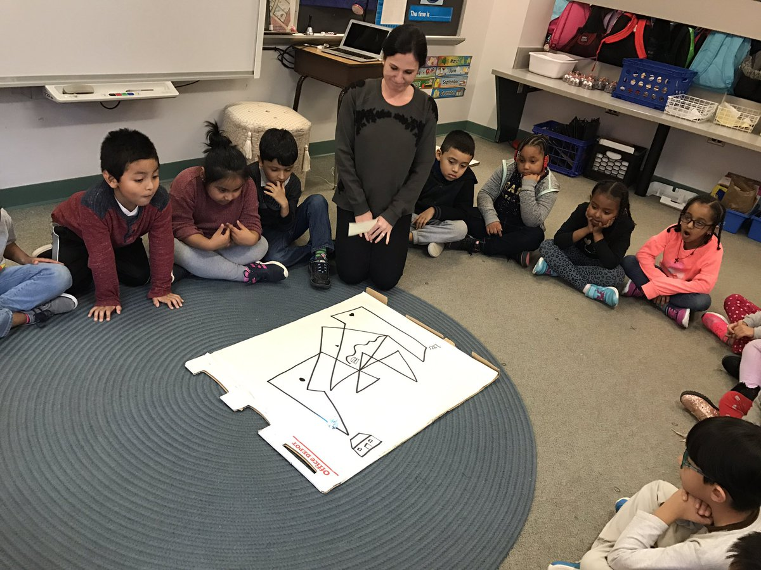
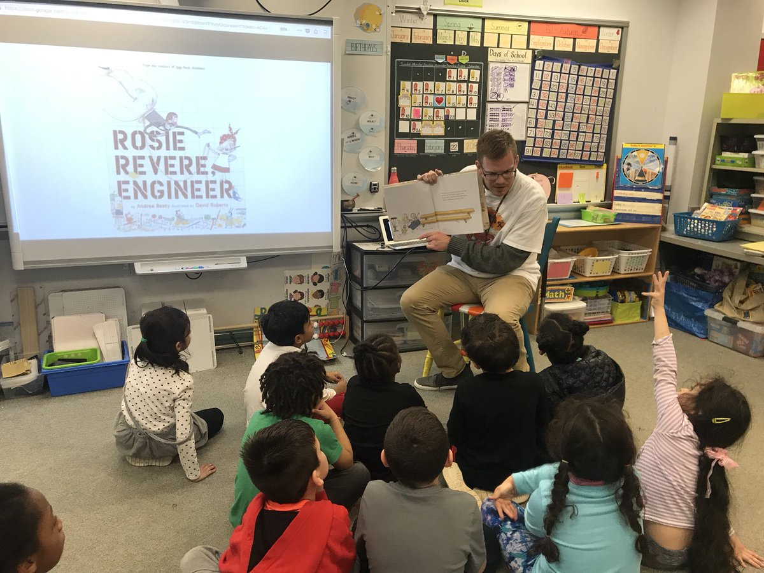
Introductions
Kimberley Graves
Principal
Tracy Gaither
Assistant Principal
Rachel Landry
STEAM Coordinator
Joel Gildea
Instructional Technology Coordinator
Notes:
2 minutes

Slide 3
Agenda
What is STEAM?
What Are we Doing?
Where Do we plan to go?
Notes:
1 minute

Slide 4
What is Drew’s Vision for STEAM?
Strengthening literacy, inquiry, problem-solving, critical thinking, collaboration and creativity
Through
Science
Math
Technology
Interpreted through
Engineering
The Arts
Notes:
2 minutes

Slide 5
Project-Based Learning as the Delivery Model
Real World Challenge
Student Inquiry
Public Product
Notes:
In project based learning, students are pulled (as opposed to pushed, as it might often feel) through the curriculum by a meaningful question to explore, an engaging real-world problem to solve, or a challenge to design or create something...
Before they can accomplish this, students need to inquire into the topic by asking questions and developing answers...
To demonstrate what they learn, students create products and make their work public to people beyond the classroom.”
- John Larmer, Buck Institute for Education

Slide 6
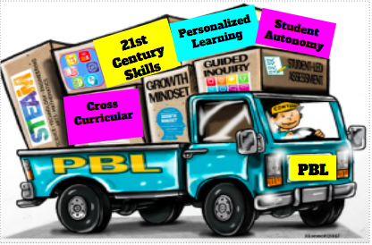
PBL Delivers…
Critical Thinking Creativity Collaboration Resourcefulness Self-Direction Good Citizenship Growth Mindset
These are basic skills needed for today’s world!

Slide 7
What are we doing?
Extensive PBL training with the Buck Institute for Education
Project-Based learning implemented across all grade levels K-5
Student Showcases (innovation Hours)
Inviting community members and beyond to add career-based elements
Introducing principles of engineering with mobile makerspace
Staff PD on technology tools
Family Events such as STEAM at Sunset
2017-2019
Laying the Groundwork
Notes:
Extensive PBL Training with the Buck Institute for Education– Gurus of Project Based Learning
Throughout the past two years, PBL has been implemented across all grade levels. Last school year all grades completed at least 2 PBL units.
PBL units ended with student showcases, sometimes called Innovation Hours, where students presented to a real audience outside of their peers.
Build connections with organizations such as the National Park Trust and RESET in addition to local professionals who have provided career based elements and authenticity to Project Based Learning.
Mobile Makerspace– has allowed students to innovate and create projects with principles of engineering.
Staff Professional development around technology tools and integration
Family events such as STEAM at Sunset

Slide 8
Project-Based Learning in Action
Notes:
This video highlights a 1st grade PBL unit on weather from last school year.

Slide 9
Gallery Walk
Notes:
10 minutes
We wanted to give you some time to take a short gallery walk, allowing you to see PBL in action across grade levels. Each TV will highlight two grade levels’ projects.

Slide 10
Where will we go next year and beyond?
Grow the STEAM Instructional Focus
Engage the Community
Create a Space to Innovate
Notes:
3 minutes
New and continuing teachers build mastery of PBL instruction
design/adapt projects for their own classrooms,
facilitate the project,
build classroom culture, and
assess student learning
Ensure teachers are supported for success
Evaluate Progress and make adjustments
Expand STEAM curriculum to PreK
Expand partnerships with families, businesses, organizations and other schools to provide authentic “clients” for PBL
Schoolwide PBL Innovation Showcases
Redesign instructional spaces to support PBL
Create a STEAM Lab with makerspace to provide a space to innovate

Slide 11
Check us out on Twitter
@APSDrewSTEAM

Slide 12
Questions?

Slide 13
Contact Information
Kimberley Graves
Kimberley.Graves@apsva.us
Tracy Gaither
Tracy.Gaither@apsva.us

