Slide 1
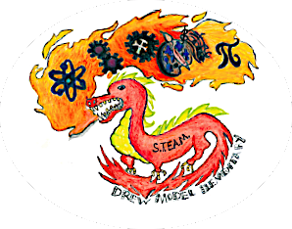
STEAM at Drew
PTA Meeting
January 18, 2018

Slide 2
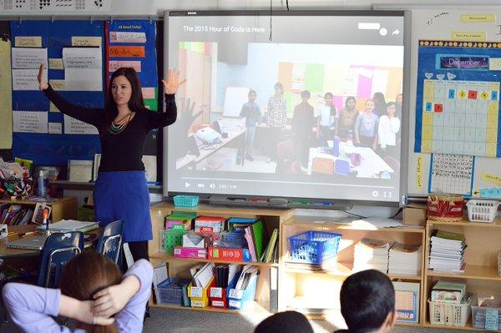
Introduction
Rachel Denbo
STEAM Coordinator
Drew Model School

Slide 3
What is STEAM?
S: Science
T: Technology
E: Engineering
A: Arts
M: Mathematics
Definition:
Instruction focused on science and technology, interpreted through engineering and the arts, all based on mathematical elements

Slide 4
Why STEAM?
“In order to equip future leaders with the necessary skills to power innovation and economic growth, students must be more than proficient readers and writers, they must be literate in science, technology, engineering and math.”
“The integration of concepts is an important prerequisite for students going to college and entering careers
Jacie Maslyk, 2016

Slide 5
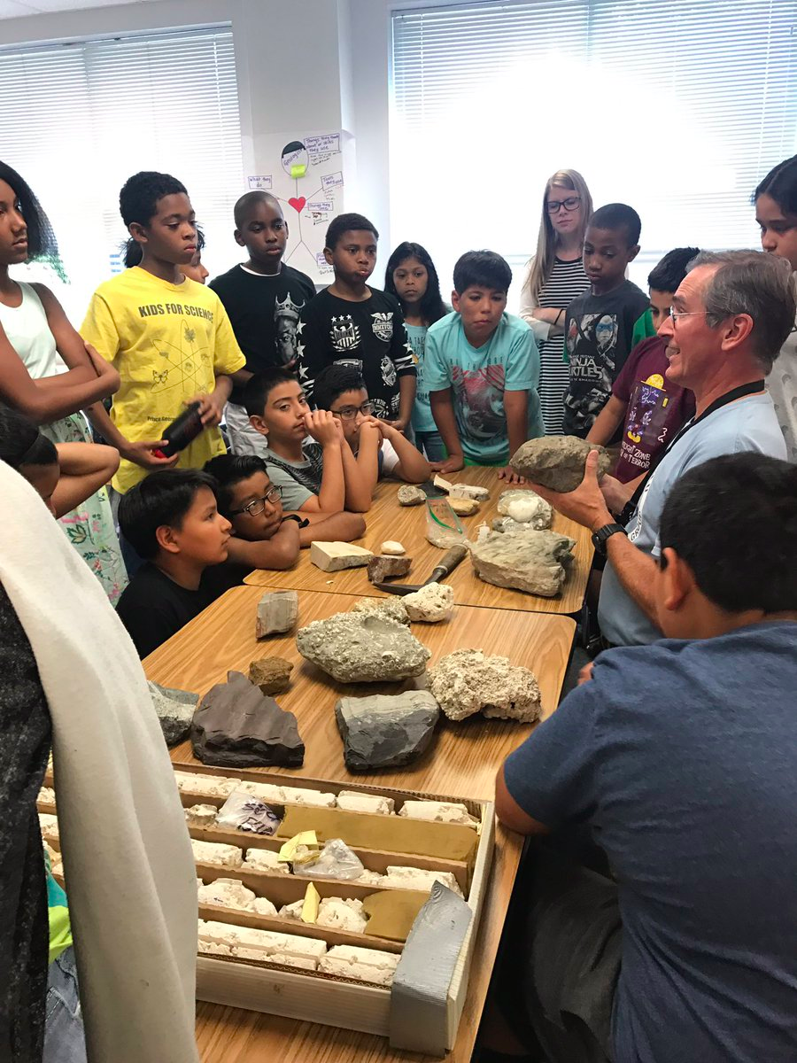
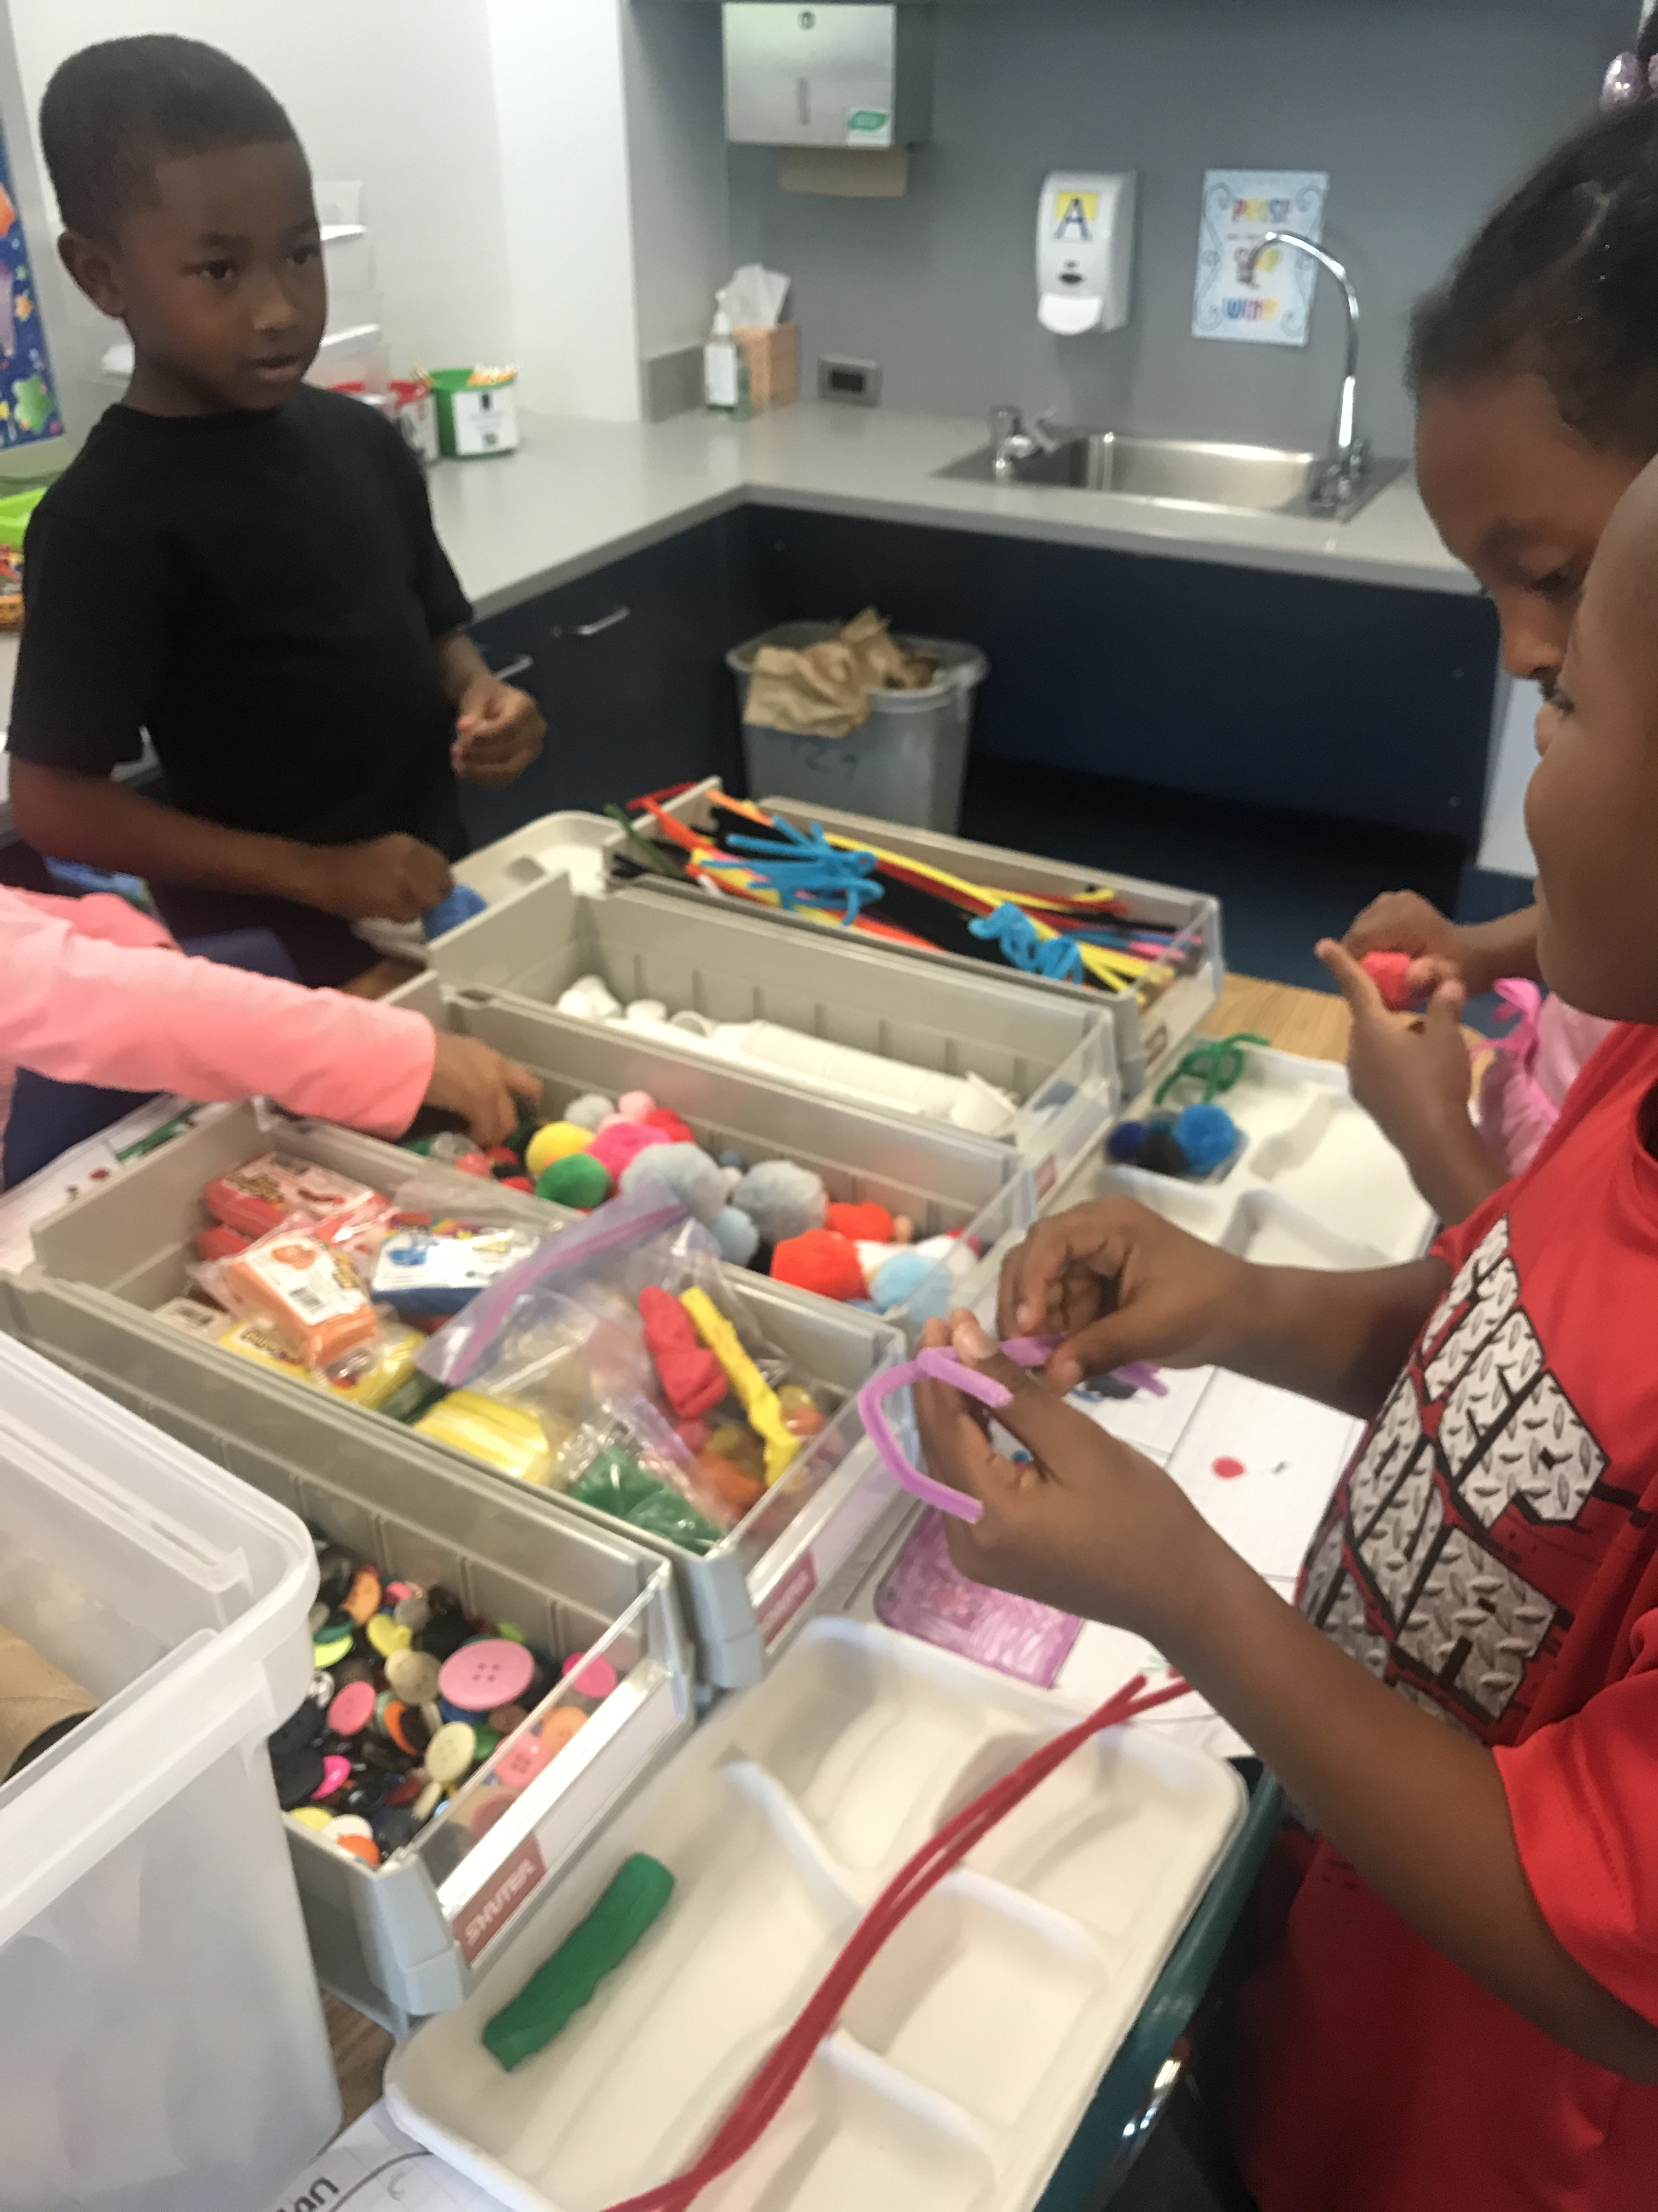
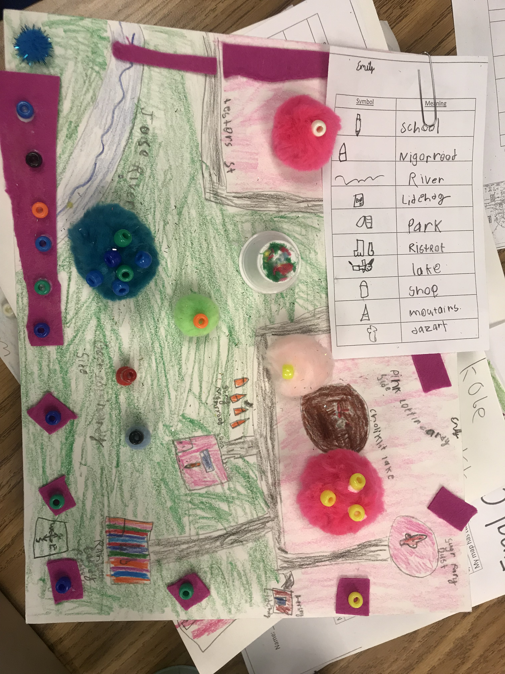
STEAM in Action at Drew
Makerspace Projects
Scientists and Other Professionals
Project-Based Learning

Slide 6
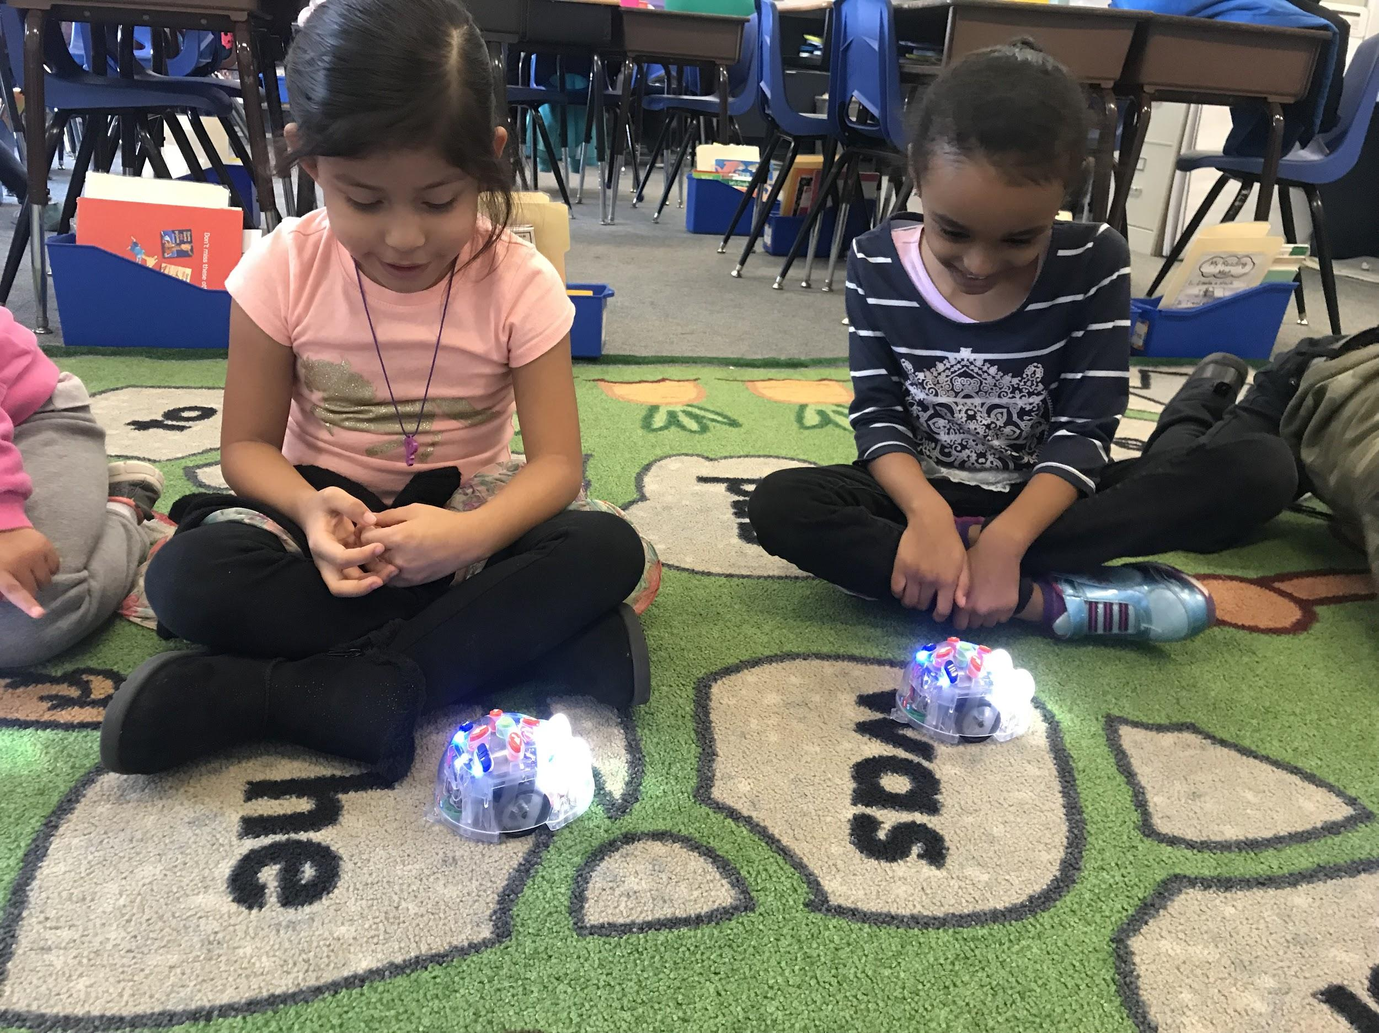
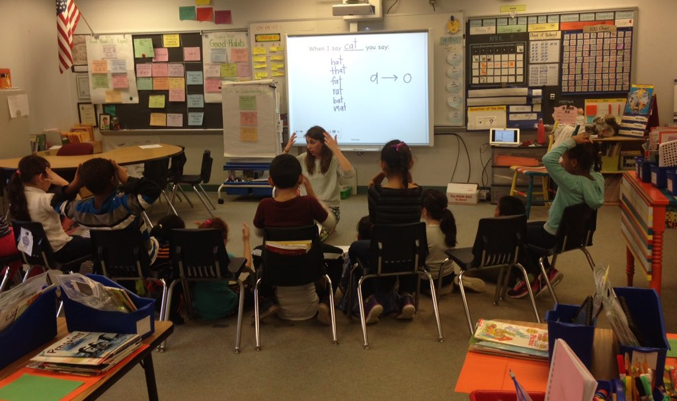
Steam in action continued...
Arts Integration: CETA Partnership
Coding and Robotics

Slide 7
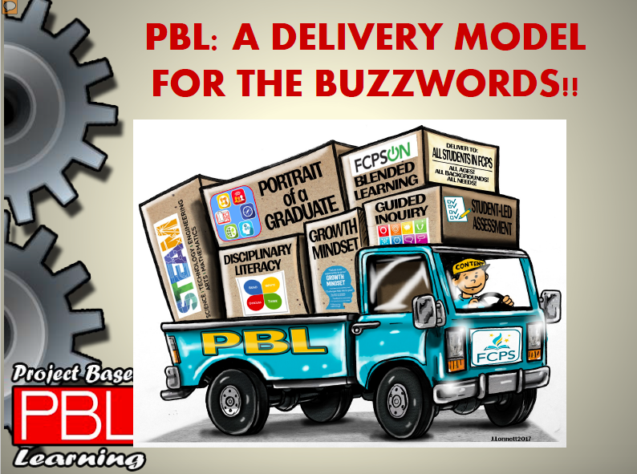
STEAM delivered through Project-Based Learning (PBL)
Blended Learning
21st Century Skills
Drew

Slide 8
PBL is Adaptable for ALL K-5 Students
All Model Special Education and ESOL Staff are participating in PBL training | Open-ended projects allow for access points and student choice that accommodate all learners
Differentiated text and databases are available for students for the research portion of projects | PBL offers a way for kids to connect with each other and share a common learning experience
Technology also provides access to content (videos, pictures, etc…) | Hands on projects allow students to show what they know in a variety of ways beyond the traditional paper pencil test.
Special Education and ESOL teachers and assistants are working with classroom teachers to meet goals and provide language support to students when needed and adapting steps of the PBL process using templates, checklists, visuals etc… | Collaboration and presentation, two core pieces of PBL, strengthen oral language skills and communication

Slide 9
Three year Gradual Implementation of STEAM
Year One | Year Two | Year Three
Project-Based Learning (PBL) in the content areas of science/social studies Innovation Hours (Parent Showcases) Makerspace: building and engineering Robotics/Coding Scientists in the classroom Arts Integration: CETA Teacher Training | Everything in Year One Plus: Science/ Engineering Fair STEAM Clubs Community Outreach-- more professionals in the classrooms | Everything in Years One and Two Plus: Quarterly Innovation Hours Permanent Makerspace Maker Faire (schoolwide) Creative scheduling Cross-curricular PBLs Additional extra curricular opportunities for students

Slide 10
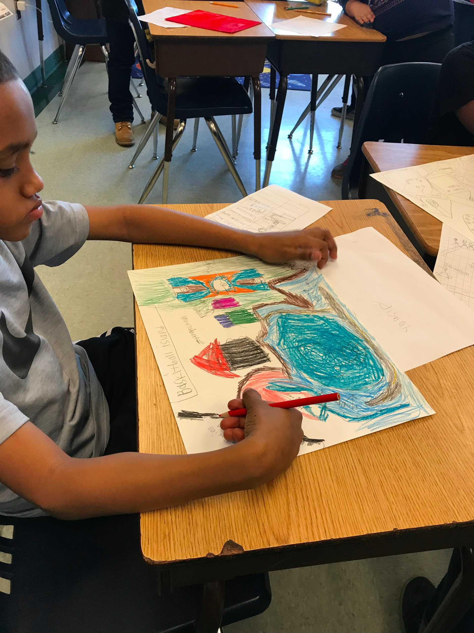
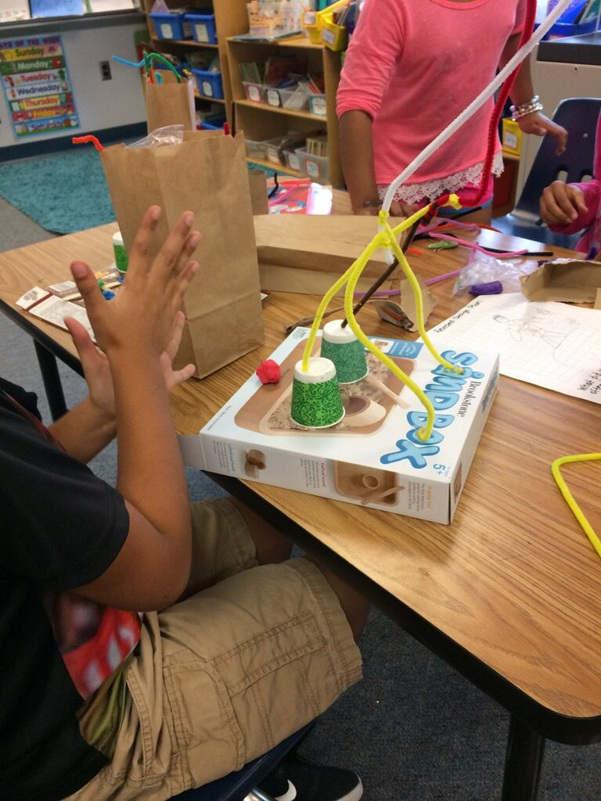
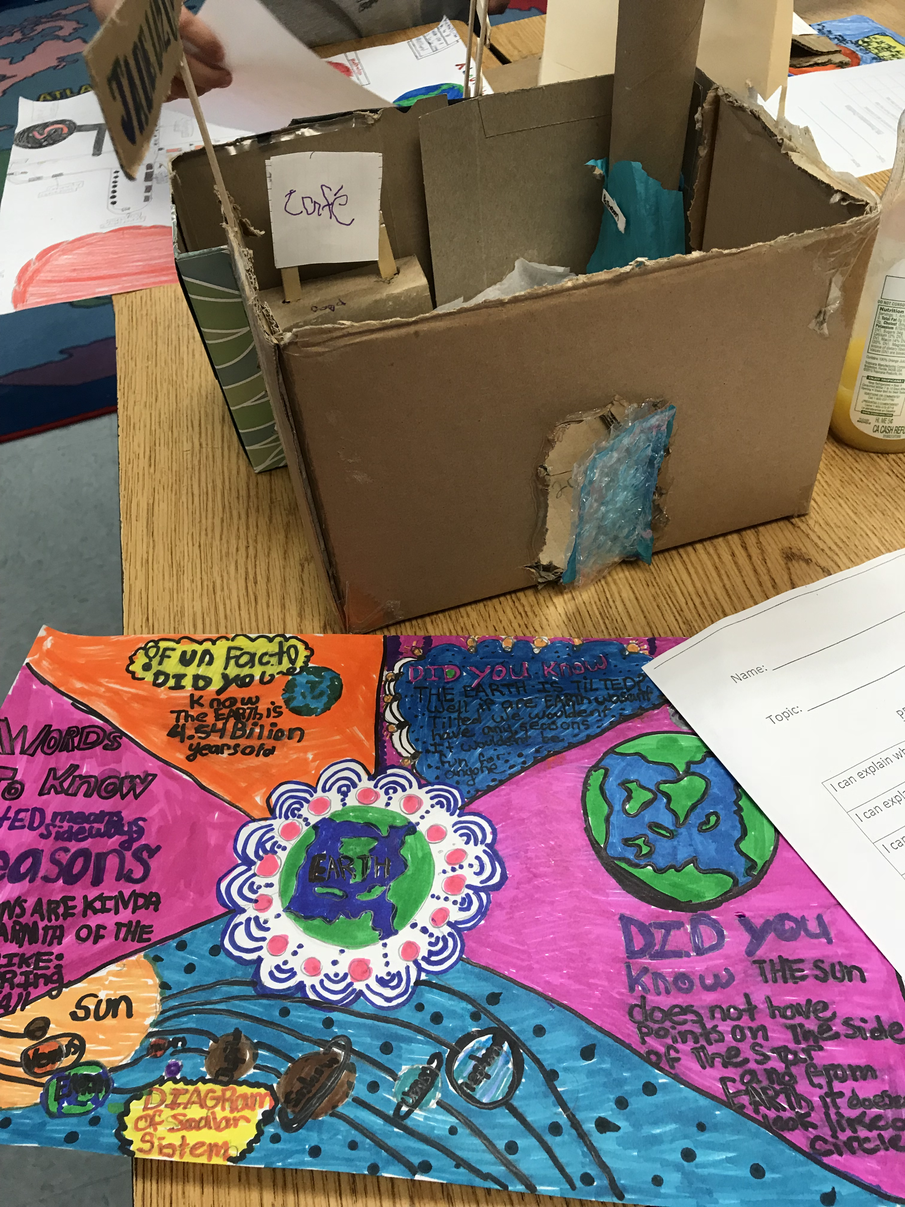
Project-Based Learning

Slide 11
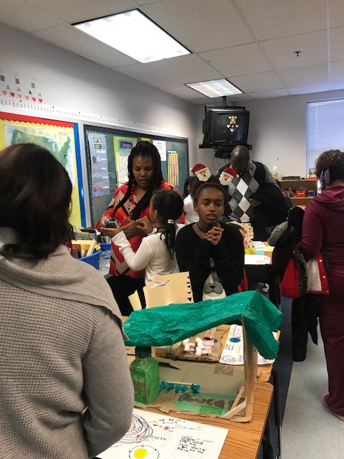
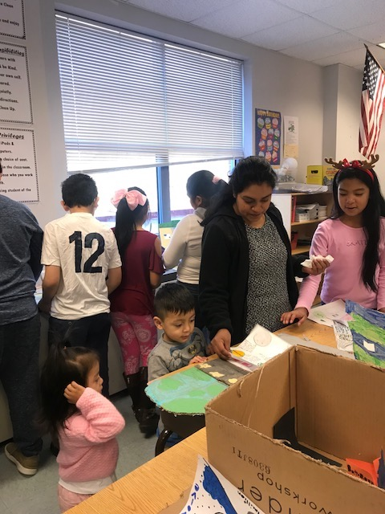
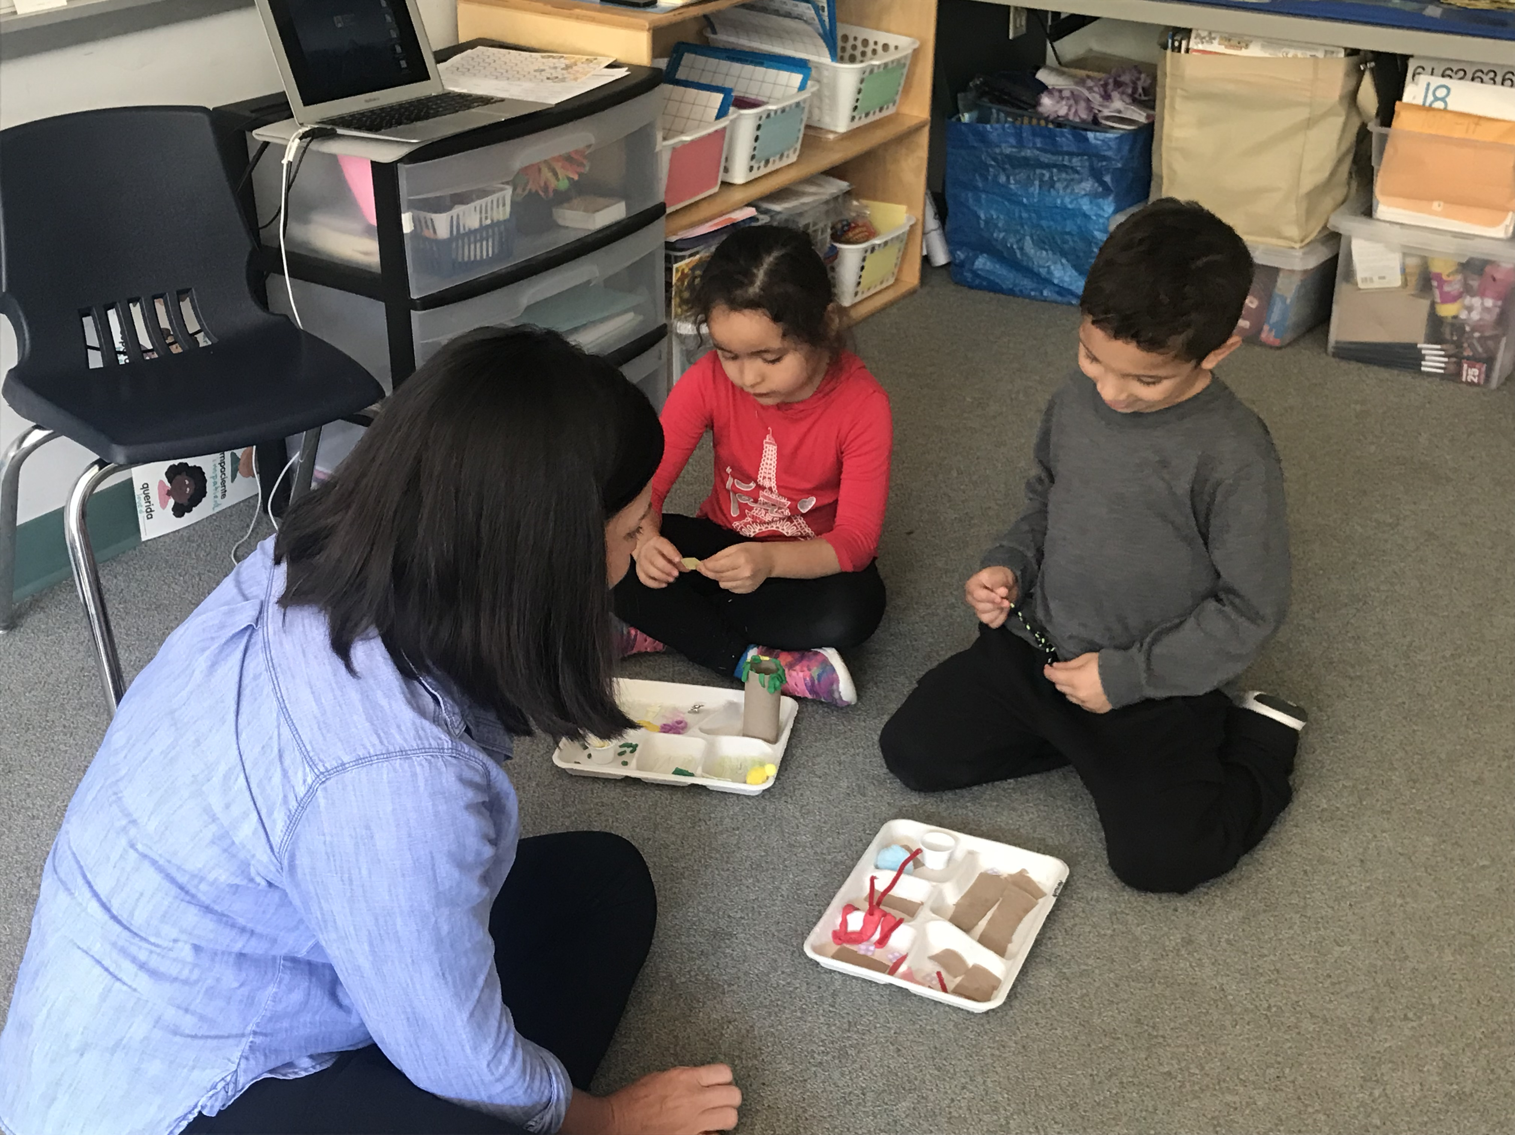
Innovation Hour Parent Showcases

Slide 12
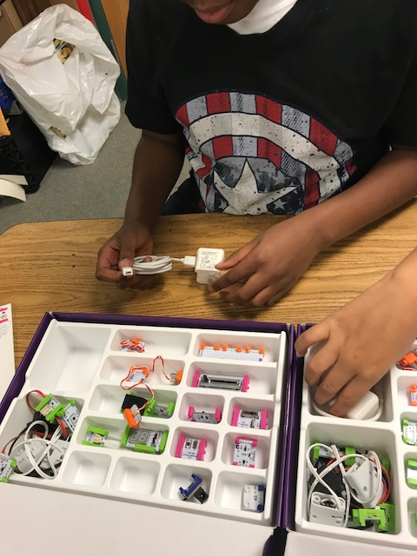
Makerspace Projects

Slide 13
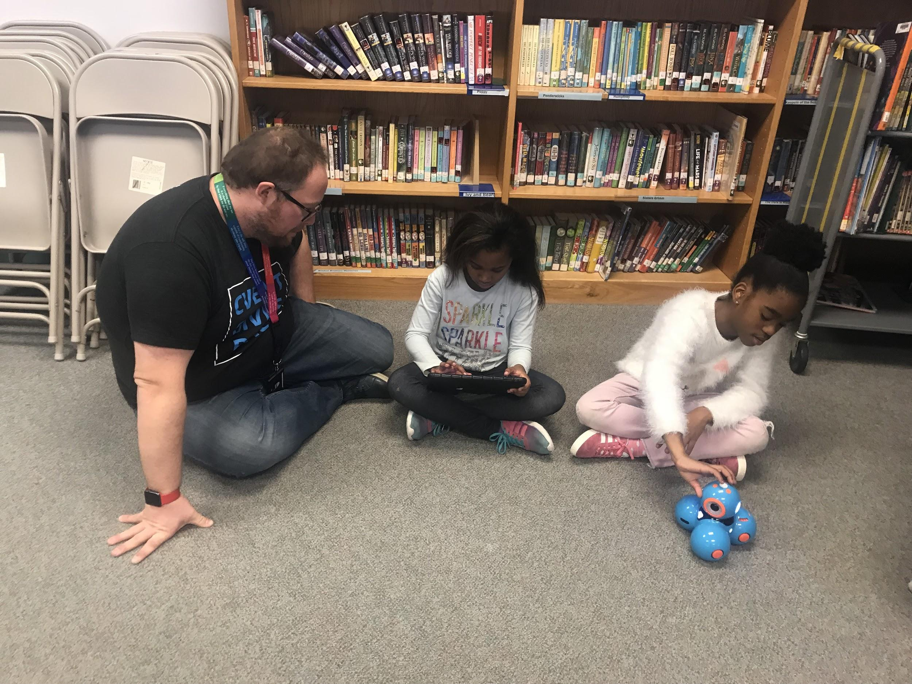
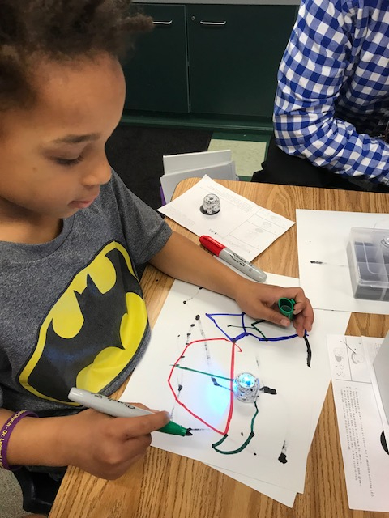
Robotics/Coding

Slide 14
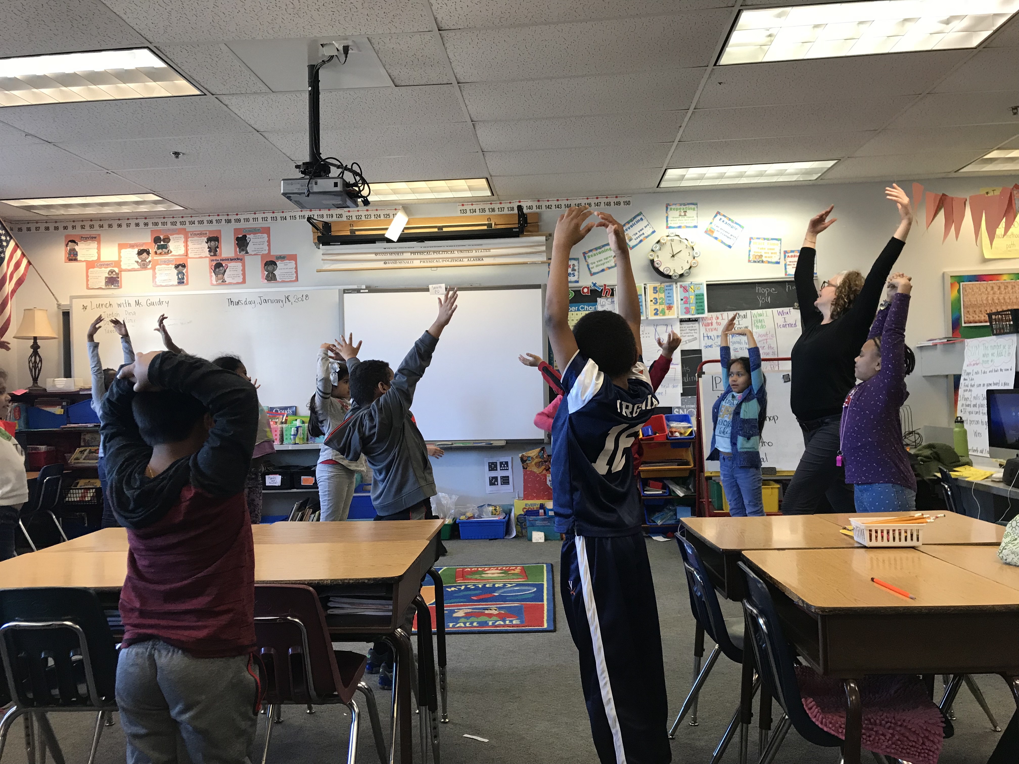
Arts Integration

Slide 15
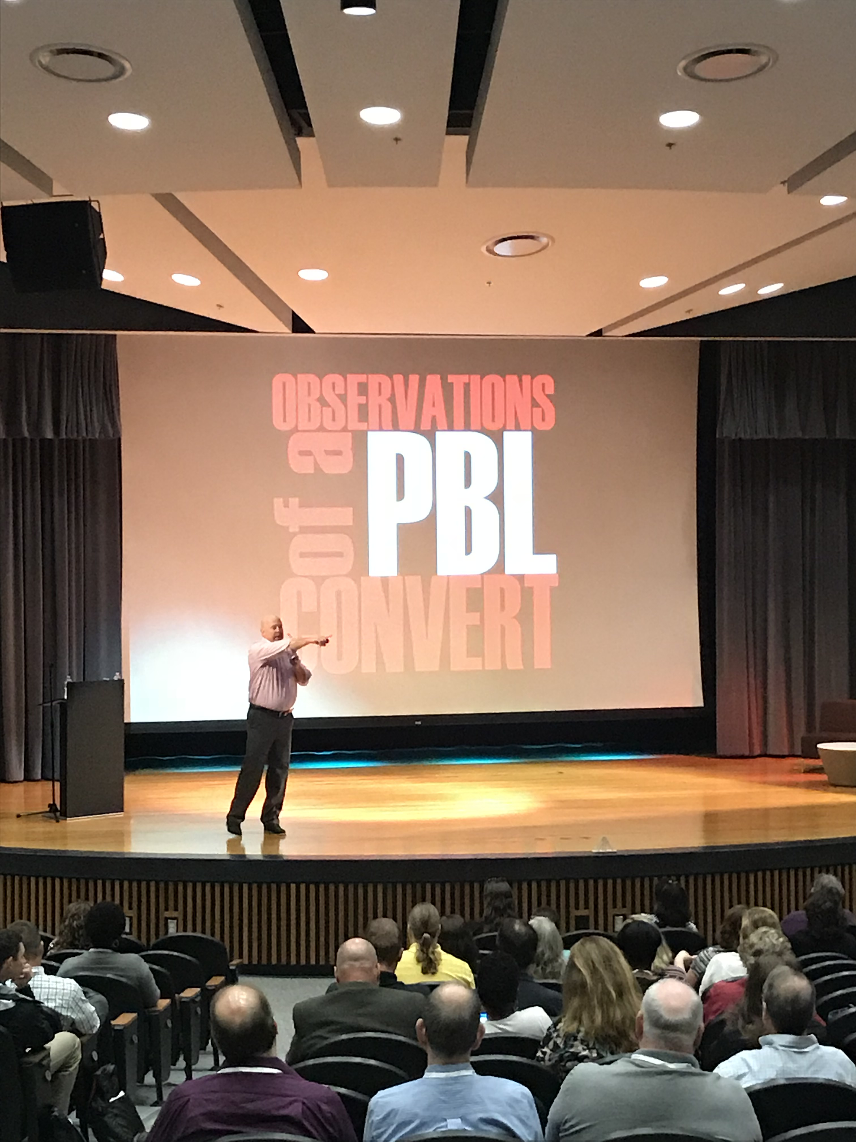
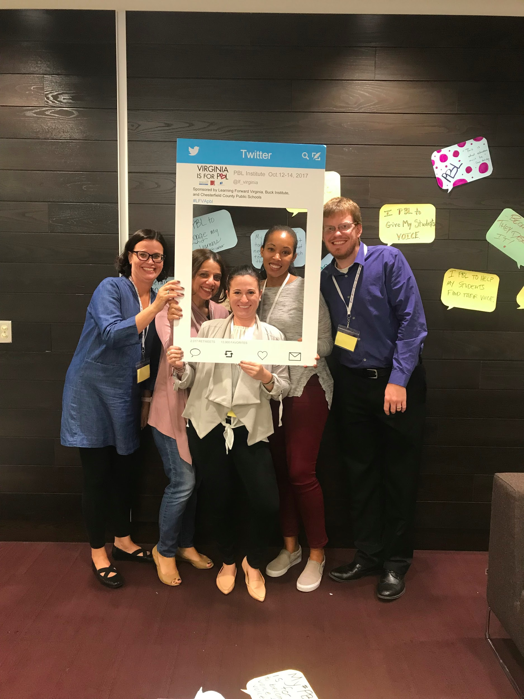
Teacher Training

Slide 16
Expected Outcomes
Increased student engagement
Spark interest in the fields of science, math, engineering, technology and the arts
Increased problem solving across content areas
Build connections across content areas to foster career and college readiness
Increased parent and community engagement

Slide 17
Questions?
Contact Information
Rachel Denbo
STEAM Coordinator
Rachel.Denbo@apsva.us

