Slide 1
First Grade 3D Maps
A STEAM PBL Experience

Slide 2
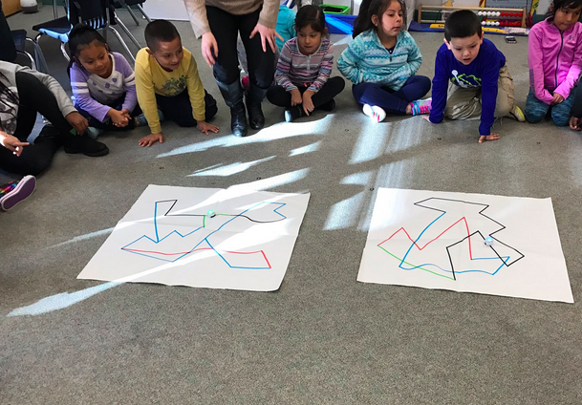
Our Entry Event
To peak our interests, we first met Ozobot, the miniature robot who reads color as its language.
Ozobot was all mixed up and didn’t know where to go!
We decided that using a map could help Ozobot travel.

Slide 3
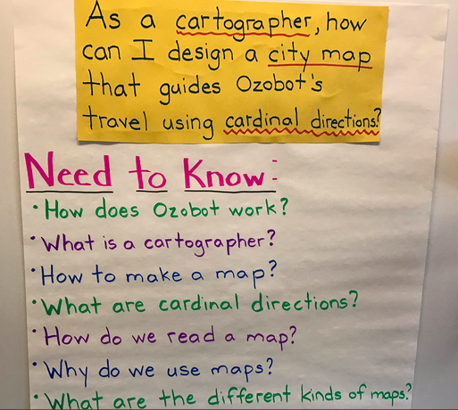
Driving Question/Need to Know
As a cartographer, how can I design a city map that guides Ozobot's travel using cardinal directions?

Slide 4
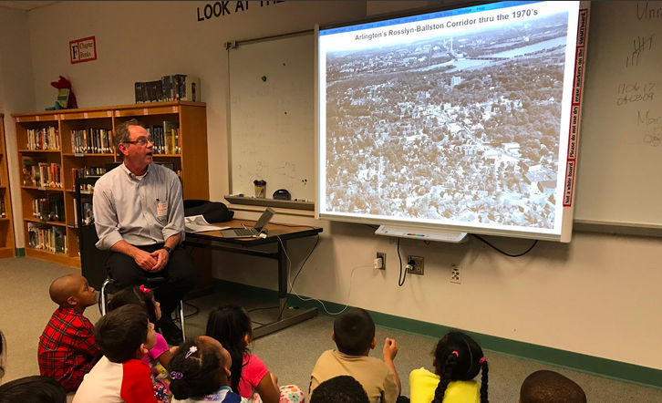
Learning from a Professional
First graders met Kris Krider, a city planner from Arlington County. He taught them about different kinds of maps and how city planners and cartographers work together on projects.

Slide 5
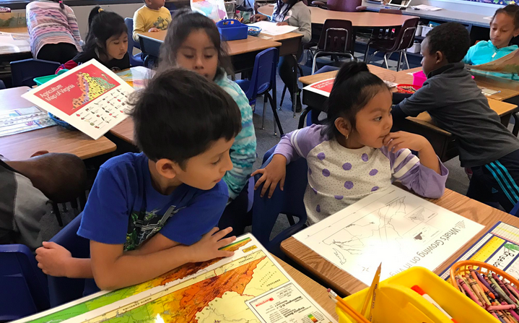
Student to Cartographer Inquiry
First graders turned into cartographers as they analyzed maps, learned about the cardinal directions (North, South, East and West) and explored the parts of maps.

Slide 6
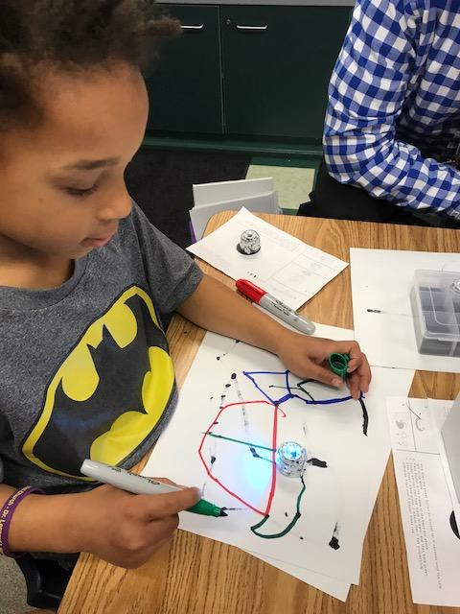
Meeting Ozobot
First graders were so excited to learn more about Ozobot during their Hour of Code. They practiced drawing the perfect lines for Ozobot to follow.

Slide 7
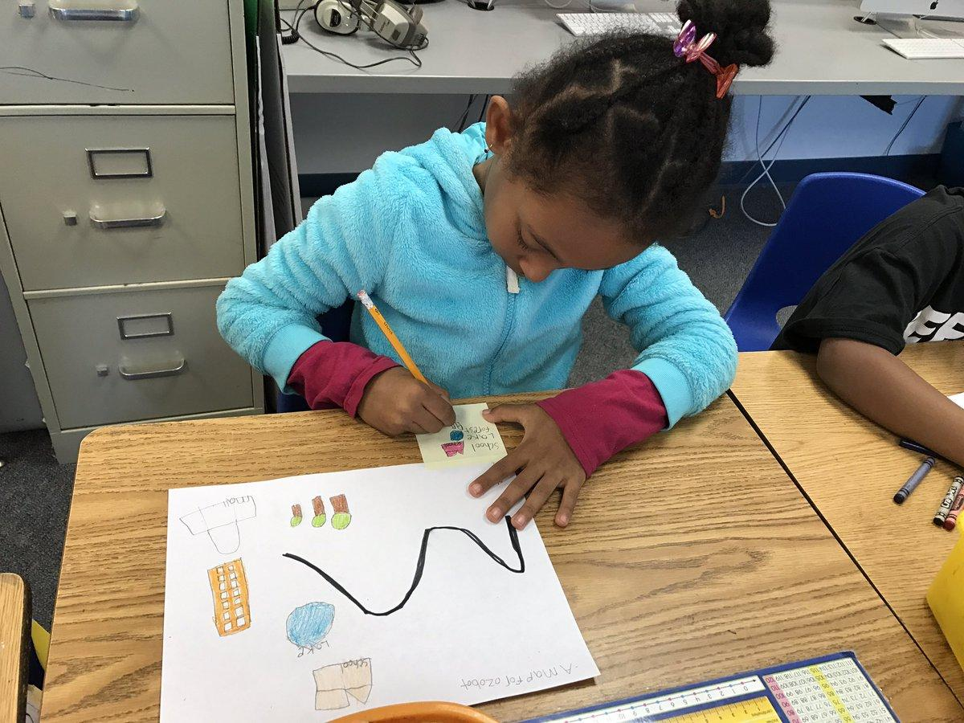
Planning like a Cartographer
First grade cartographers created their map plans on paper. Plans included symbols, a map key, a title, a compass rose and a road for Ozobot to travel on!

Slide 8
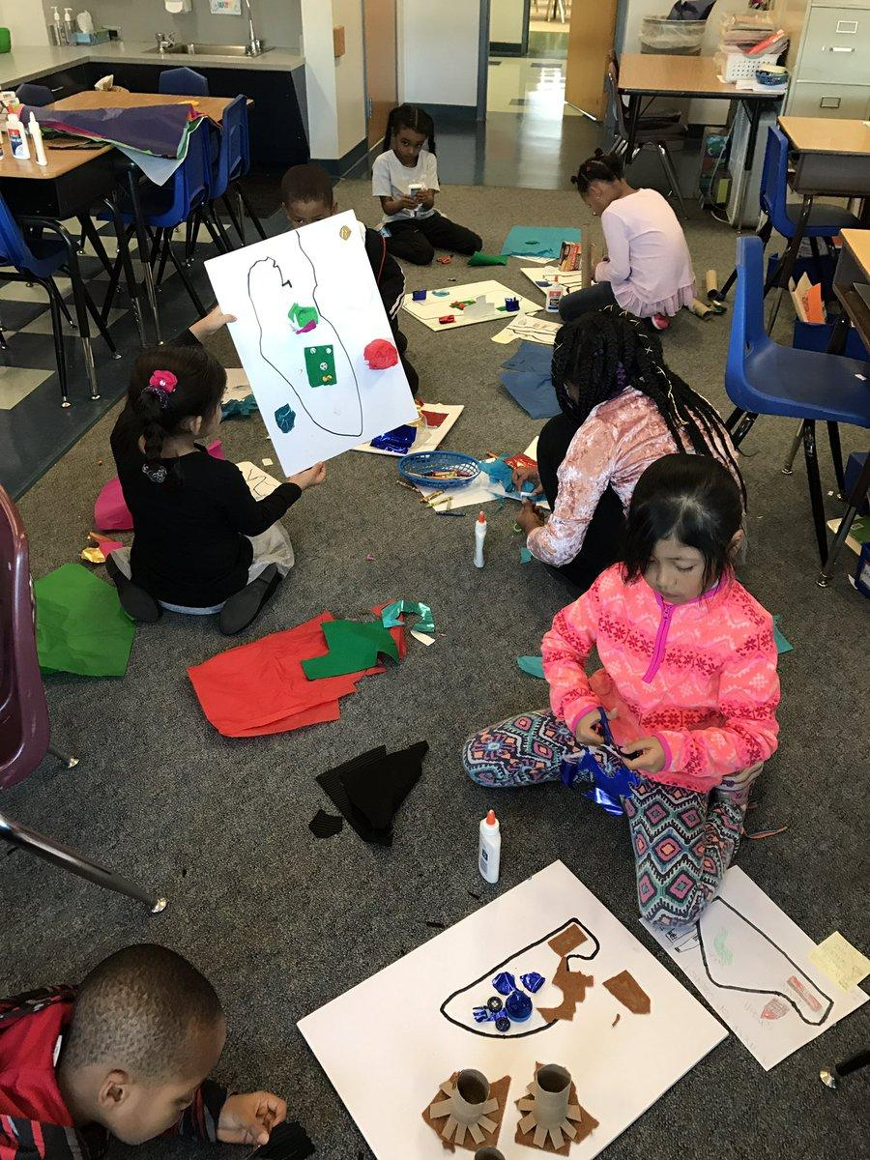
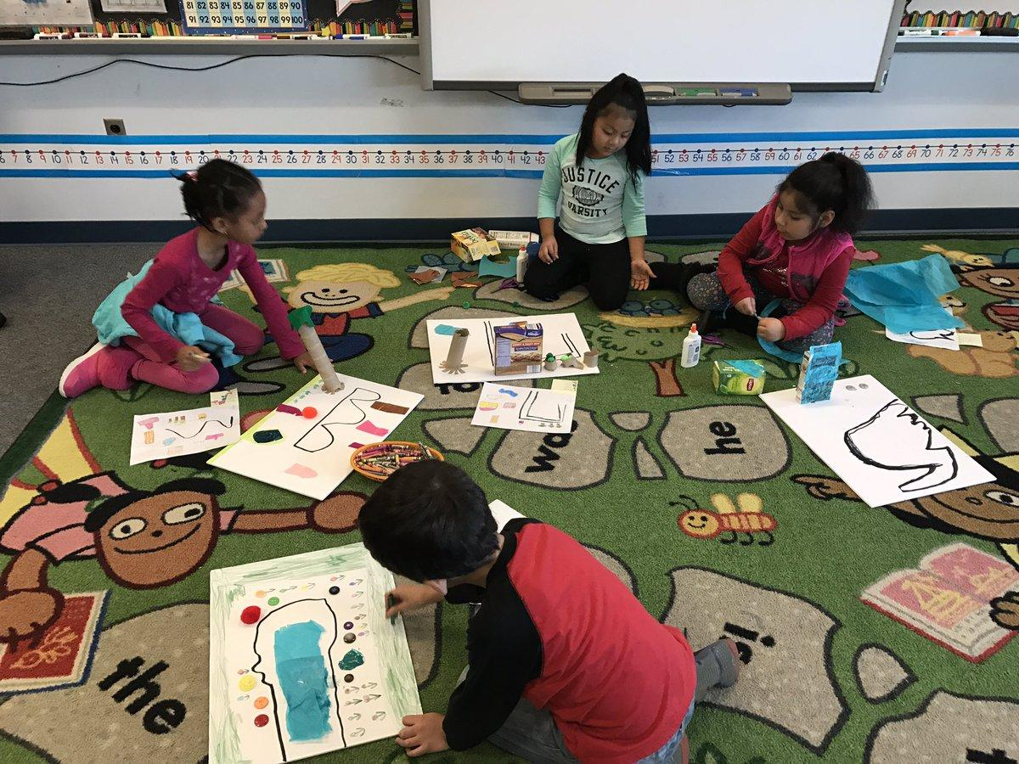
Turning Plans into 3D Maps!
Once the students finished their design plans, they choose materials to represent the places on their maps! They drew the road for Ozobot too.

