Slide 1
Third Grade Fictional Maps
A STEAM PBL Experience

Slide 2
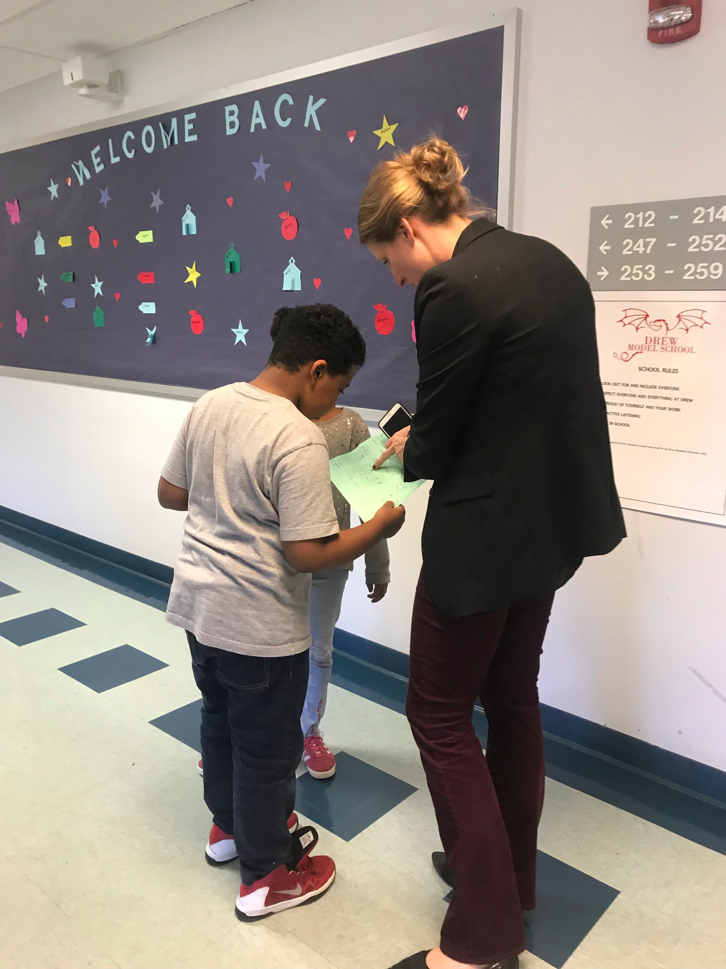
Our Entry Event
Third graders used maps of Drew Model School to locate clues. At the end of the scavenger hunt, the students found their driving question.

Slide 3
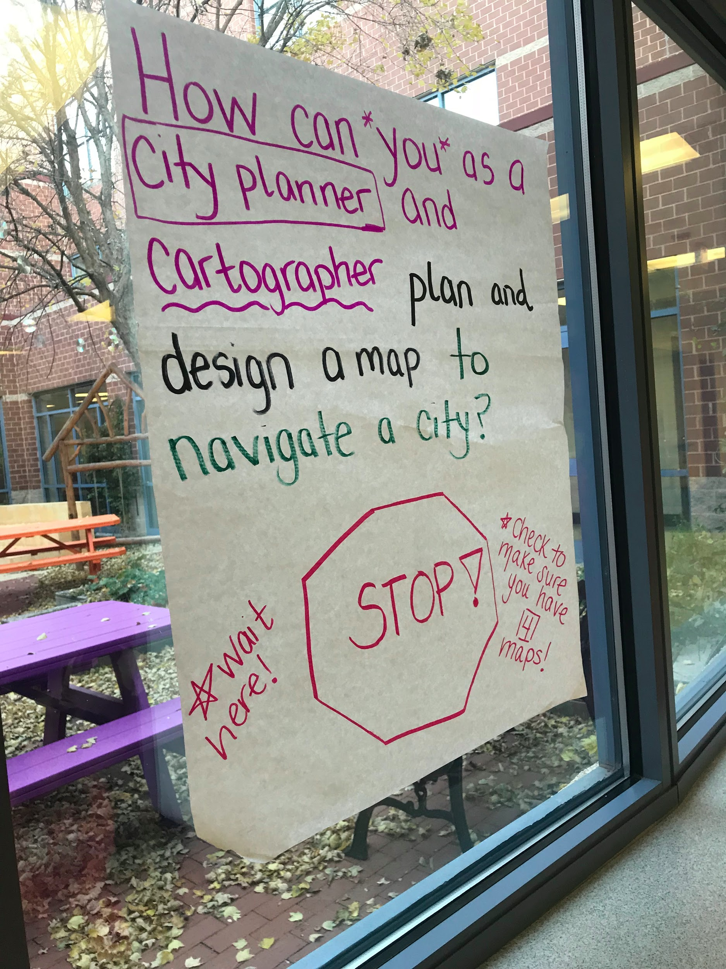
Driving Question
Students found the driving question at the end of the scavenger hunt.
How can you, as a city planner and cartographer, plan and design a map to navigate a fictional city?

Slide 4
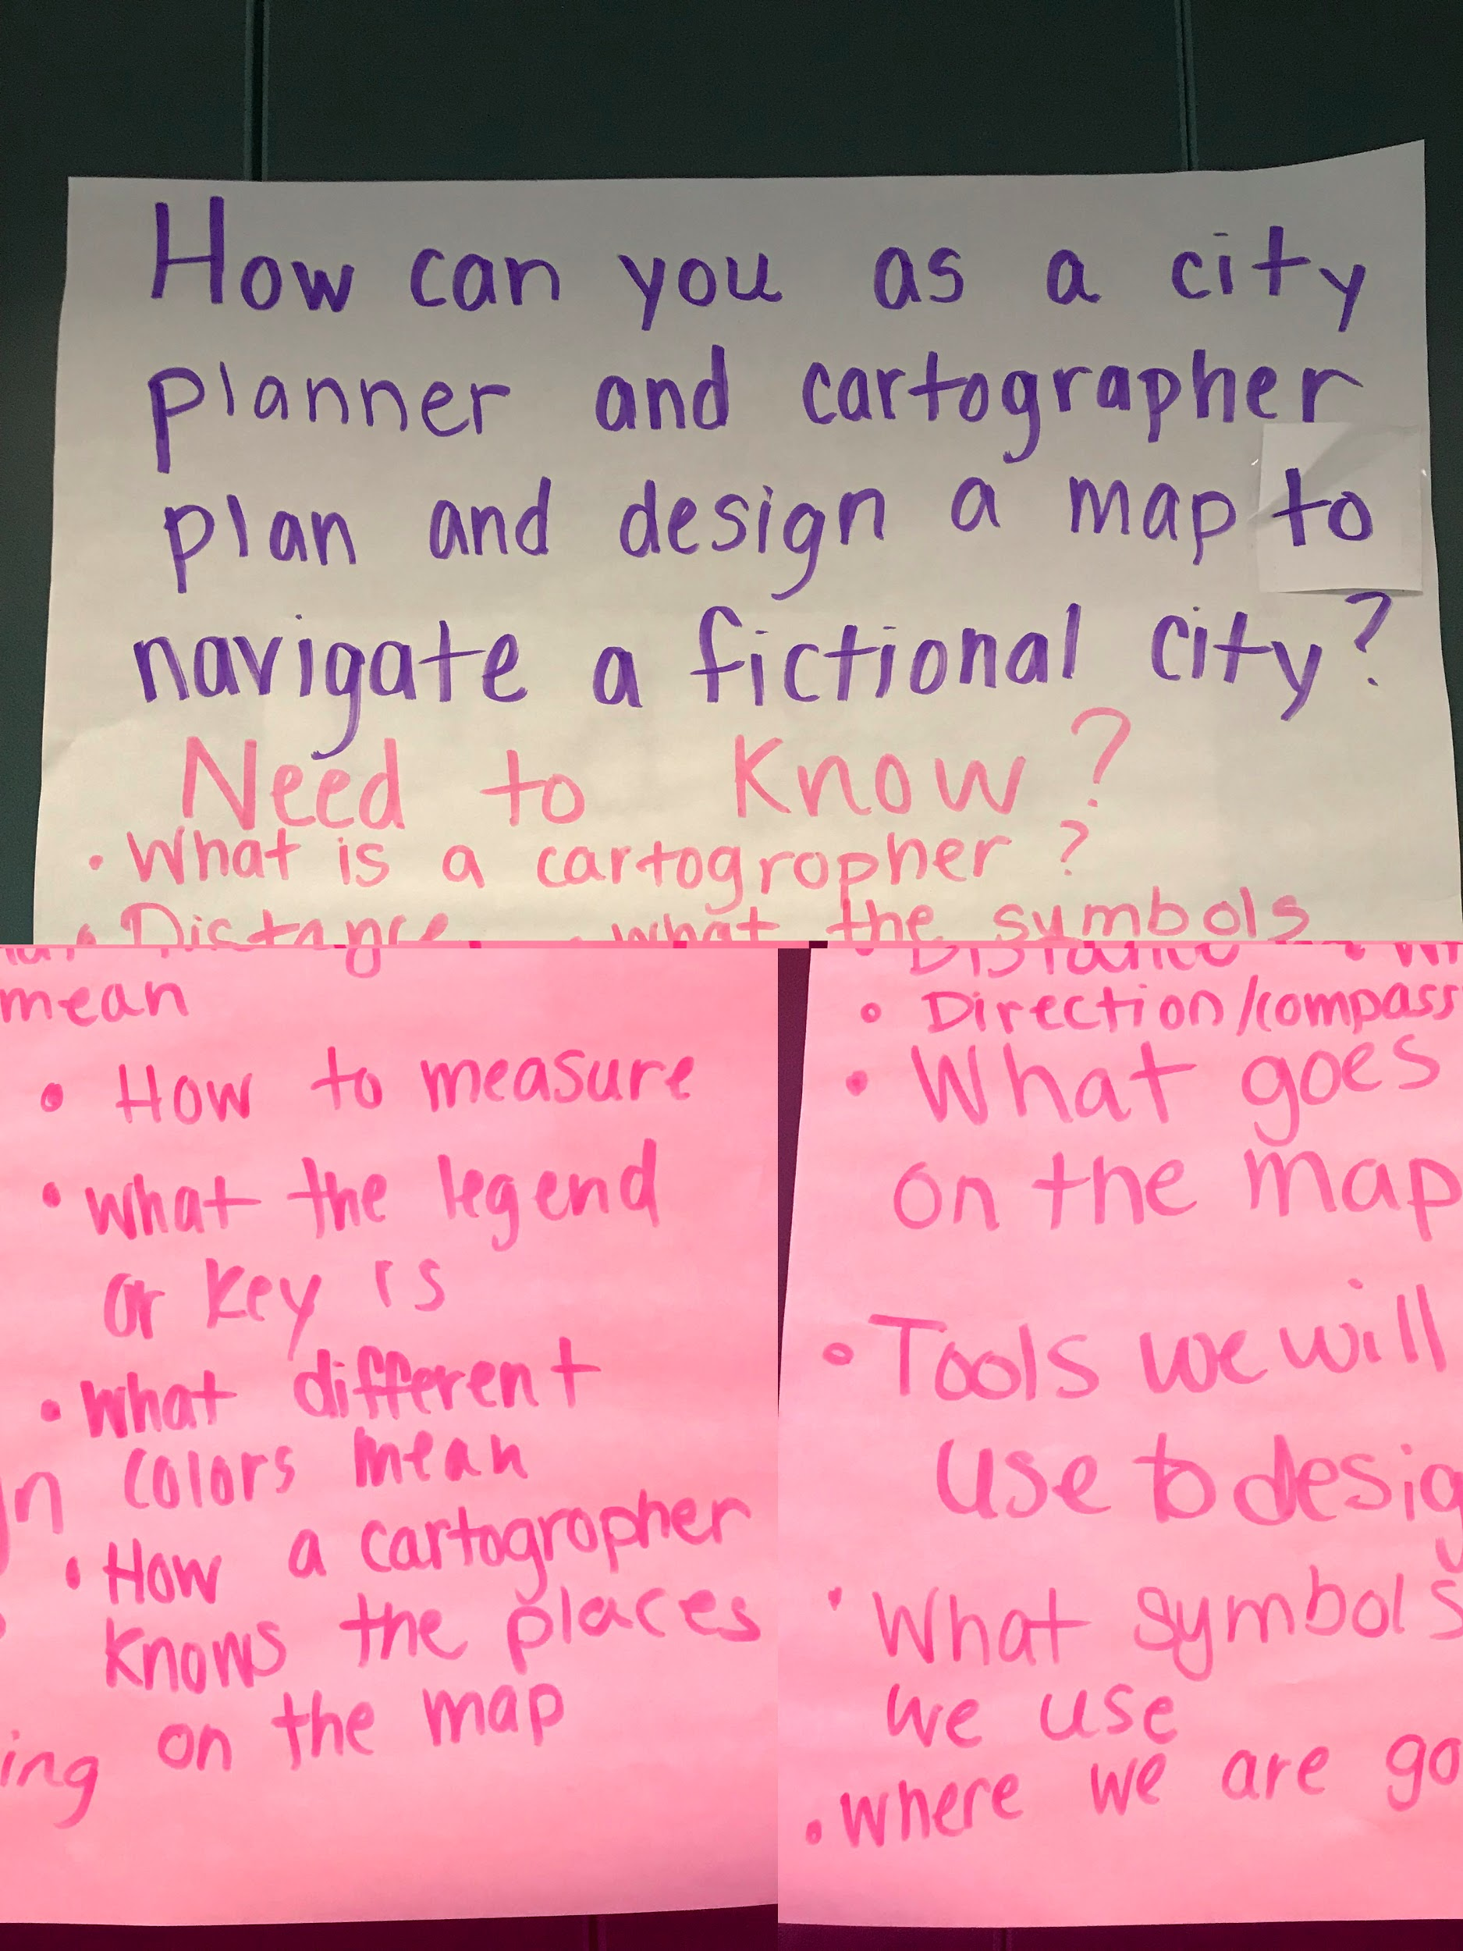
Need to Know Board
Students brainstormed questions they would need to find the answers to in order to complete their project successfully. This list remained on display throughout the project to keep them on track.

Slide 5
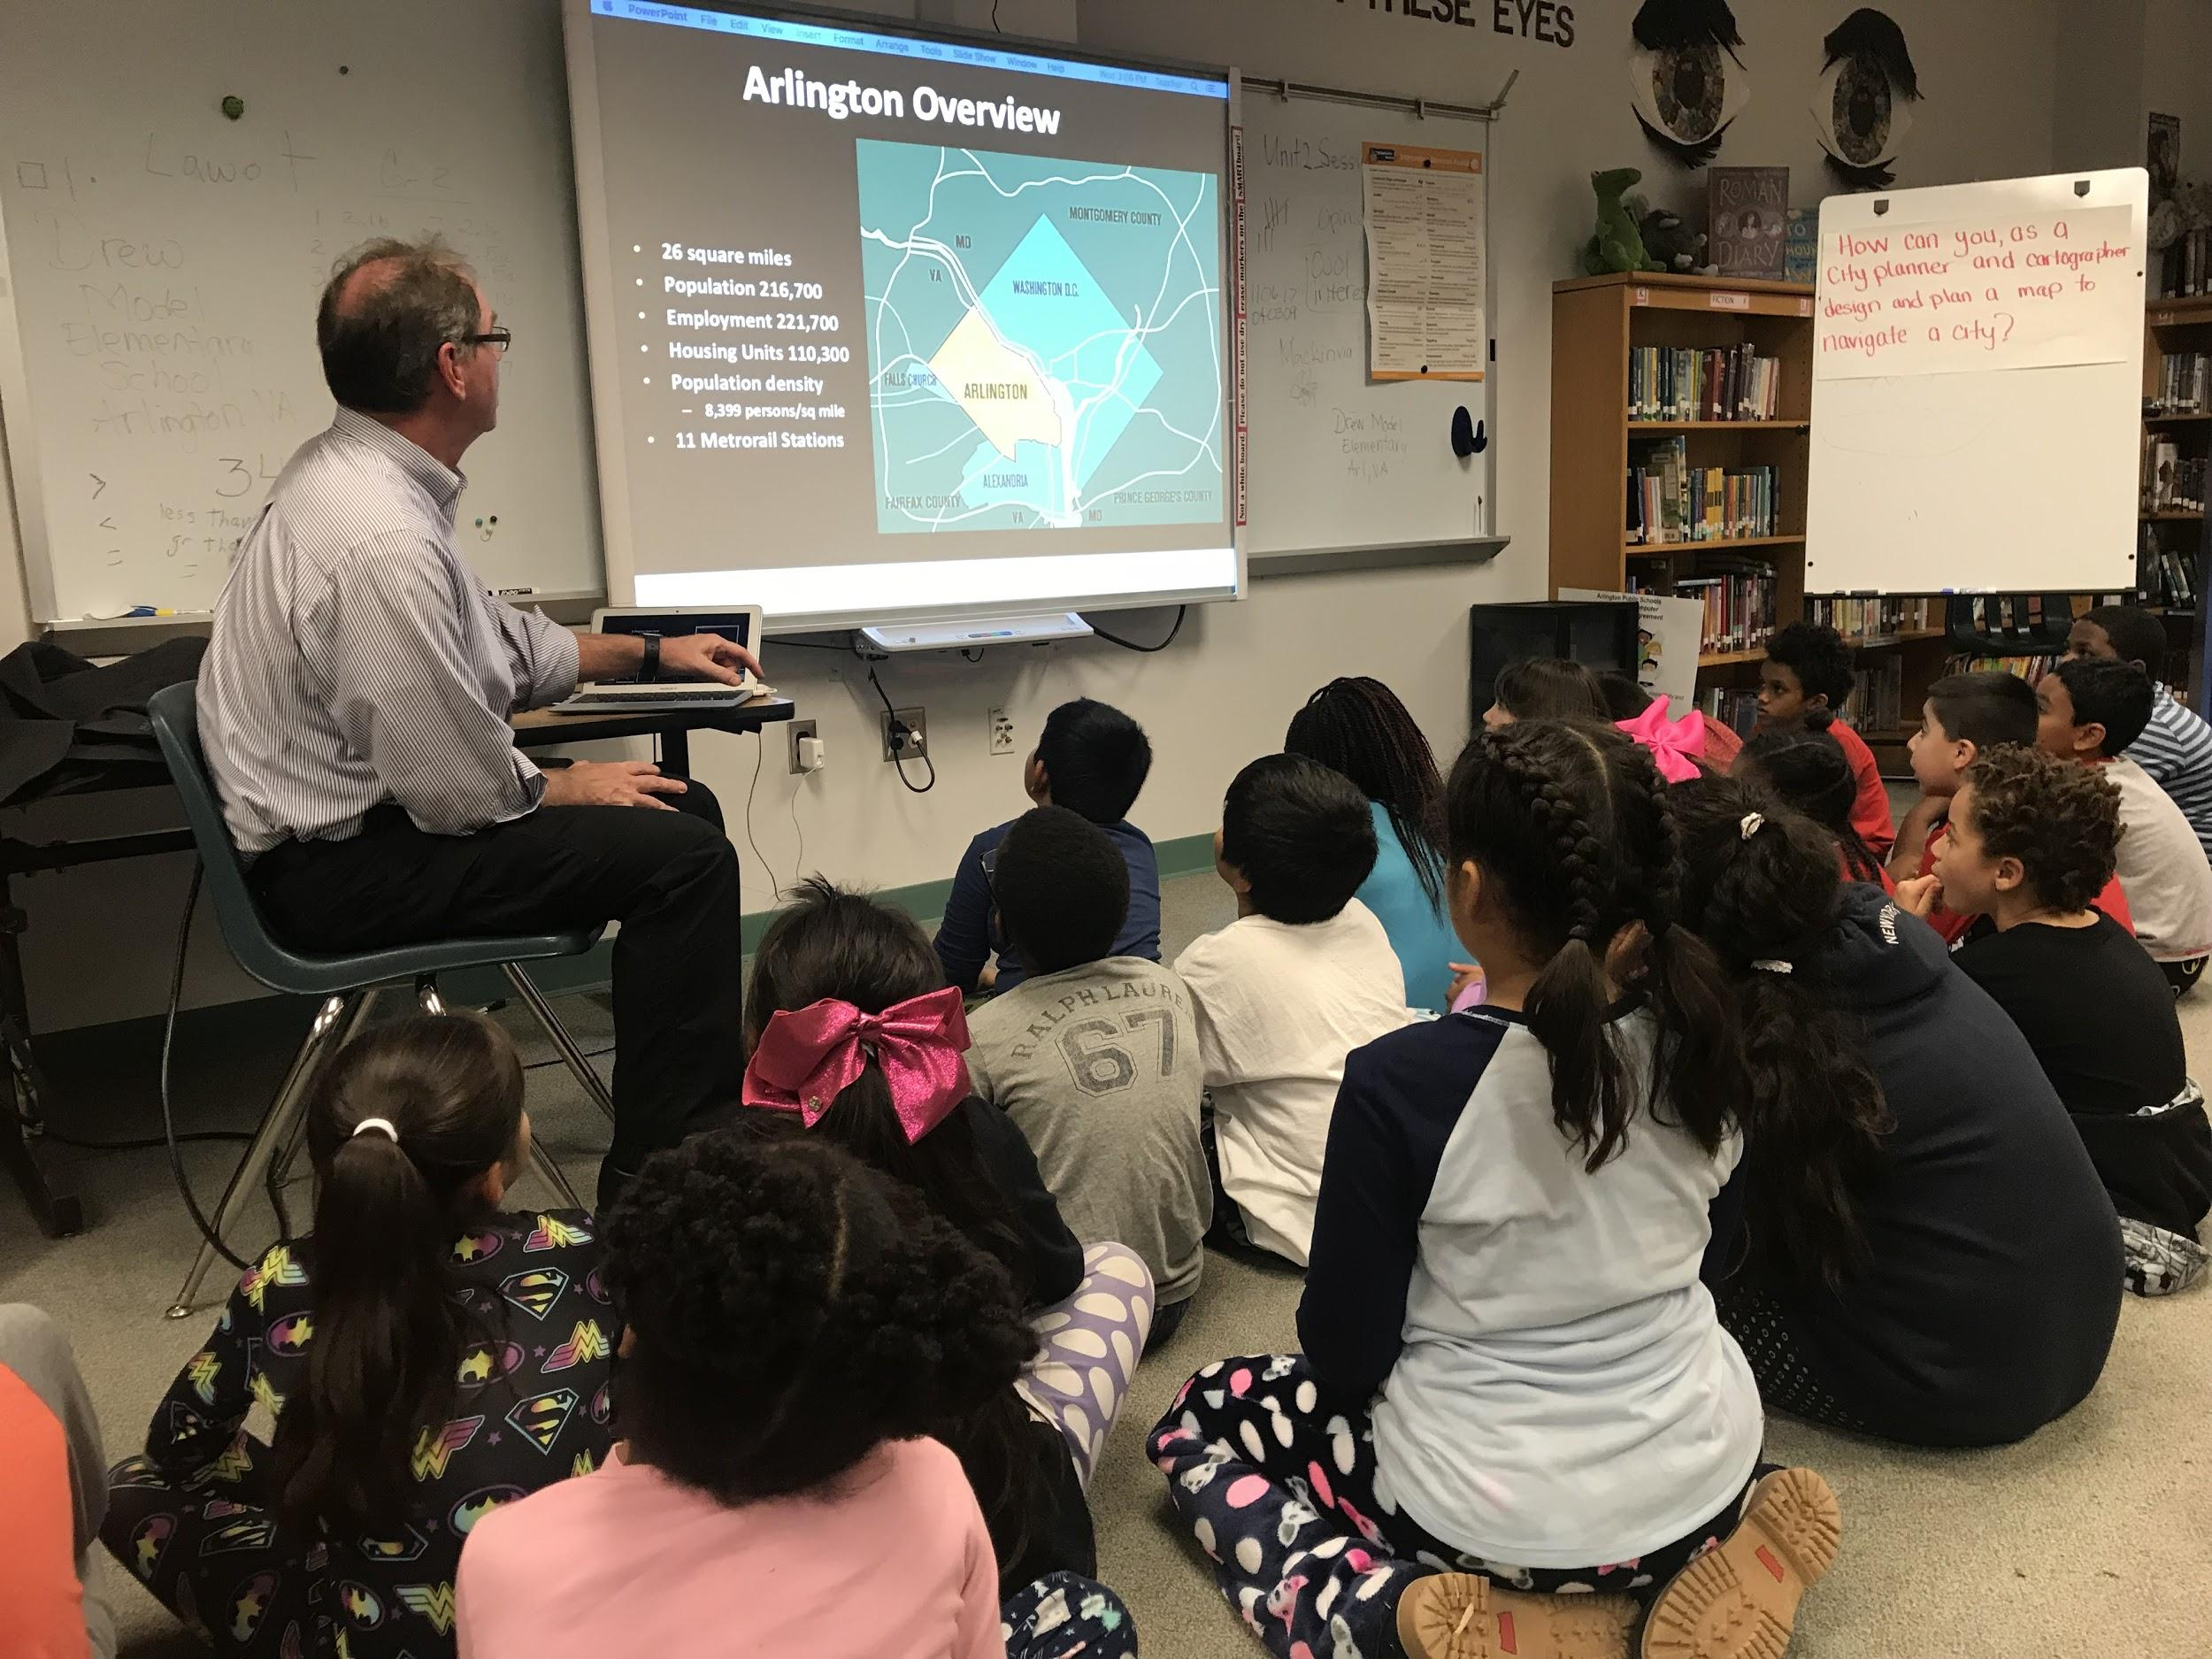
Learning from a Professional
Third graders met Kris Krider, a city planner from Arlington County. He taught them about different kinds of maps and the process city planners use when planning a city.

Slide 6
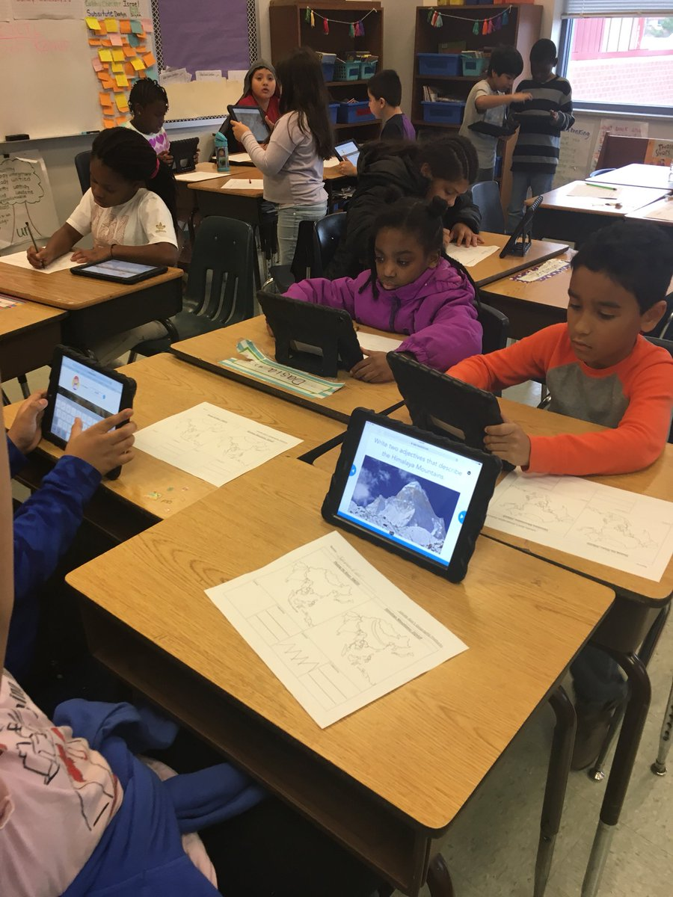
Student to City Planner Inquiry
Third graders turned into city planners as they analyzed maps using Nearpod to discover land features on 5 different continents.

Slide 7
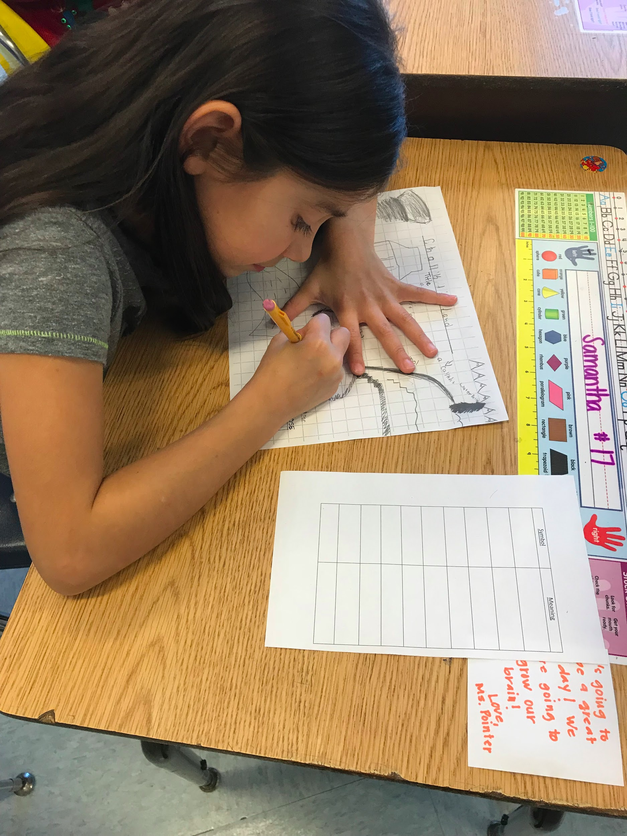
Planning Maps Like a City Planner
Students then brainstormed which fictional city they would design a map for. They worked like city planners, starting with the natural features and then adding in buildings and roads.

Slide 8
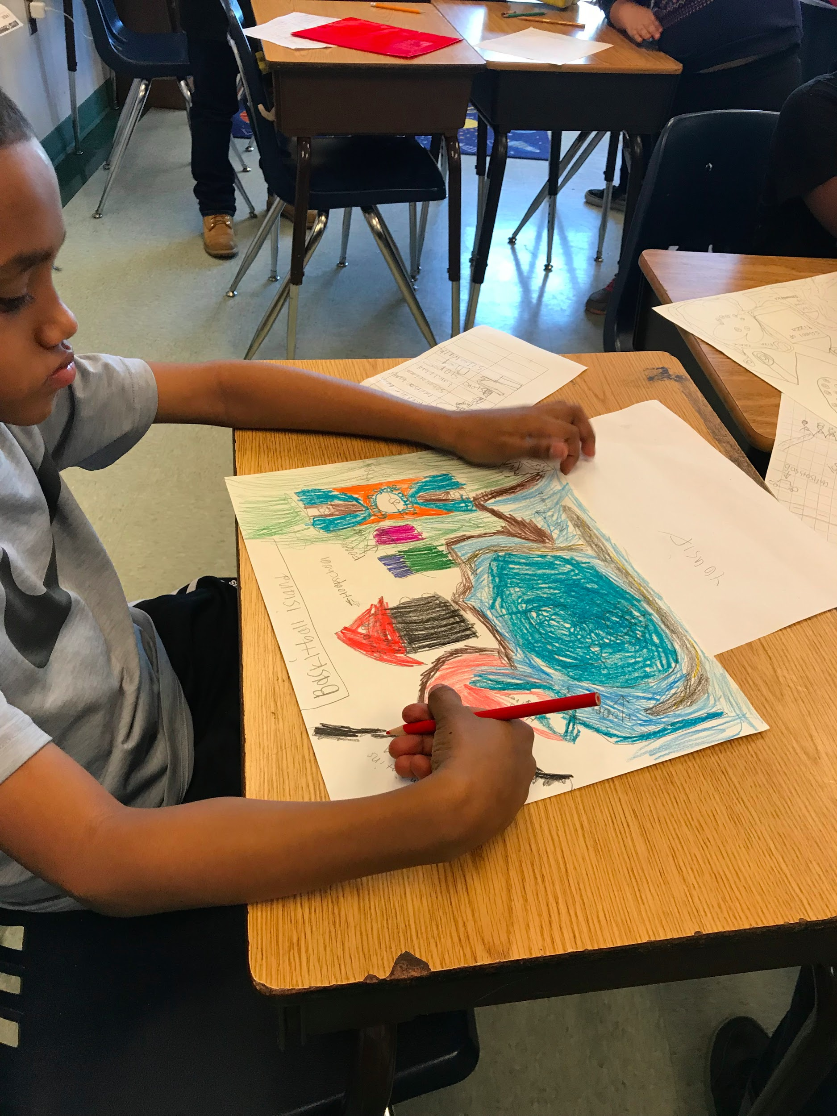
Turning Plans into Maps
Then, the third graders used their plans to neatly and thoroughly transfer their symbols, title and sketches to their final copies. They also added some 3D pieces to make their maps POP!

Slide 9
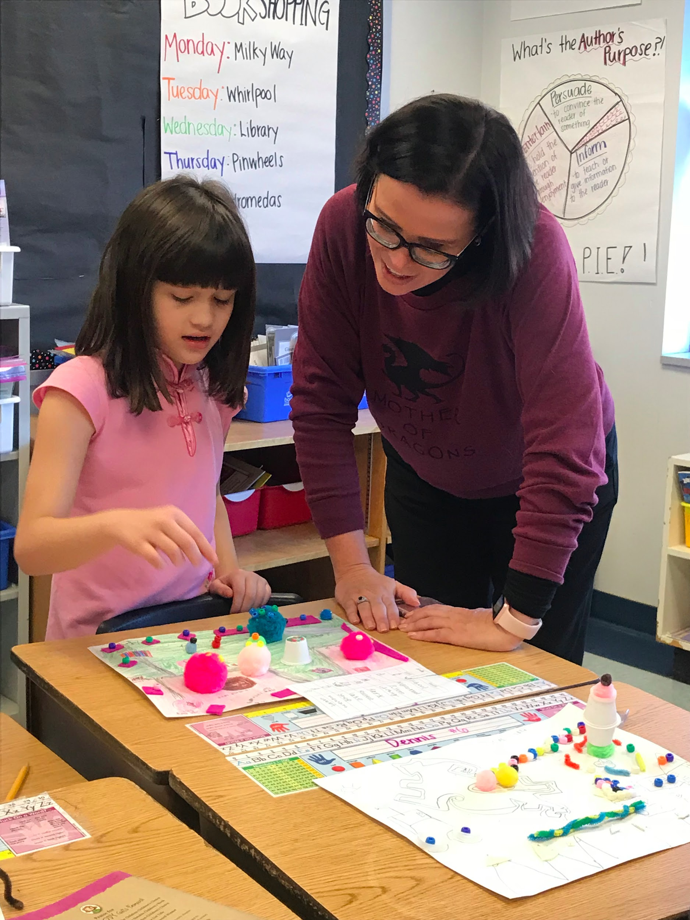
Time to Share!
3rd graders shared their maps with fellow 1st grade cartographers and Drew teachers. They received feedback for their work.

Slide 10
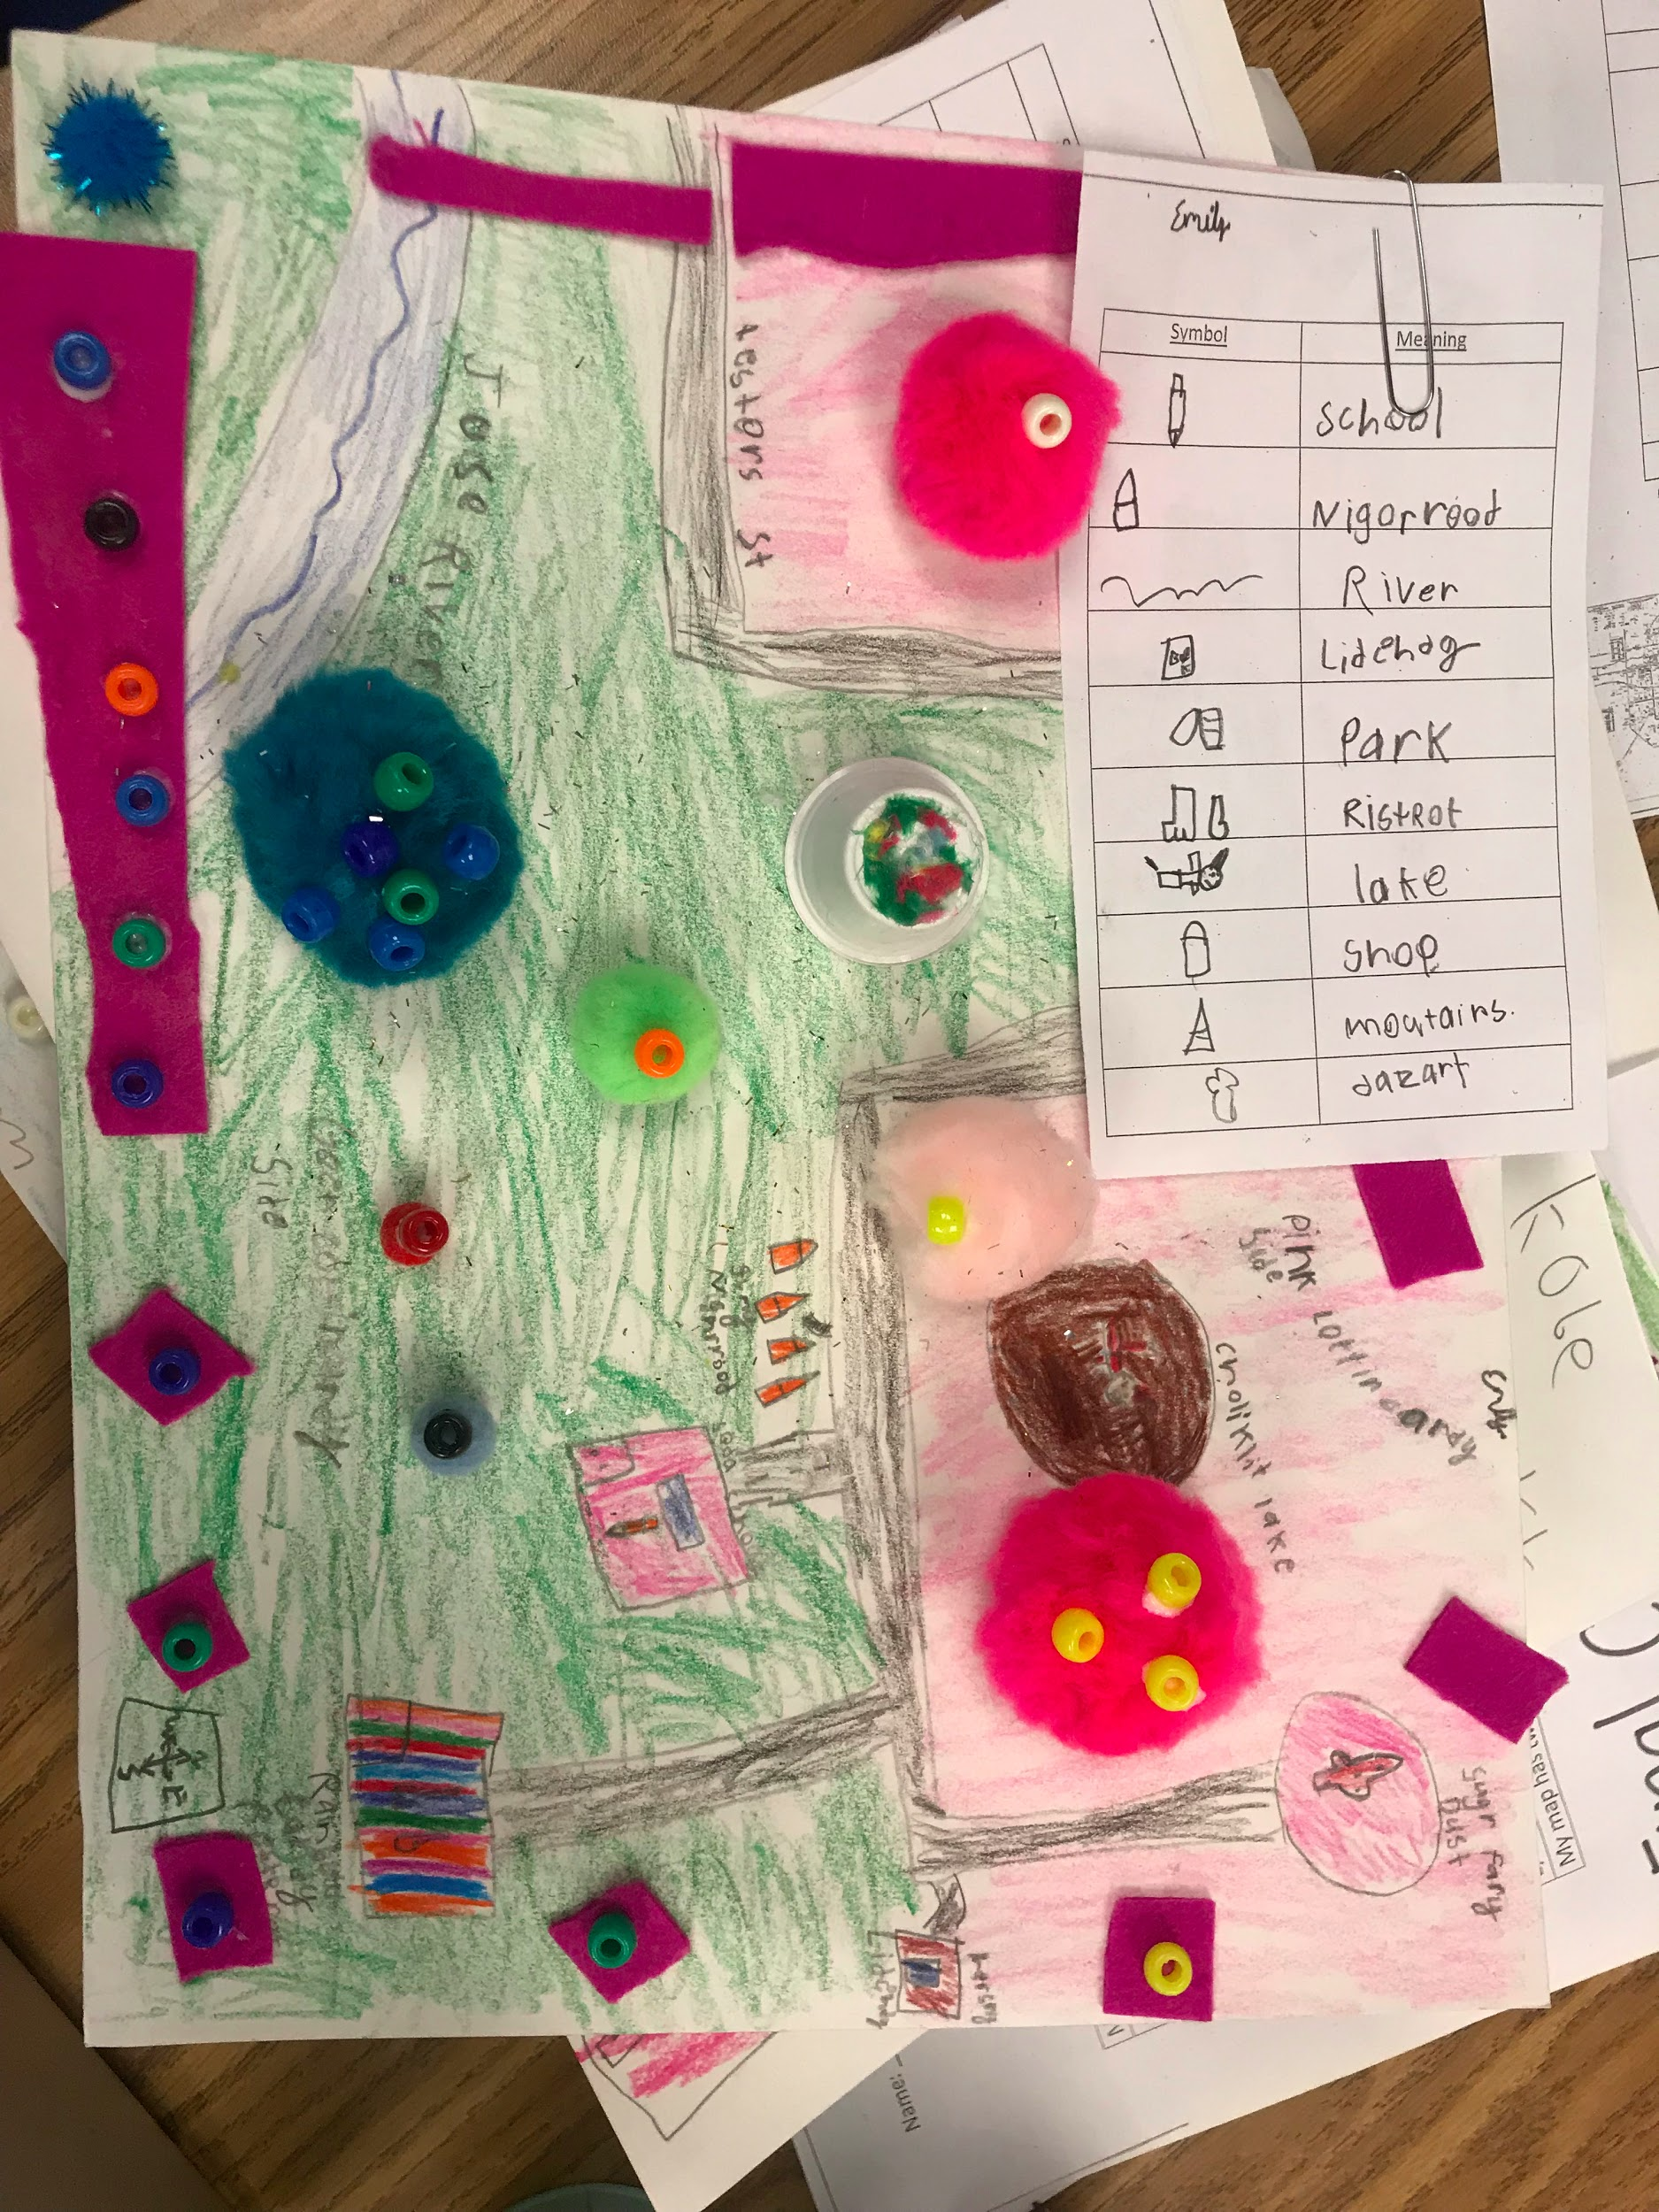
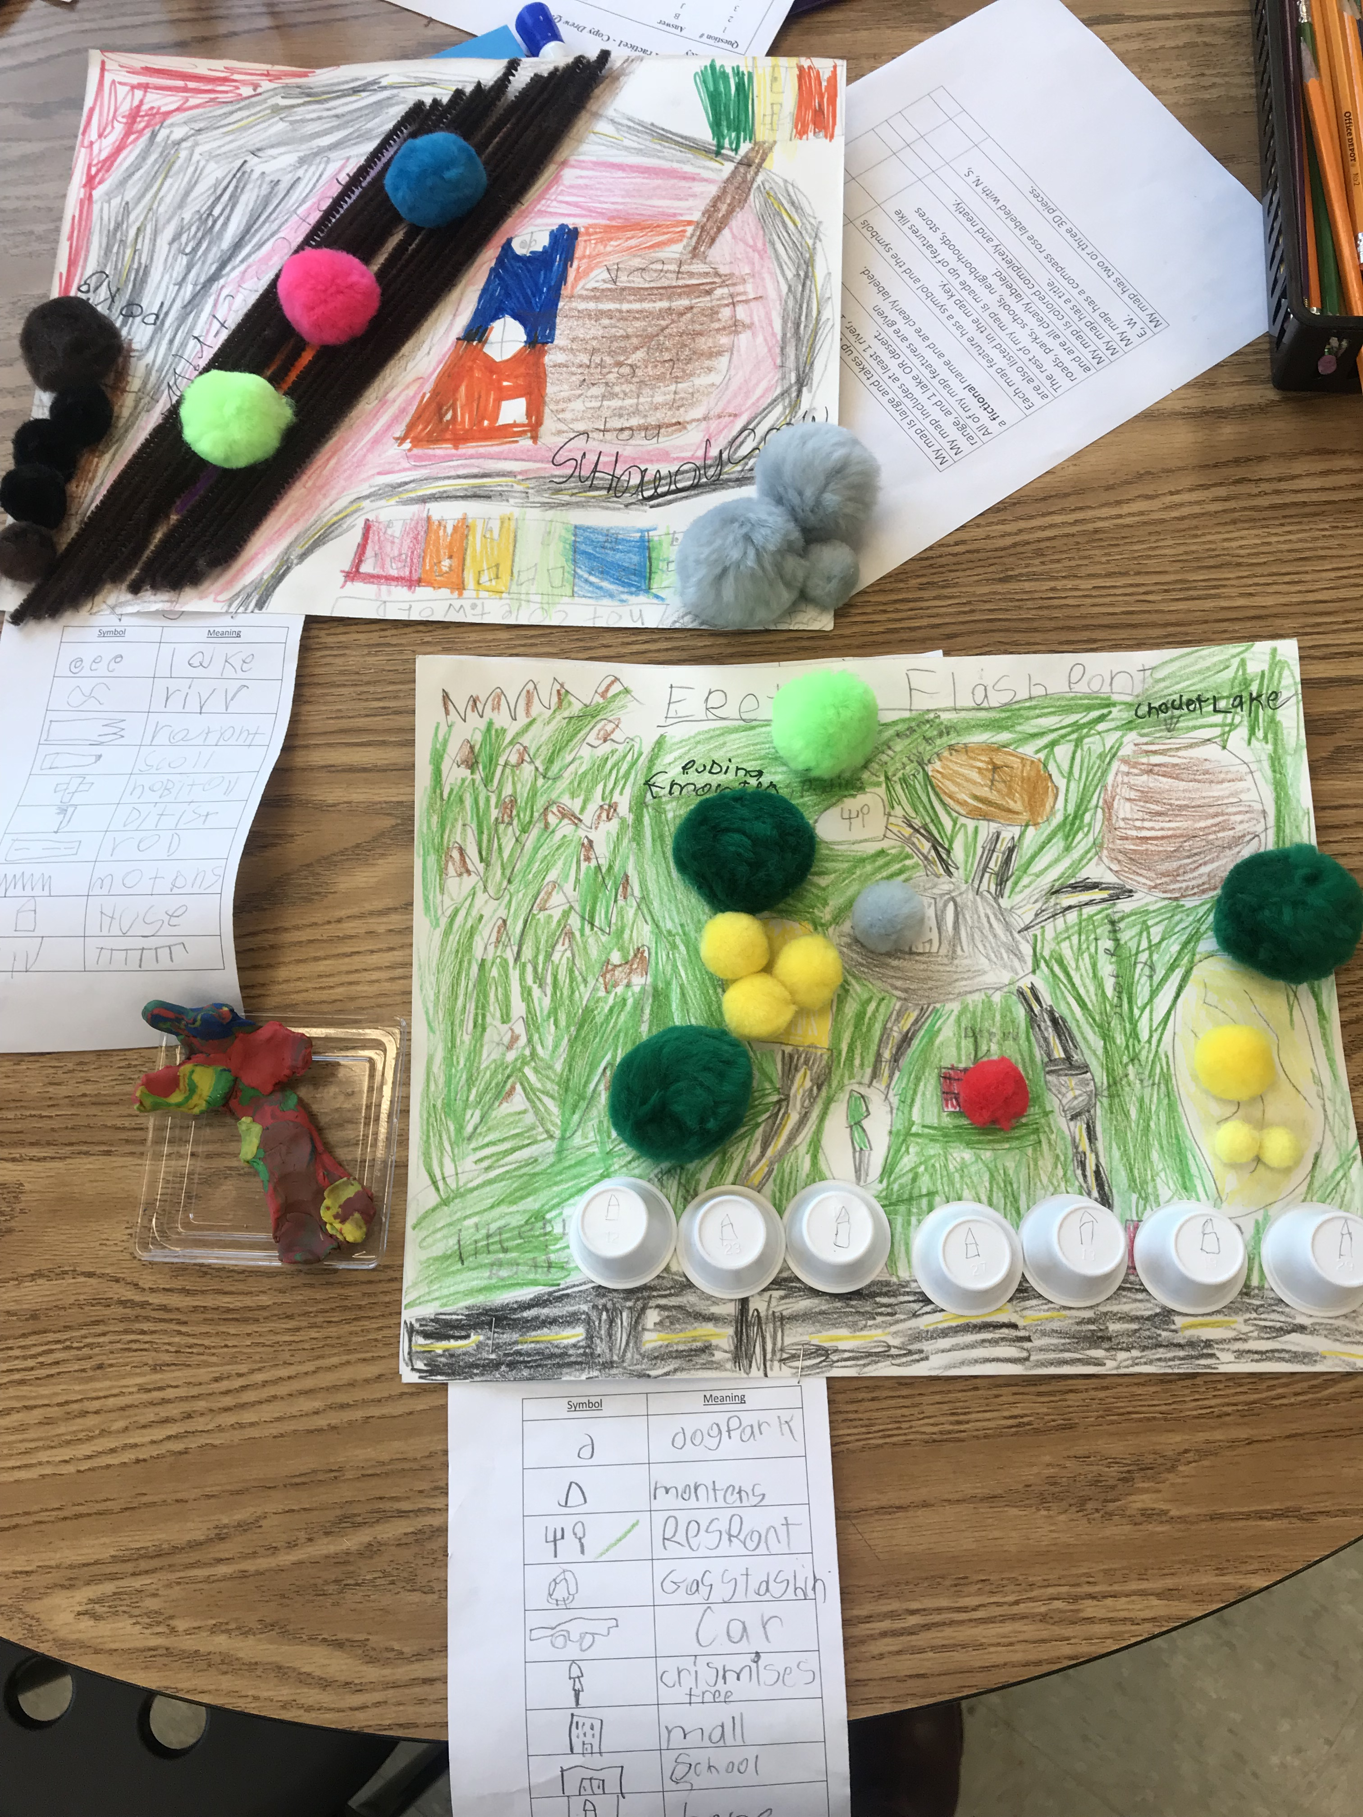
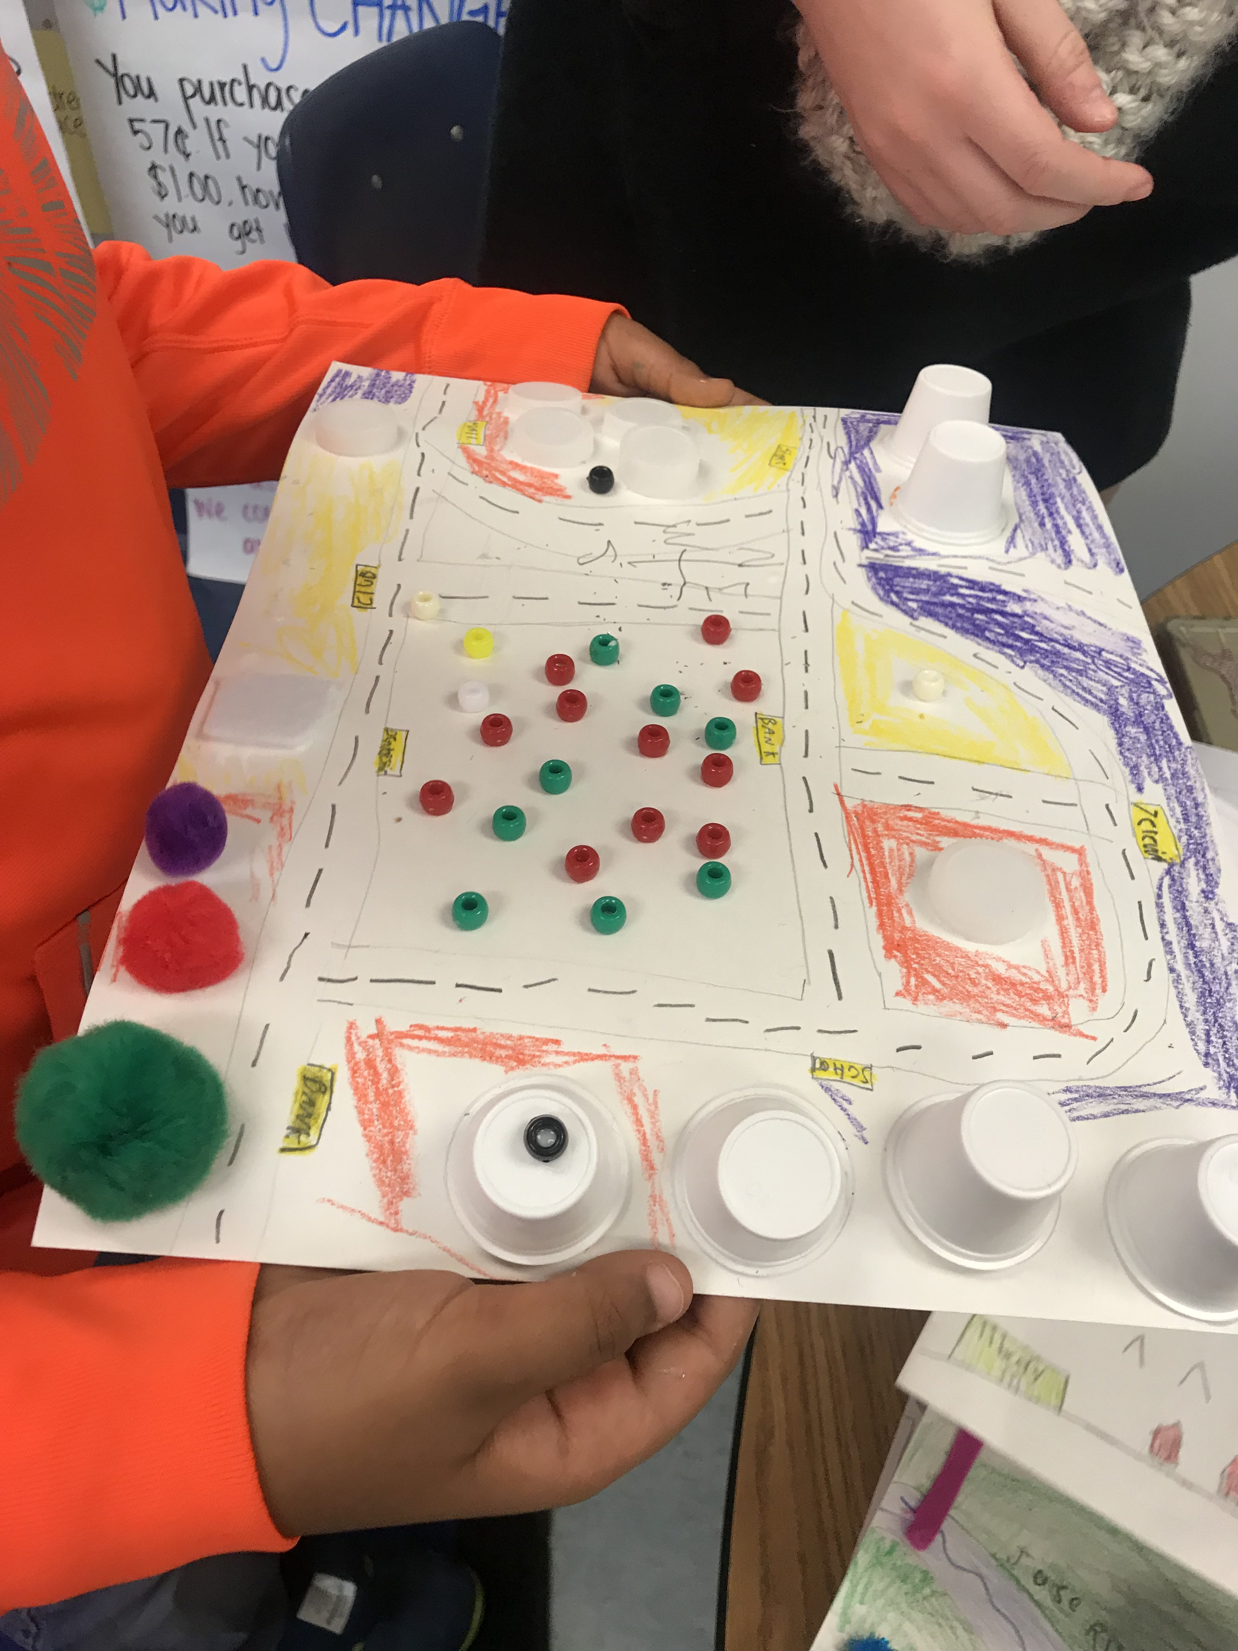
Finished Map Examples

