Slide 1
Fourth Grade Research Labs
A STEAM PBL Experience

Slide 2
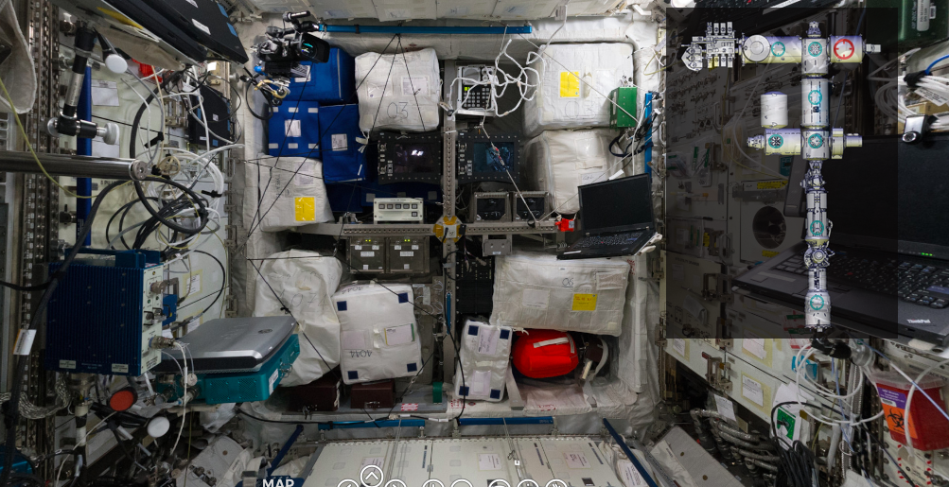
Our Entry Event
Fourth graders took a virtual 360 tour of the International Space Station. Students made observations and had their interested peaked.

Slide 3
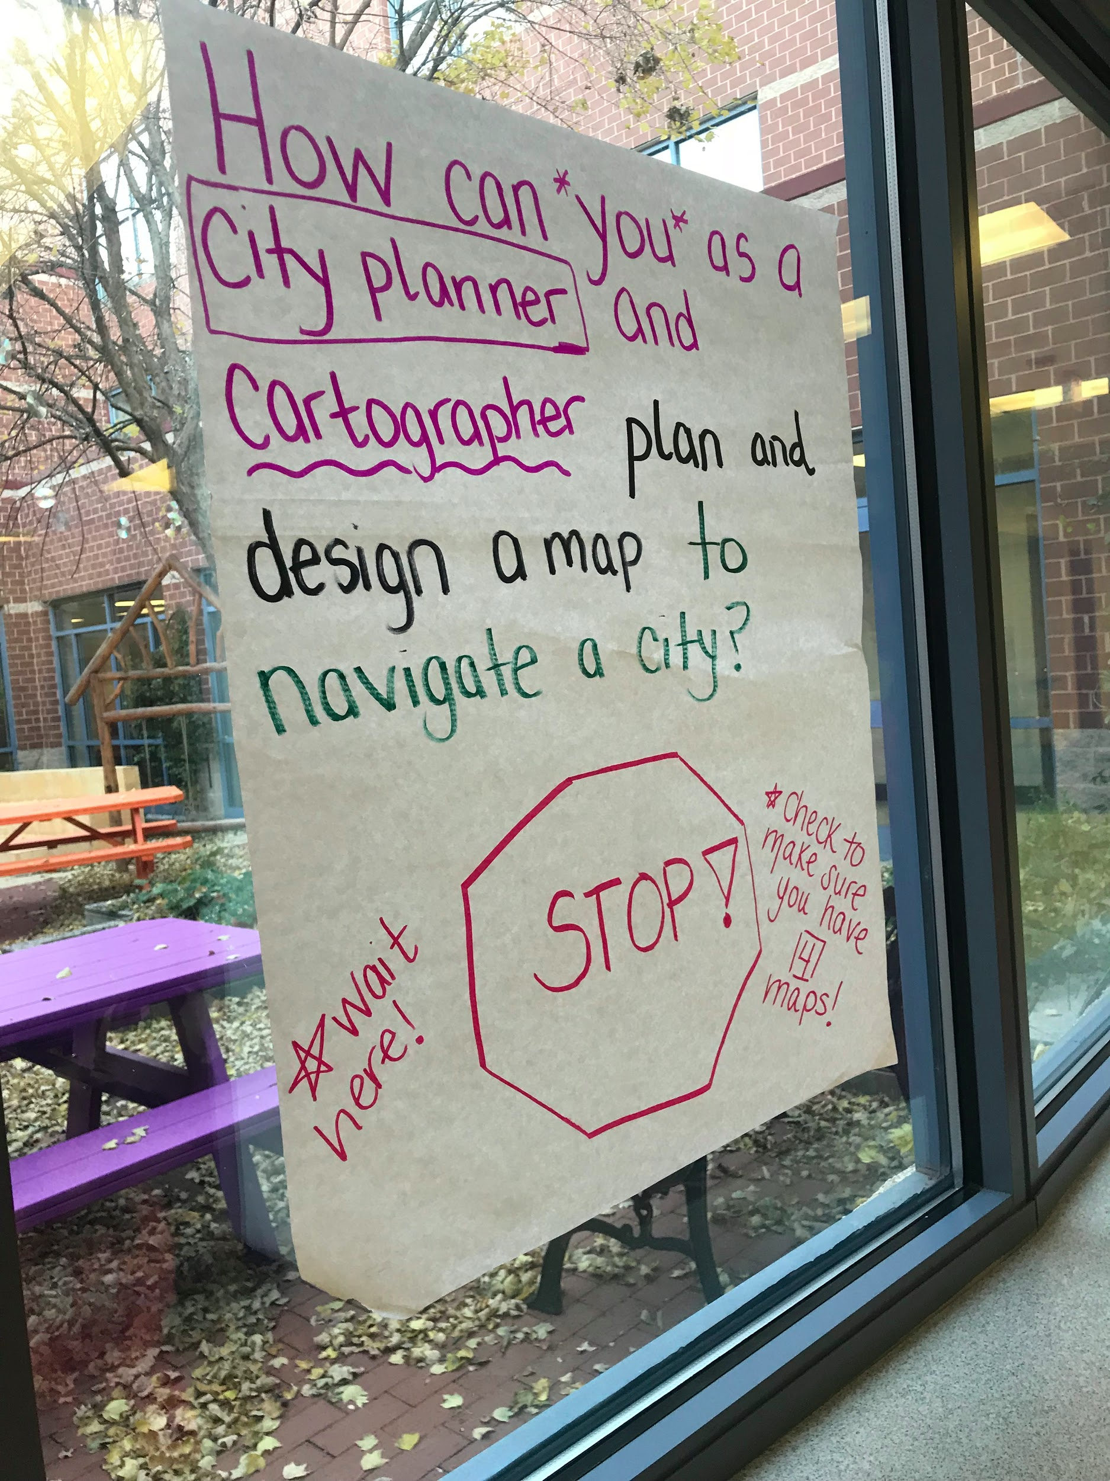
Driving Question
The students were then introduced to their driving question:
How can you as a NASA engineer design and create a representation of a research lab for 5 scientists to study the sun, moon or Earth?

Slide 4
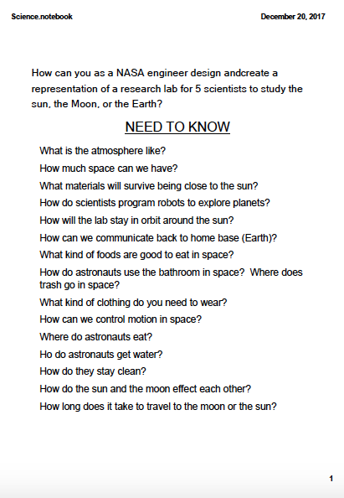
Need to Know Board
Students brainstormed questions they would need to find the answers to in order to complete their project successfully. This list was referred to throughout the unit to make sure they learned all they needed to know to complete their project.

Slide 5
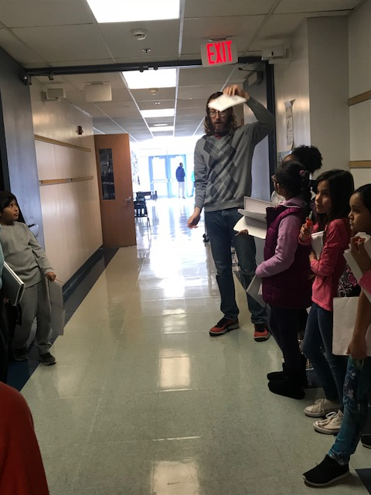
Student and Teacher Directed Inquiry
Students spent the next few weeks learning about the questions from their Need to Know Board.

Slide 6
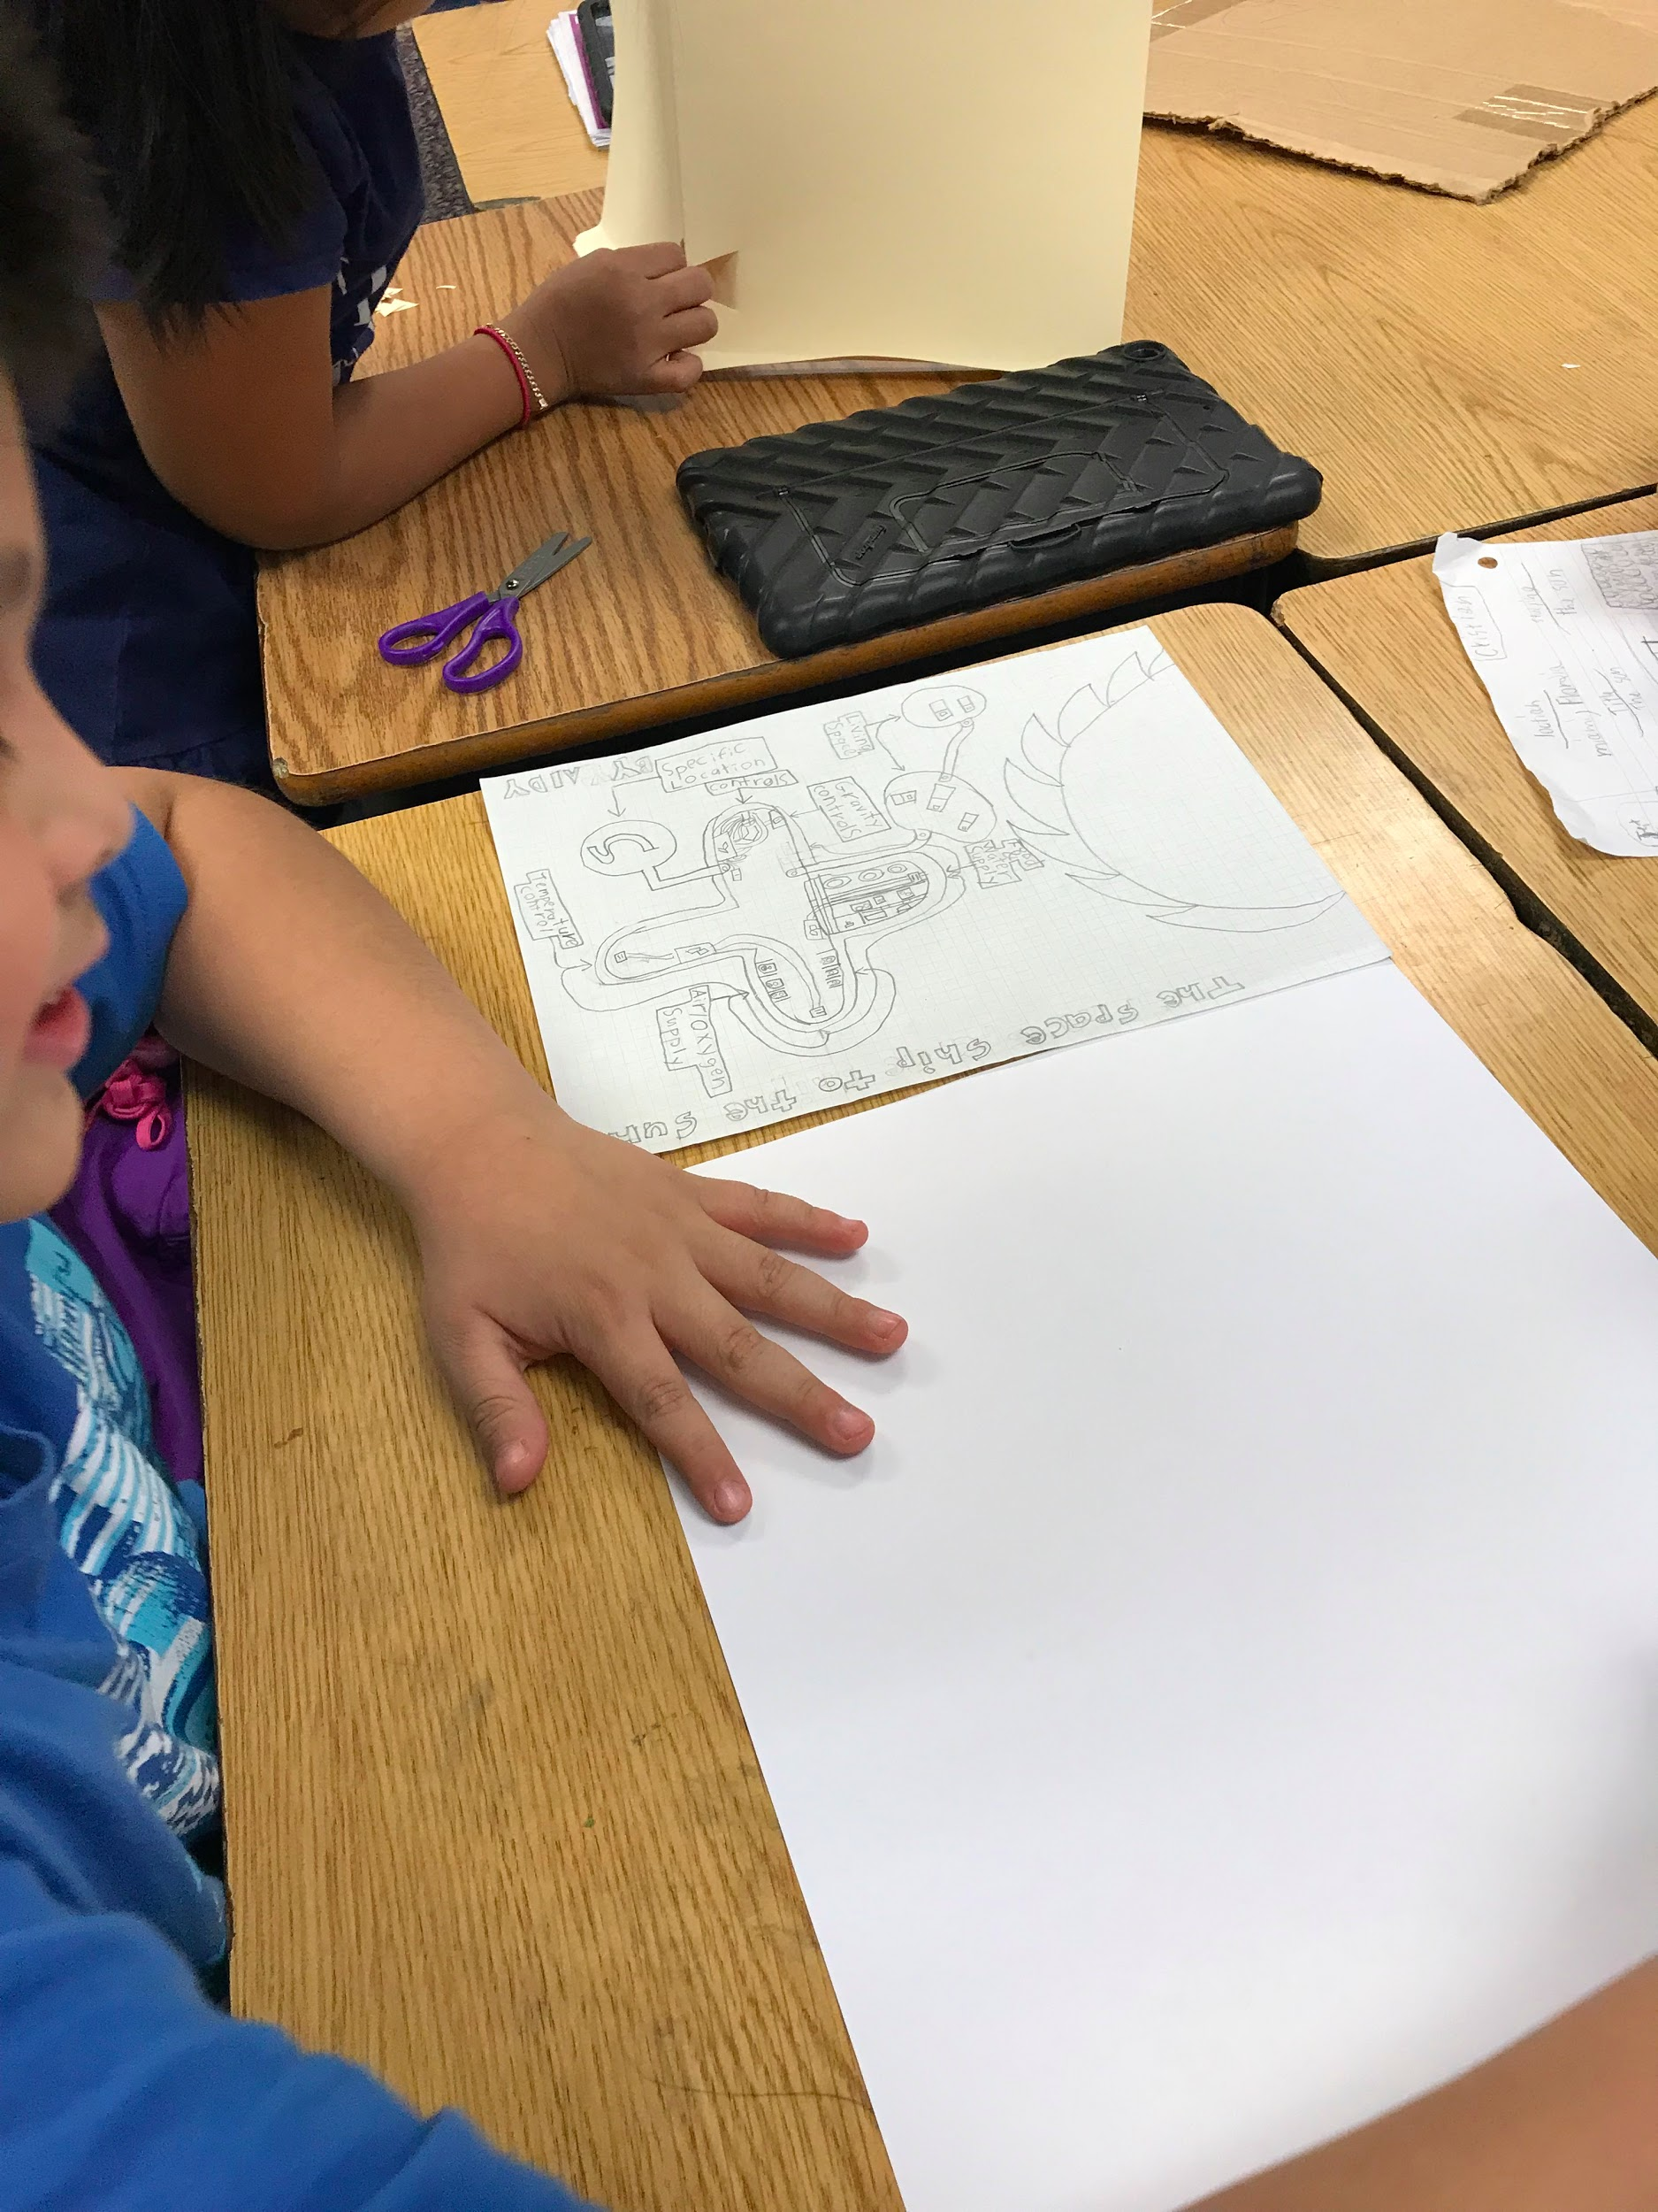
Student to Engineer
Students then transformed into NASA engineers. They selected whether their lab would study the Earth, moon or sun. Engineers first created a plan and made sure to include everything listed on the checklist.

Slide 7
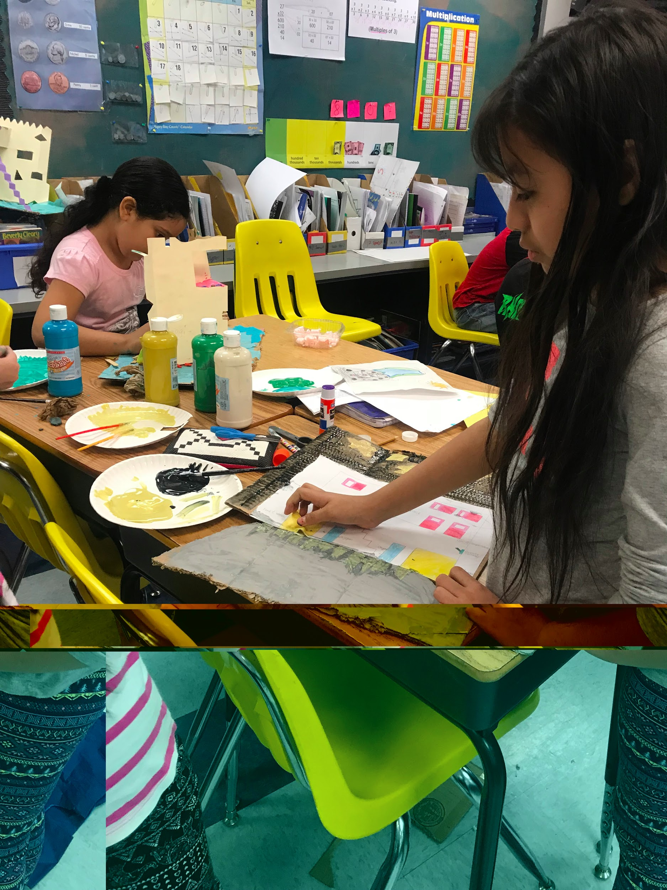
Turning Plans into Models or Drawings
Once plans were approved, students either selected makerspace materials to build a model or turned their plans into neat, detailed drawings.

Slide 8
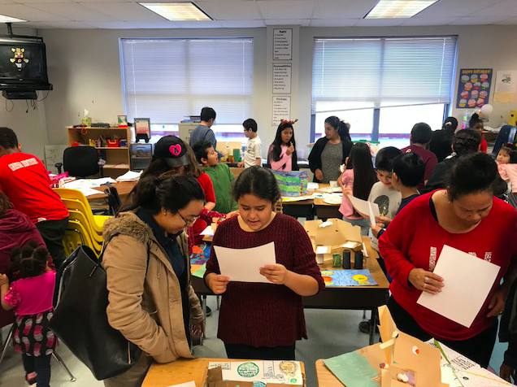
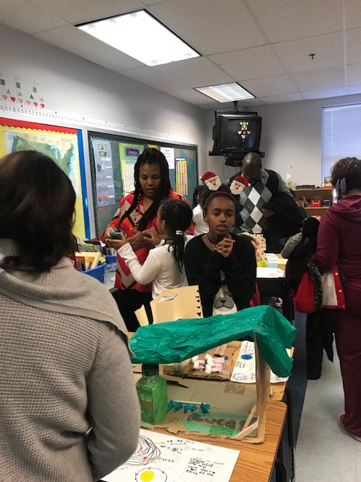
Time to Present!
4th grade engineers shared their models, drawings and nonfiction writing pieces with Drew teachers and their parents. Parents were welcomed to the classroom before the innovation hour for pancakes and other goodies.

Slide 9
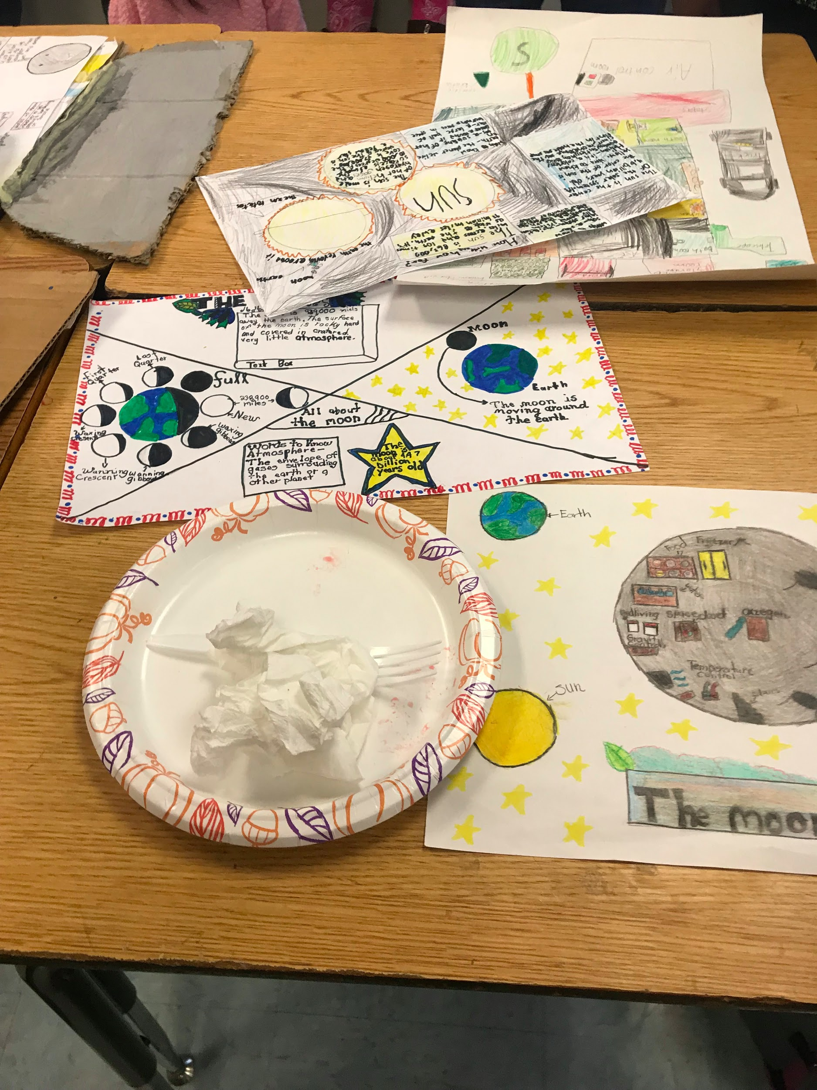
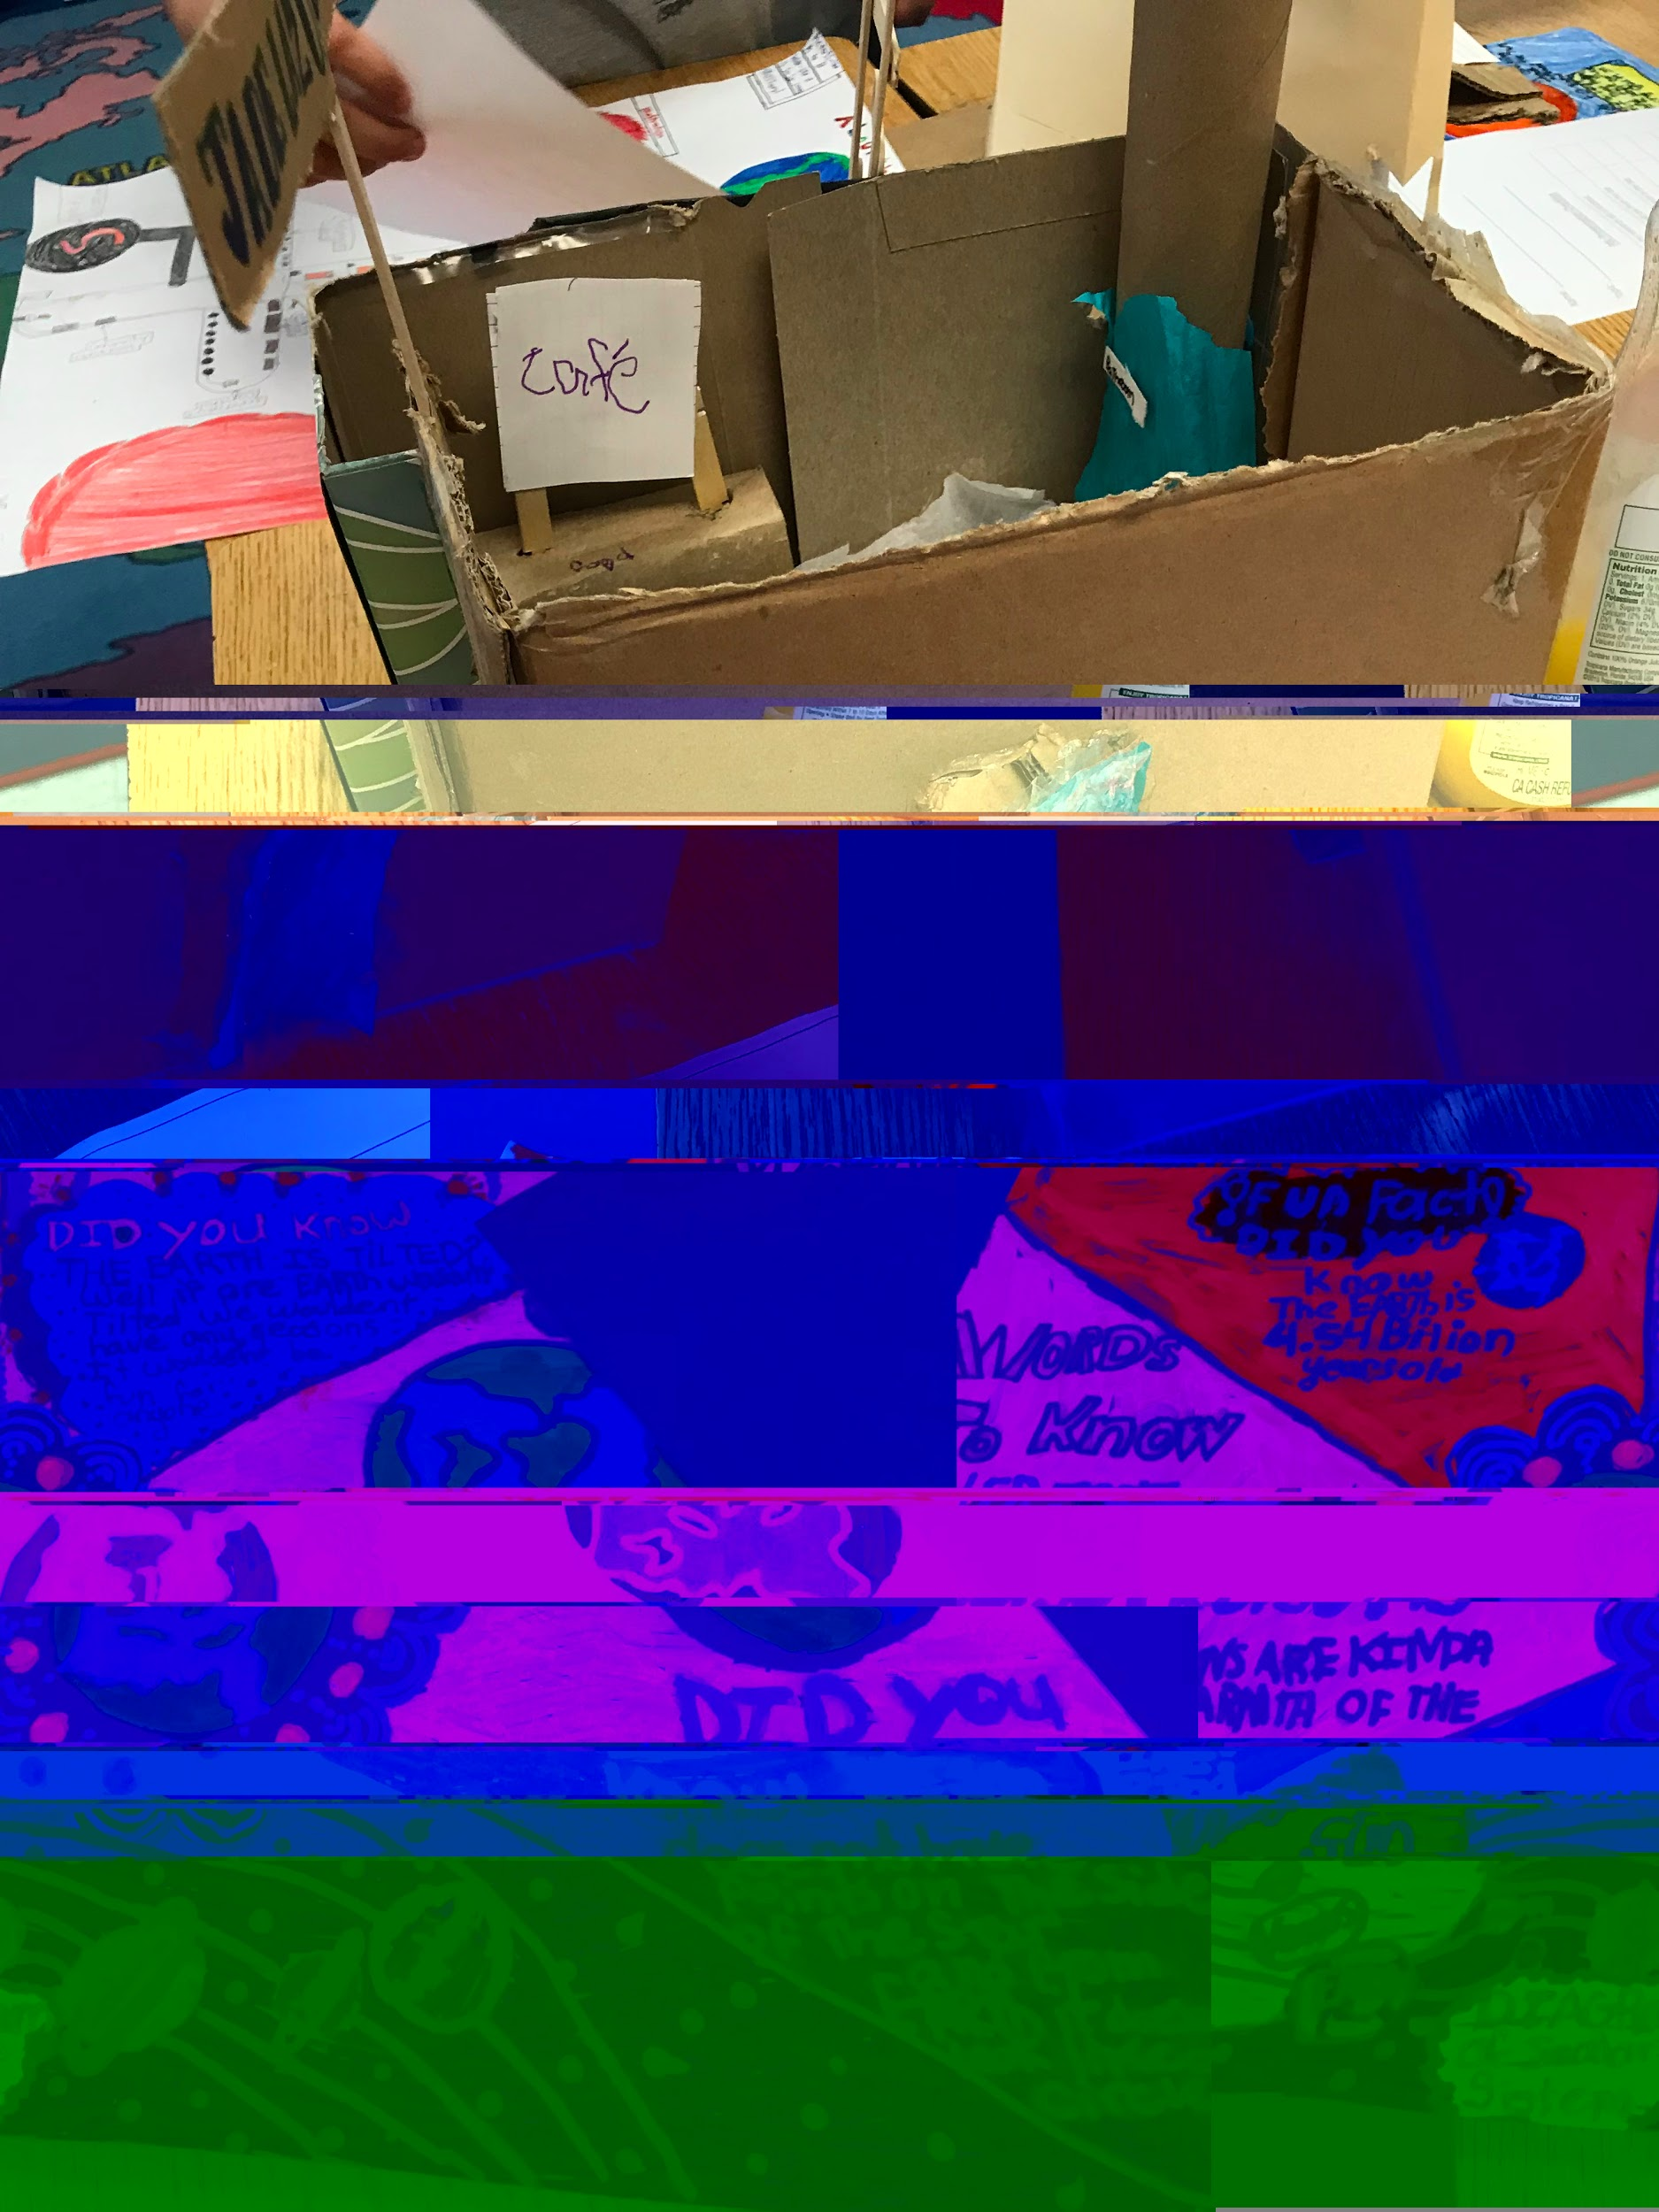
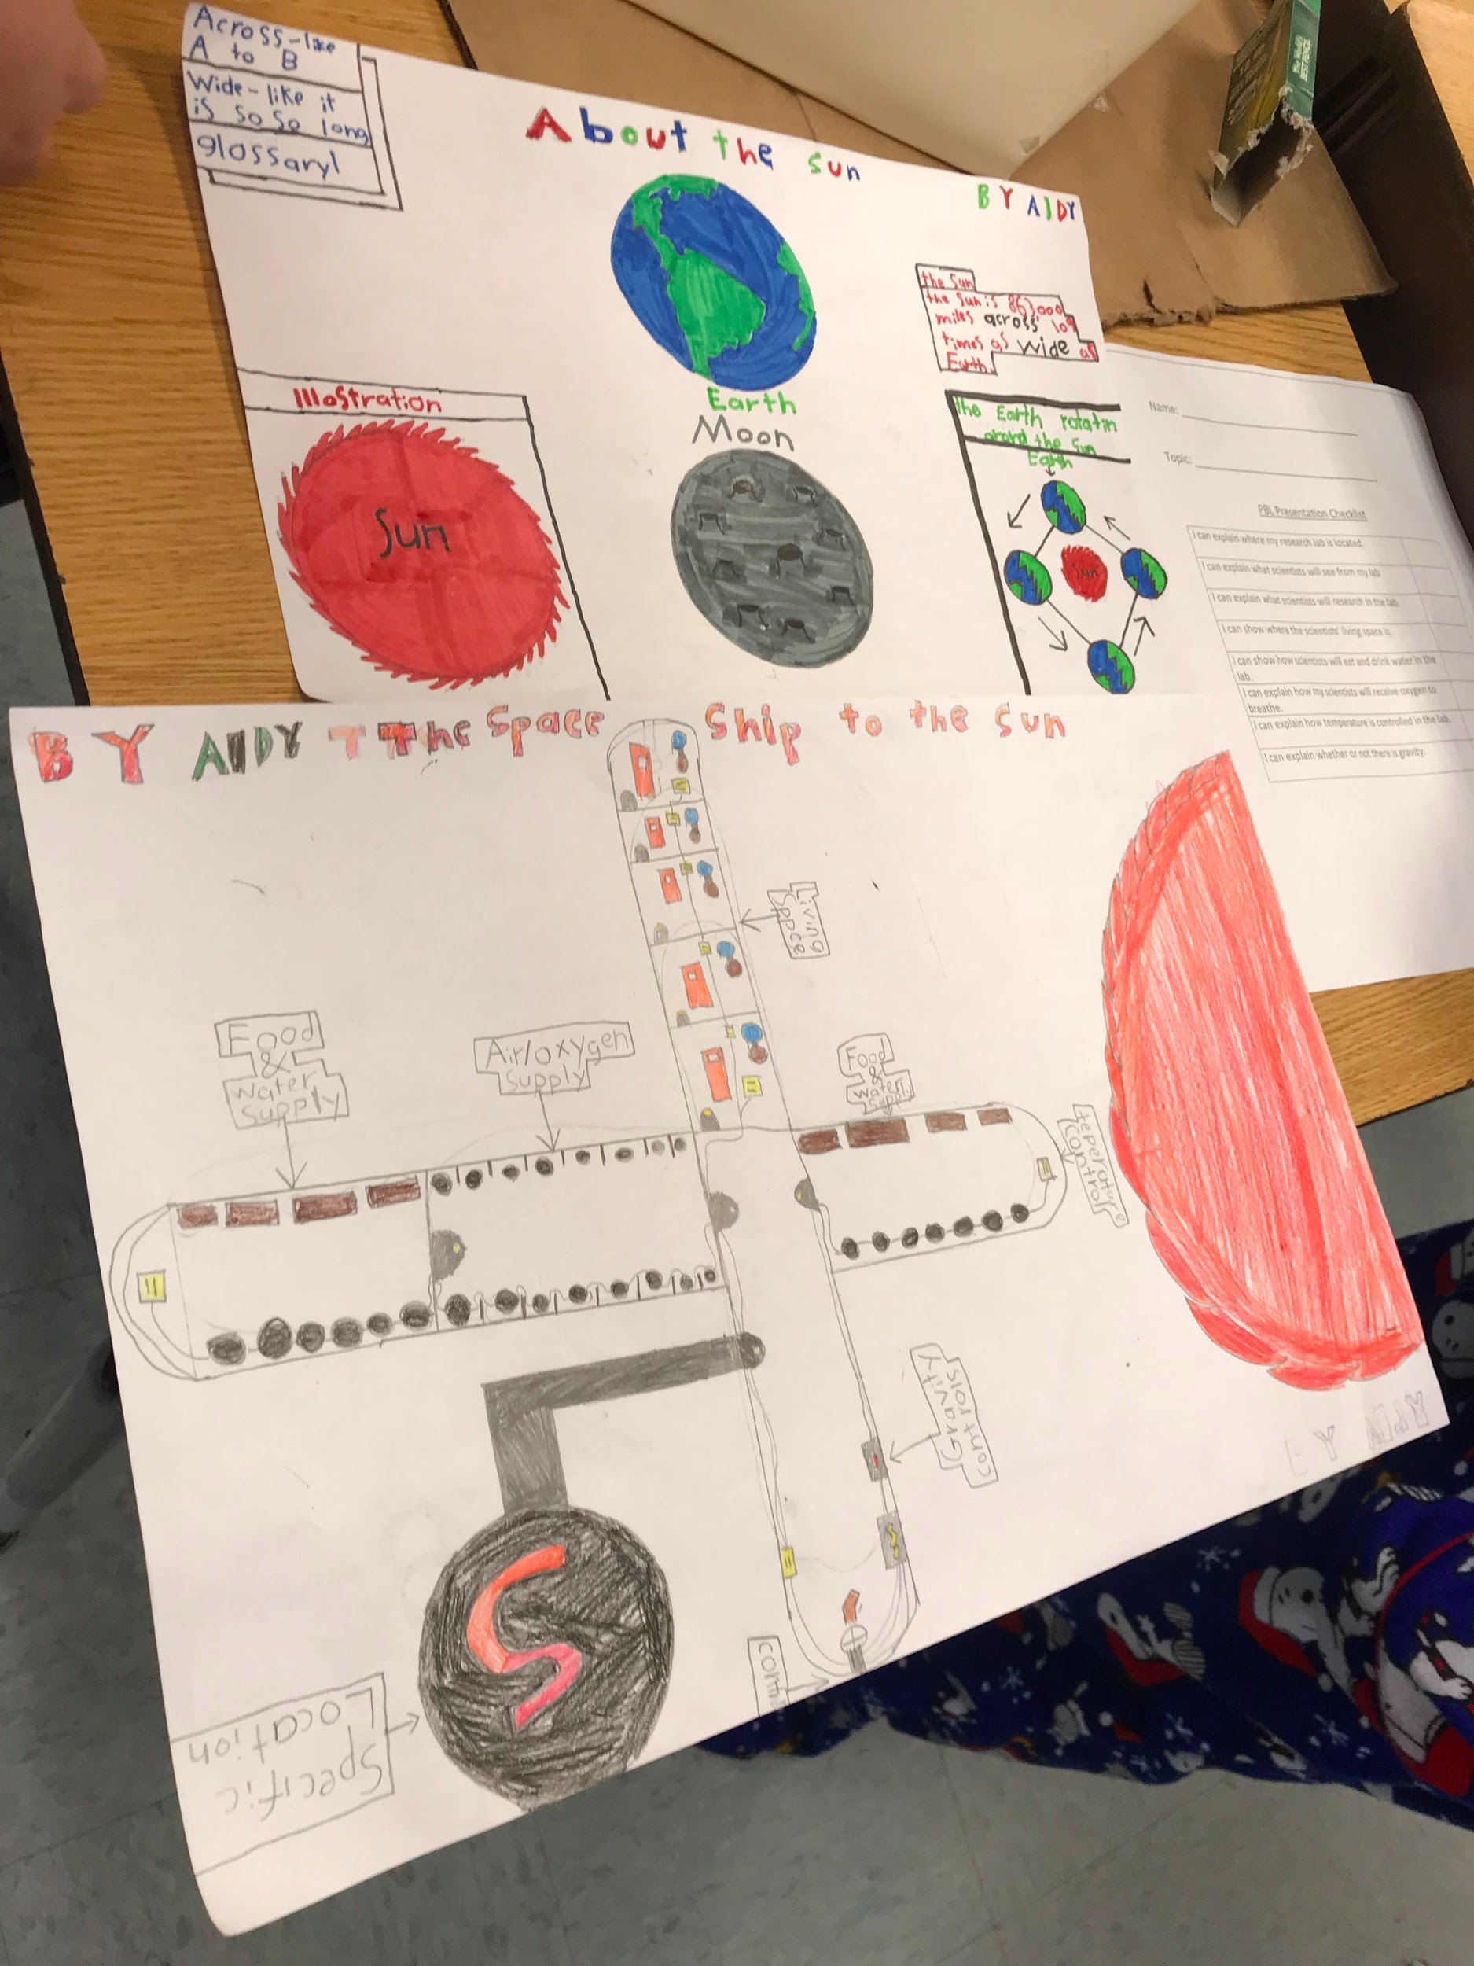
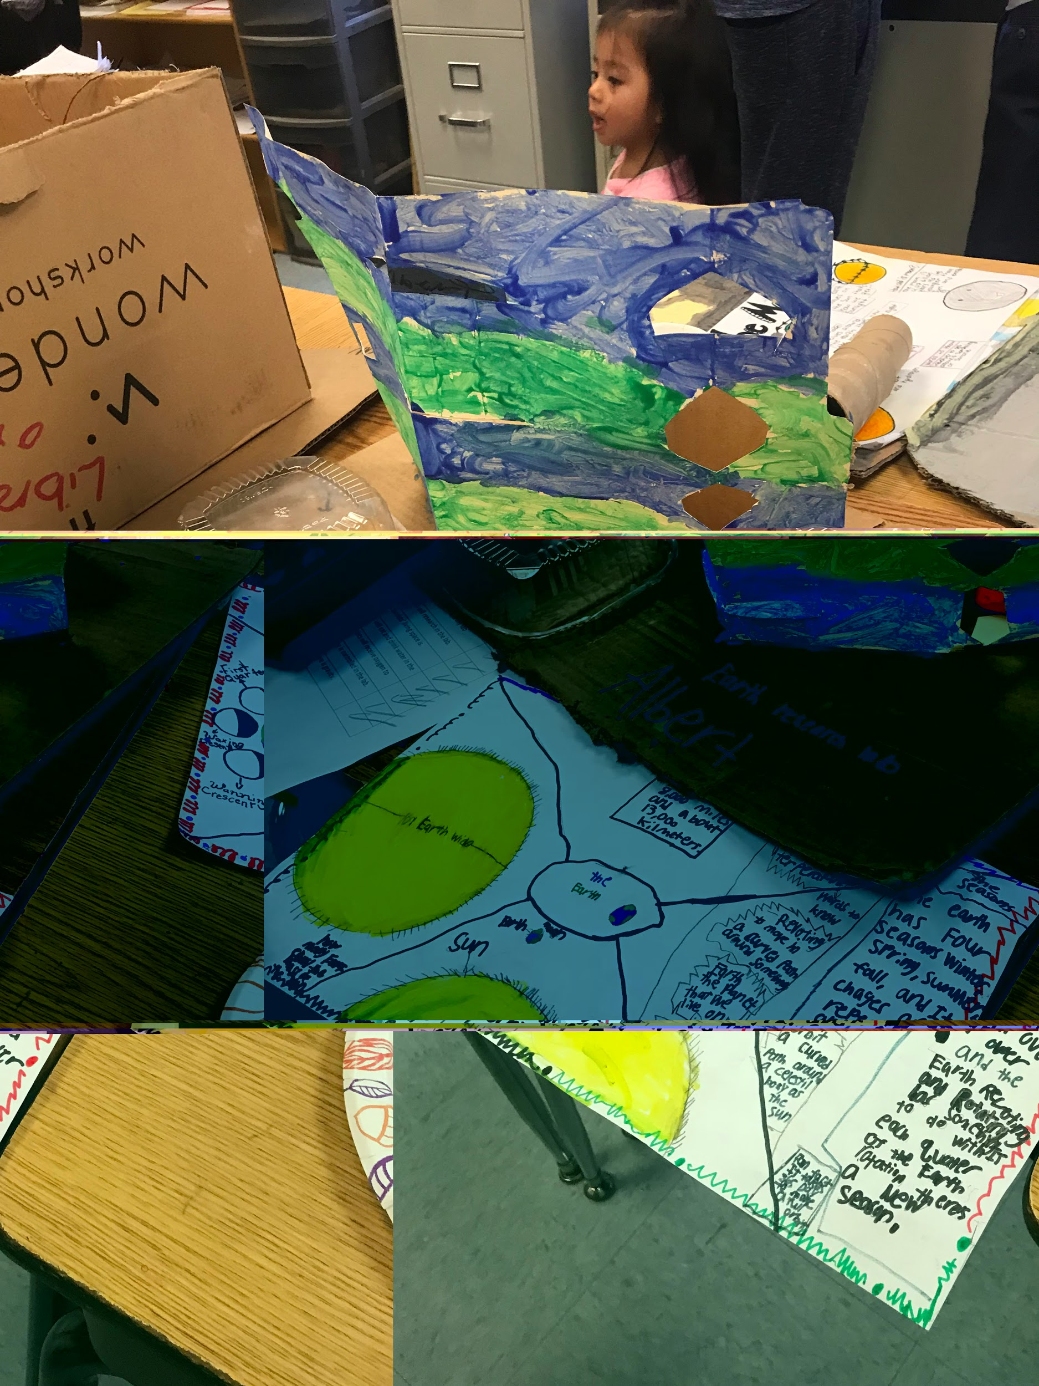
Finished Research Labs Examples

