Slide 1
Hibernation Habitats
A Kindergarten PBL

Slide 2
Entry Event
Kindergarten students were introduced to their PBL by exploring a variety of pictures that showed different animals hibernating. Most students already knew that bears are hibernators.

Slide 3
Driving Question
Students were then introduced to their driving question which would guide their exploration throughout their PBL Unit.
How should you, as a habitat specialist, create a safe cozy winter home for your animal to hibernate?

Slide 4
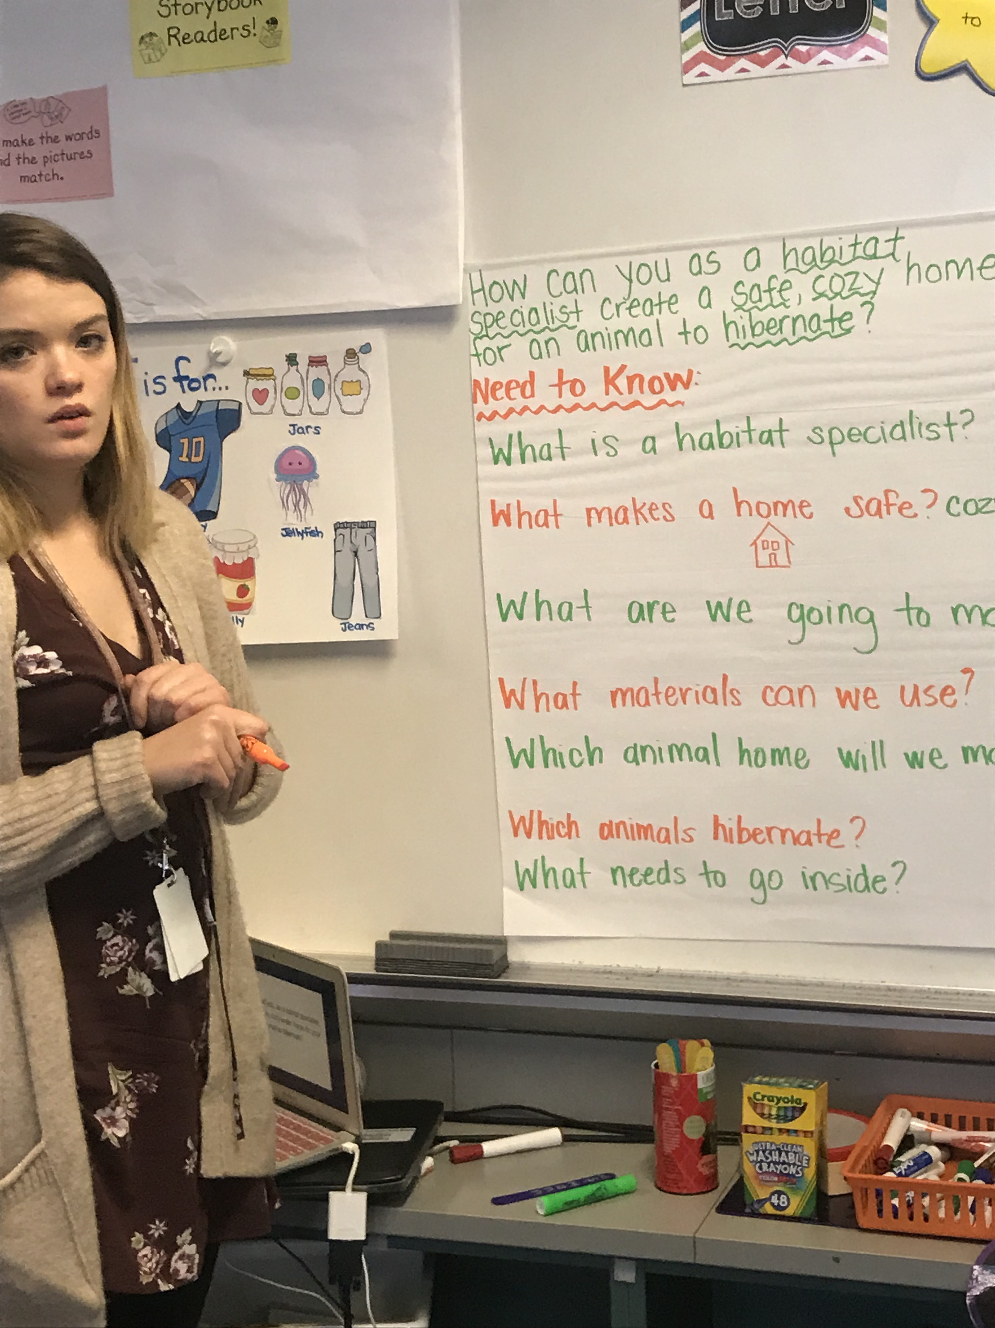
Need to Know Board
The students then brainstormed questions they would need to find out the answers to before they could successfully complete their projects. These questions were recorded on the “Need to Know Board” and referred to throughout the unit.

Slide 5
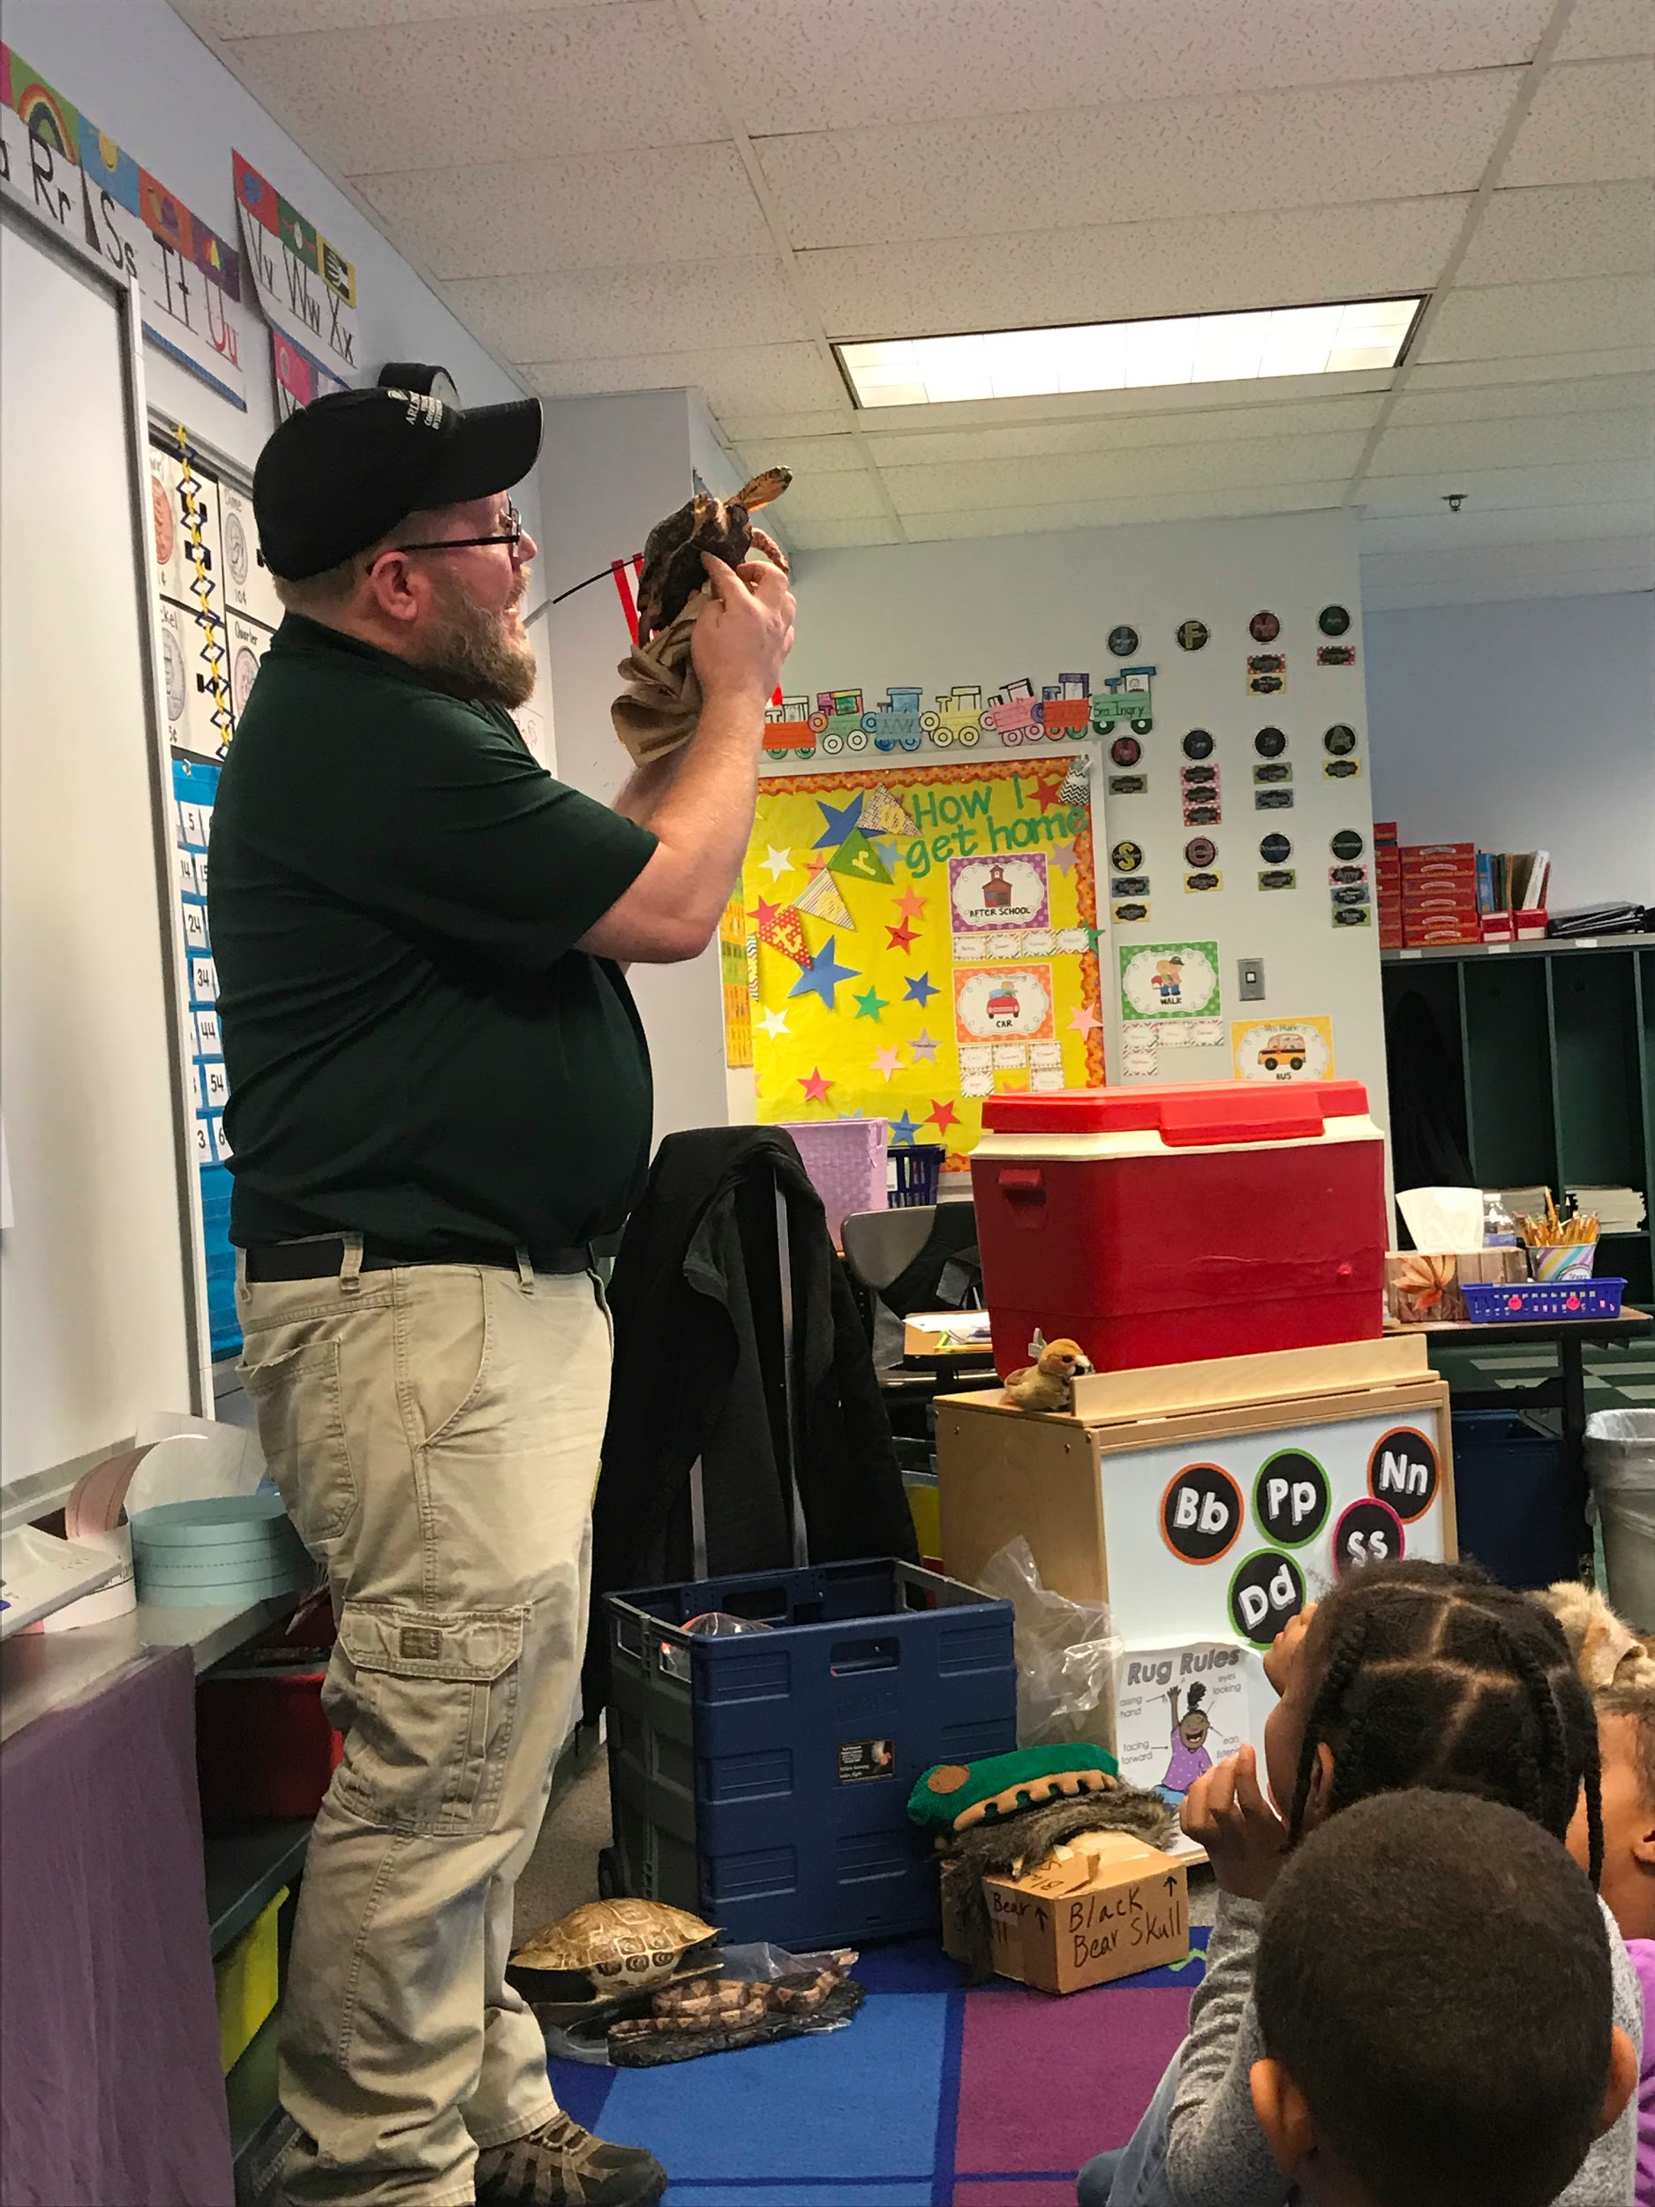
Learning from a Professional
Mr. Ken, naturalist from Gulf Branch Nature Center came to Drew to talk to the Kindergarteners about hibernation. The students had the chance to touch some furs, skulls and a live turtle!

Slide 6
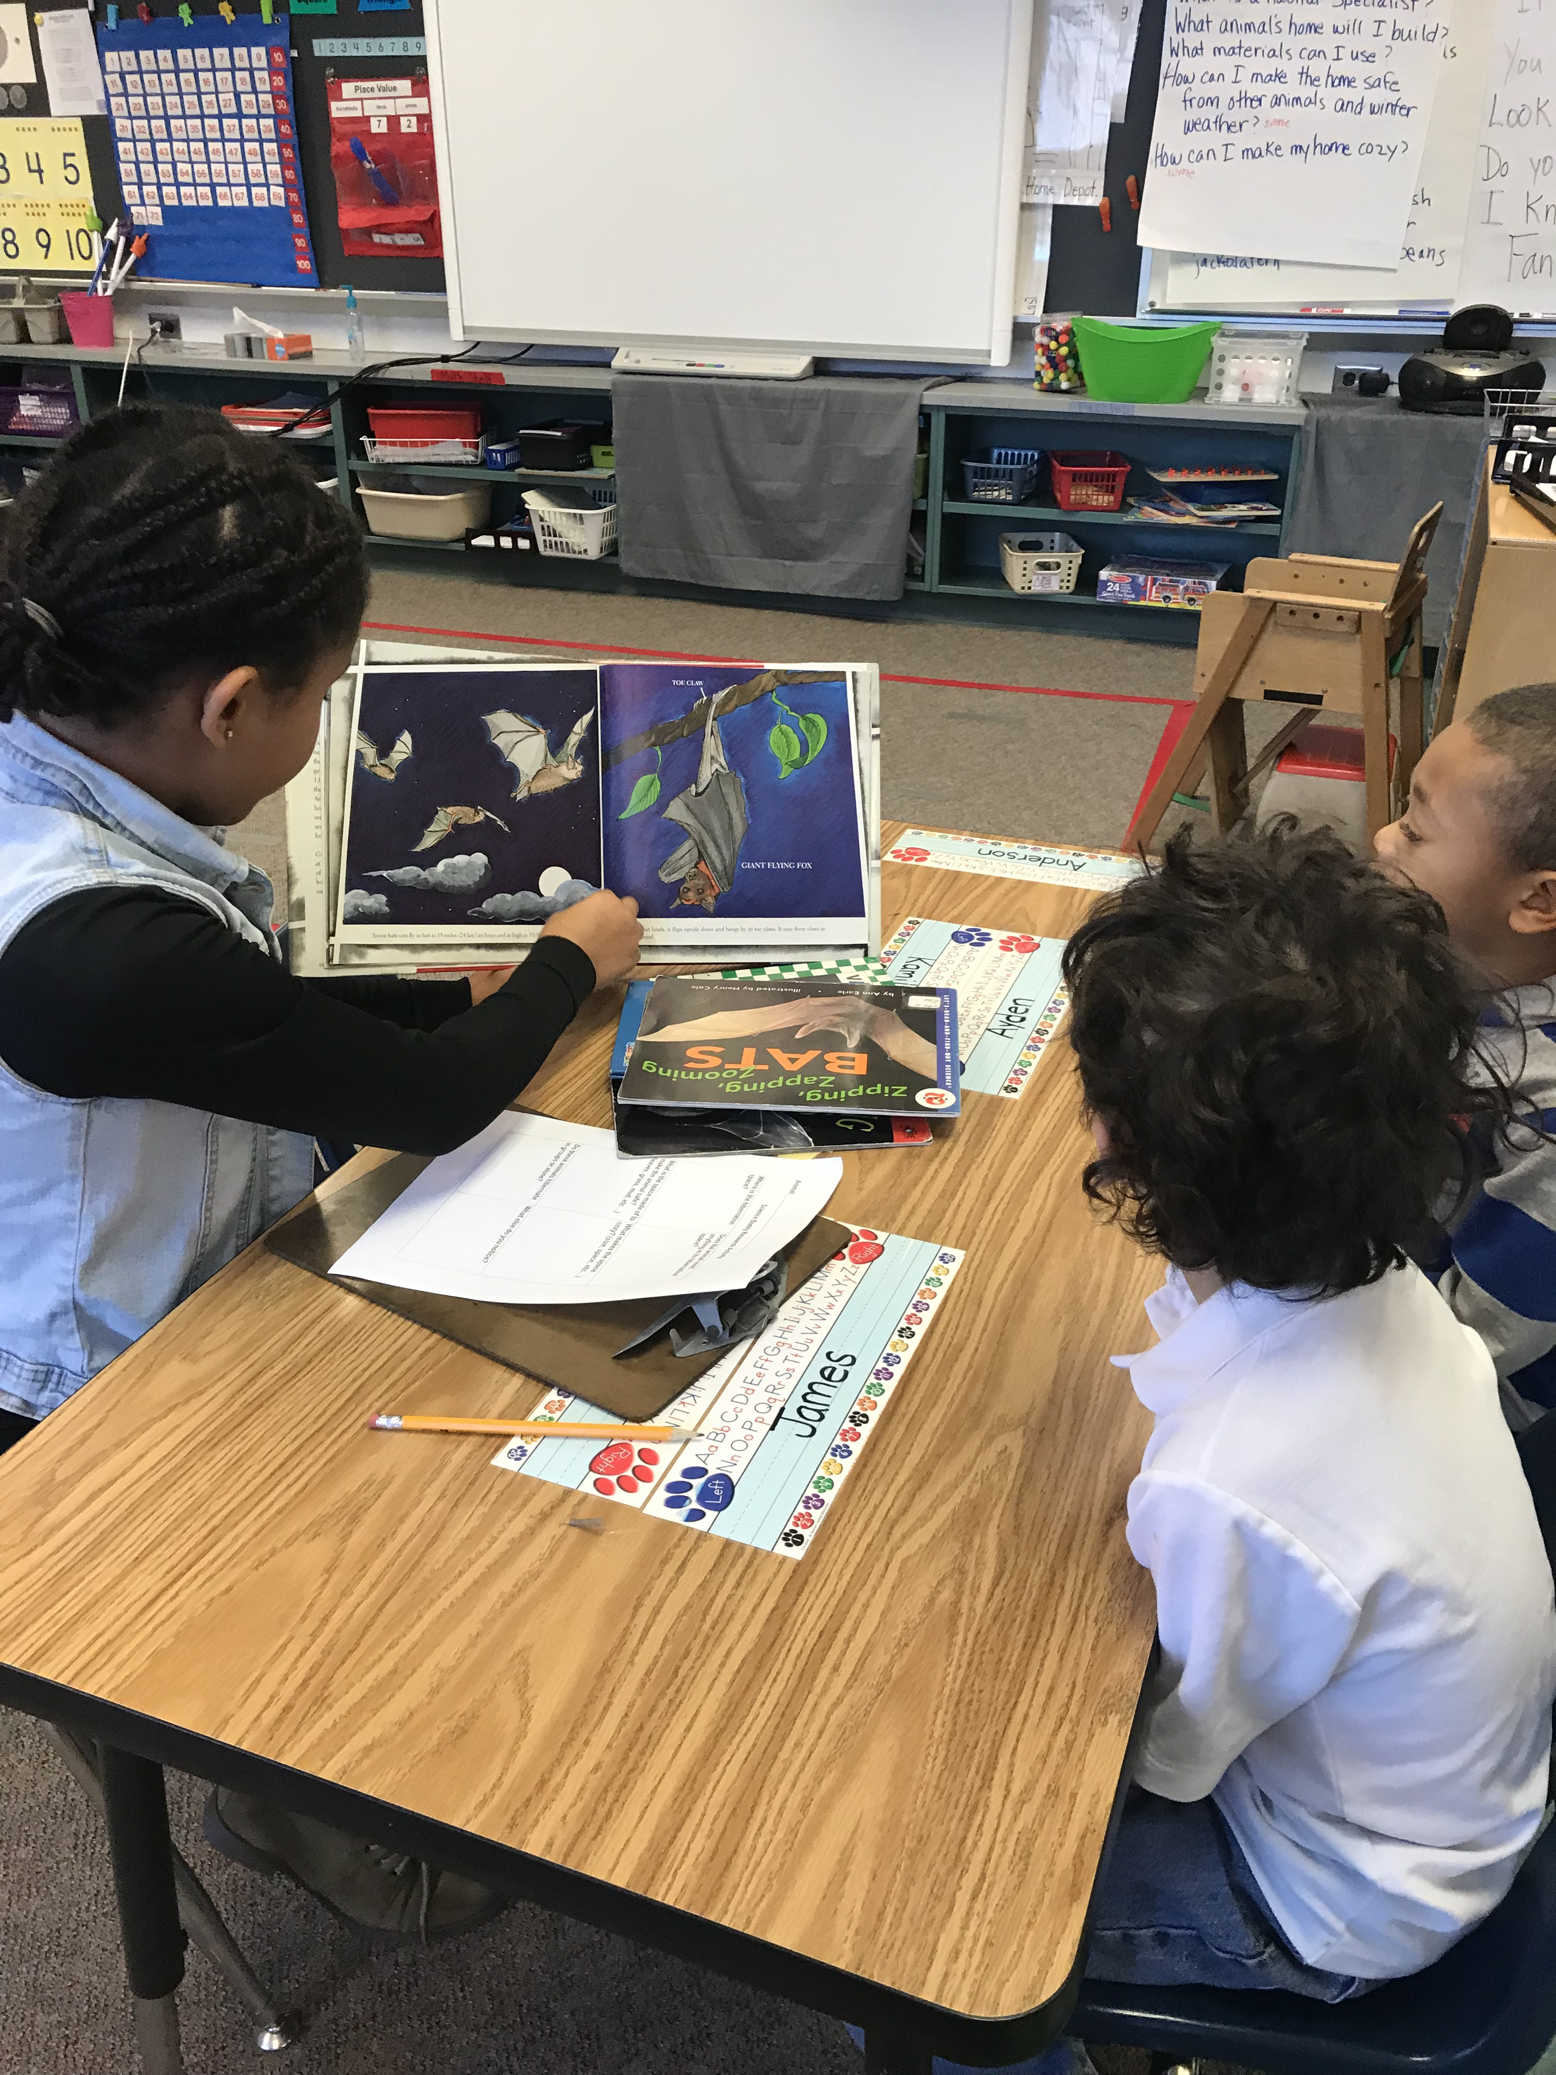
Student Inquiry
Our 5th grade science buddies joined our classes to help research our hibernating animals. We looked through books and used iPads to find information about where our animals hibernate and what keeps them safe and cozy.

Slide 7
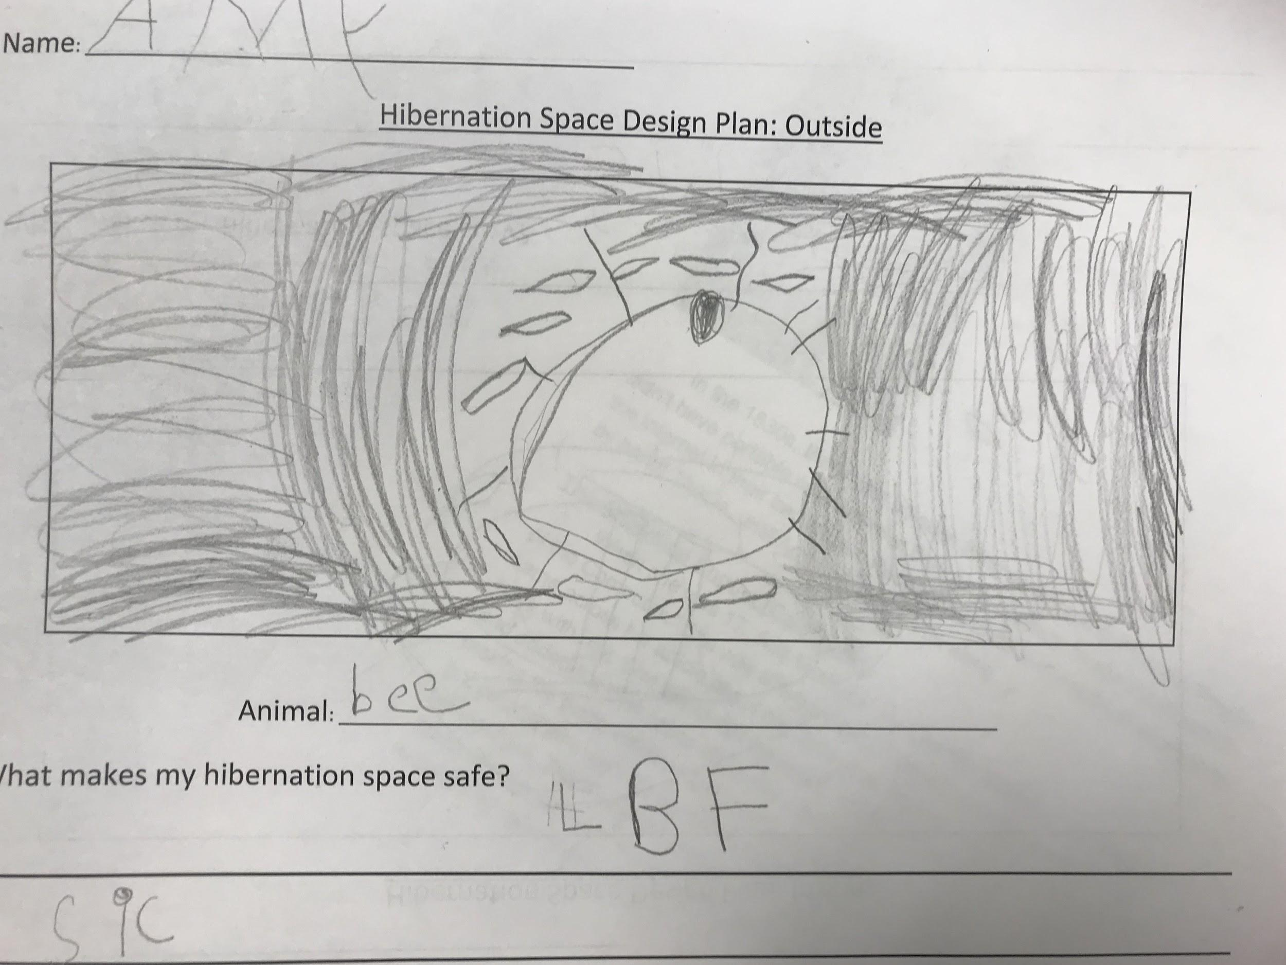
Planning like a Habitat Specialist
We worked as habitat specialists to plan what our animal’s hibernation space would look like. We used a planning sheet to draw our plan and to write about what will make it safe and cozy.

Slide 8
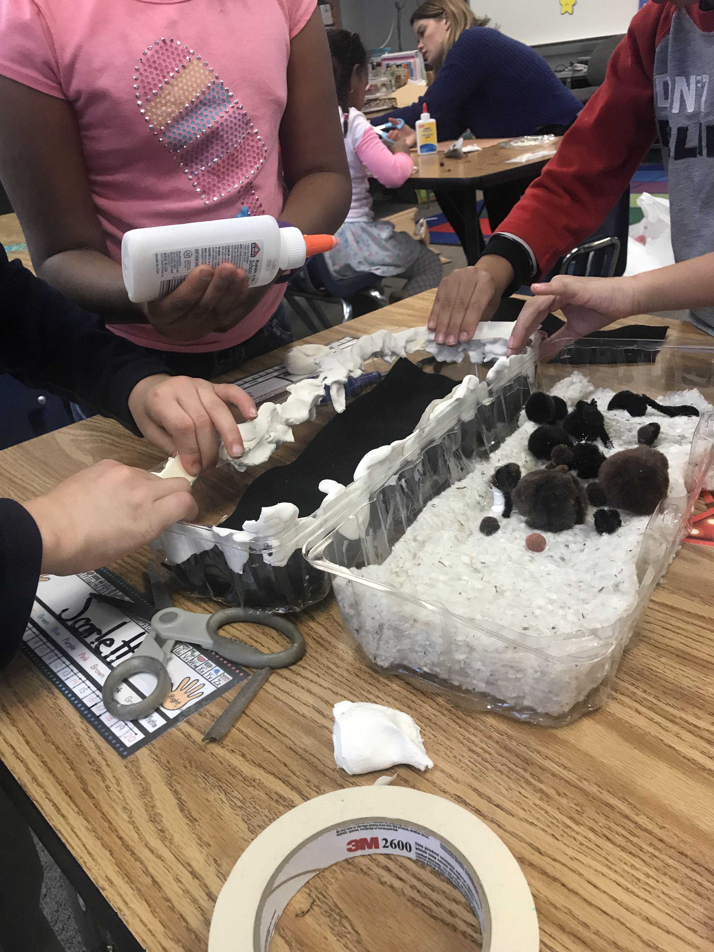
Building our Hibernation Habitats
We used Makerspace materials to turn our design plans into models. We collaborated as a group to make one habitat for our animal to stay safe and cozy in the winter.

Slide 9
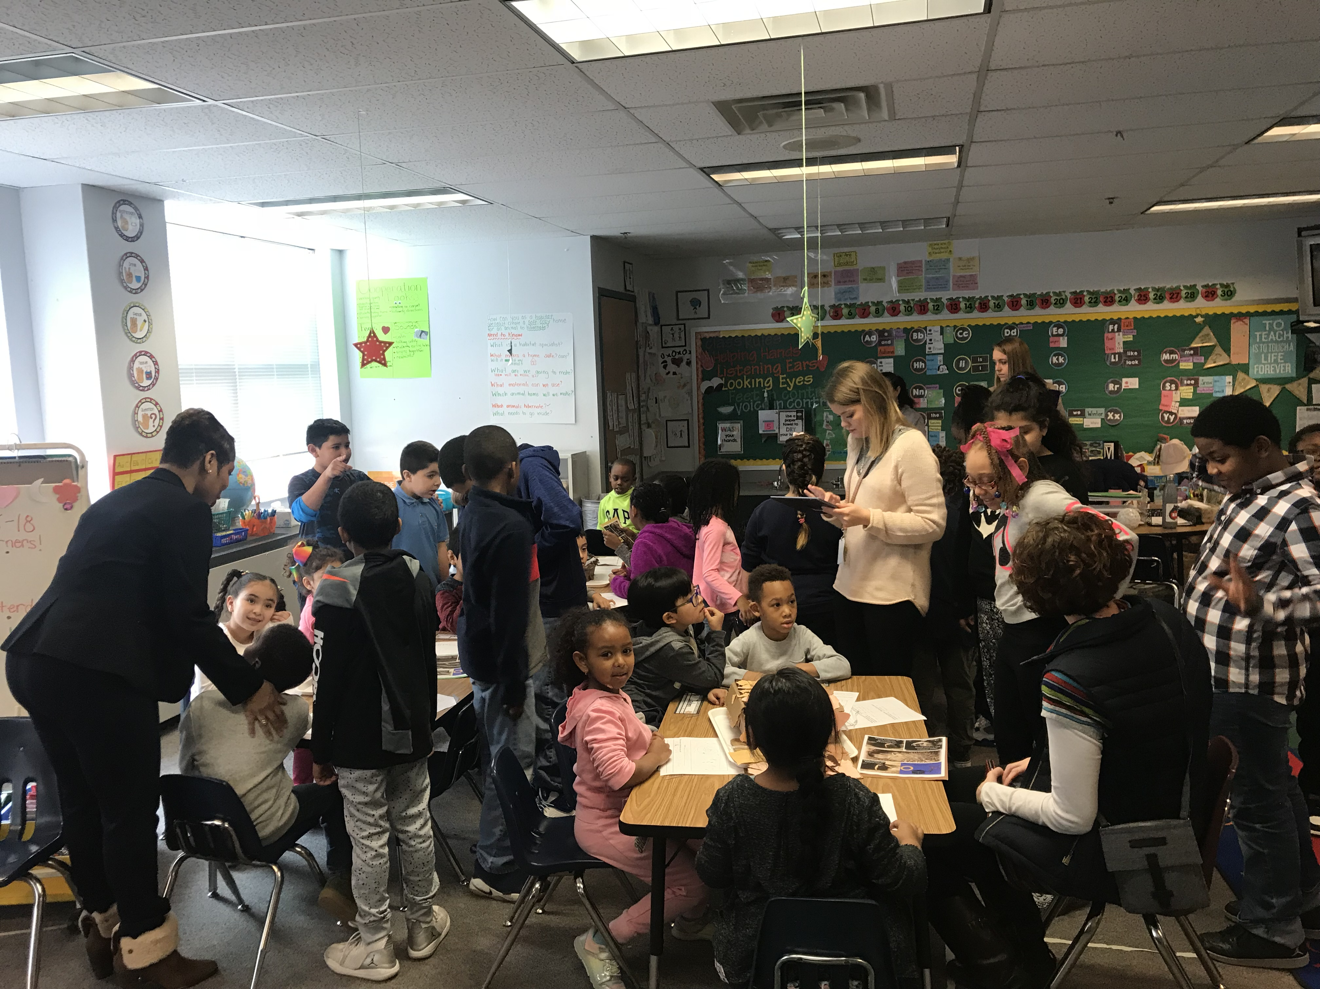
Sharing our work!
Teachers, parents and fellow Drew students came to our Innovation Hour. We told them about our hibernation habitats and they asked us how our animals stay safe and cozy! We were so happy that our 5th grade science buddies came back to see how we turned the research into models!

