Slide 1
Travel Brochures
Grade Two Project-Based Learning

Slide 2
Entry Event
Students examined pictures of their teachers, Ms. DeSousa and Ms. Guidry dressed in the wrong clothes for different types of weather. Students shared how they inferred that their teachers needed different clothes using clues from the phots.

Slide 3
Driving Question
How can you, as a meteorologist, educate tourists to prepare for an upcoming vacation?

Slide 4
Need to Know Board
Students used the Driving Question to share questions they would need to find the answers to in order to complete their job as meteorologists. This list was then posted in the classroom throughout the unit.

Slide 5
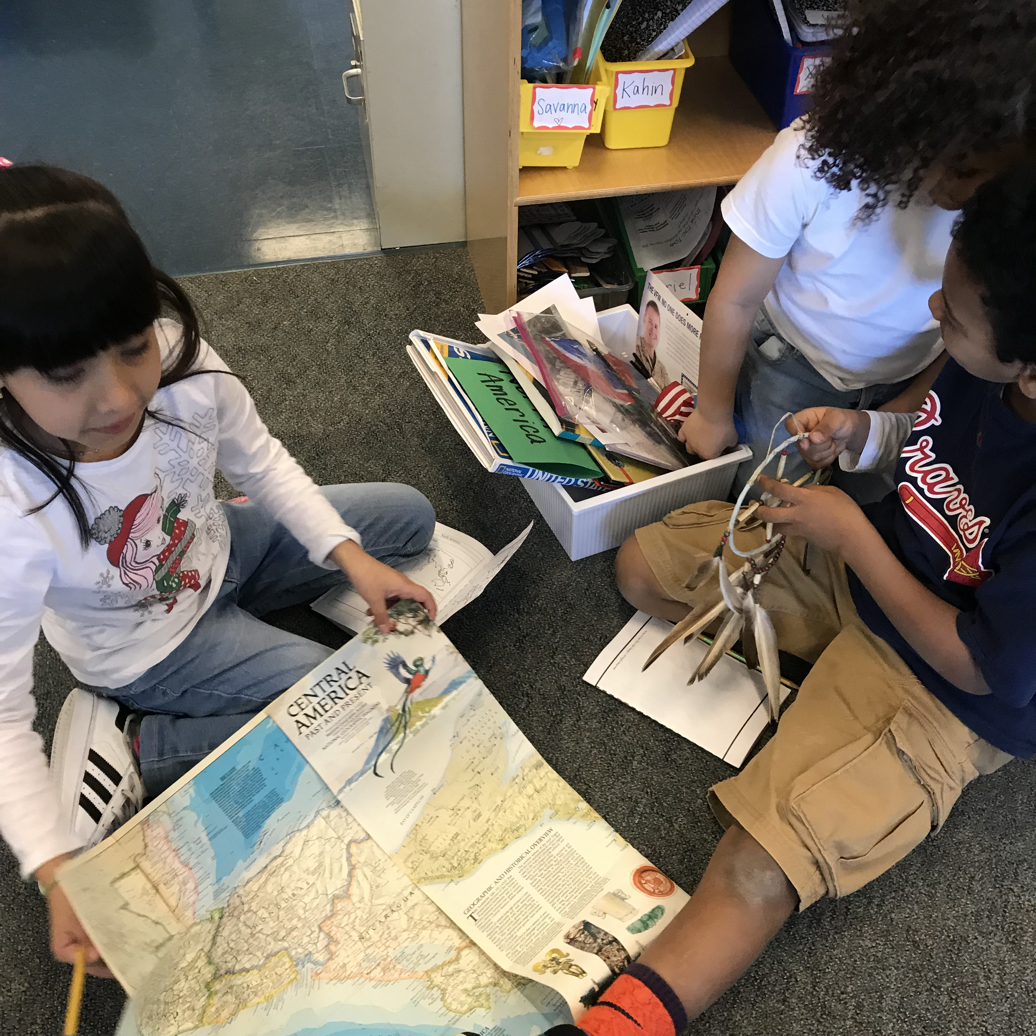
Student Inquiry
The students engaged in a variety of lessons that allowed them to explore information about the continents, weather, map skills and landforms.

Slide 6
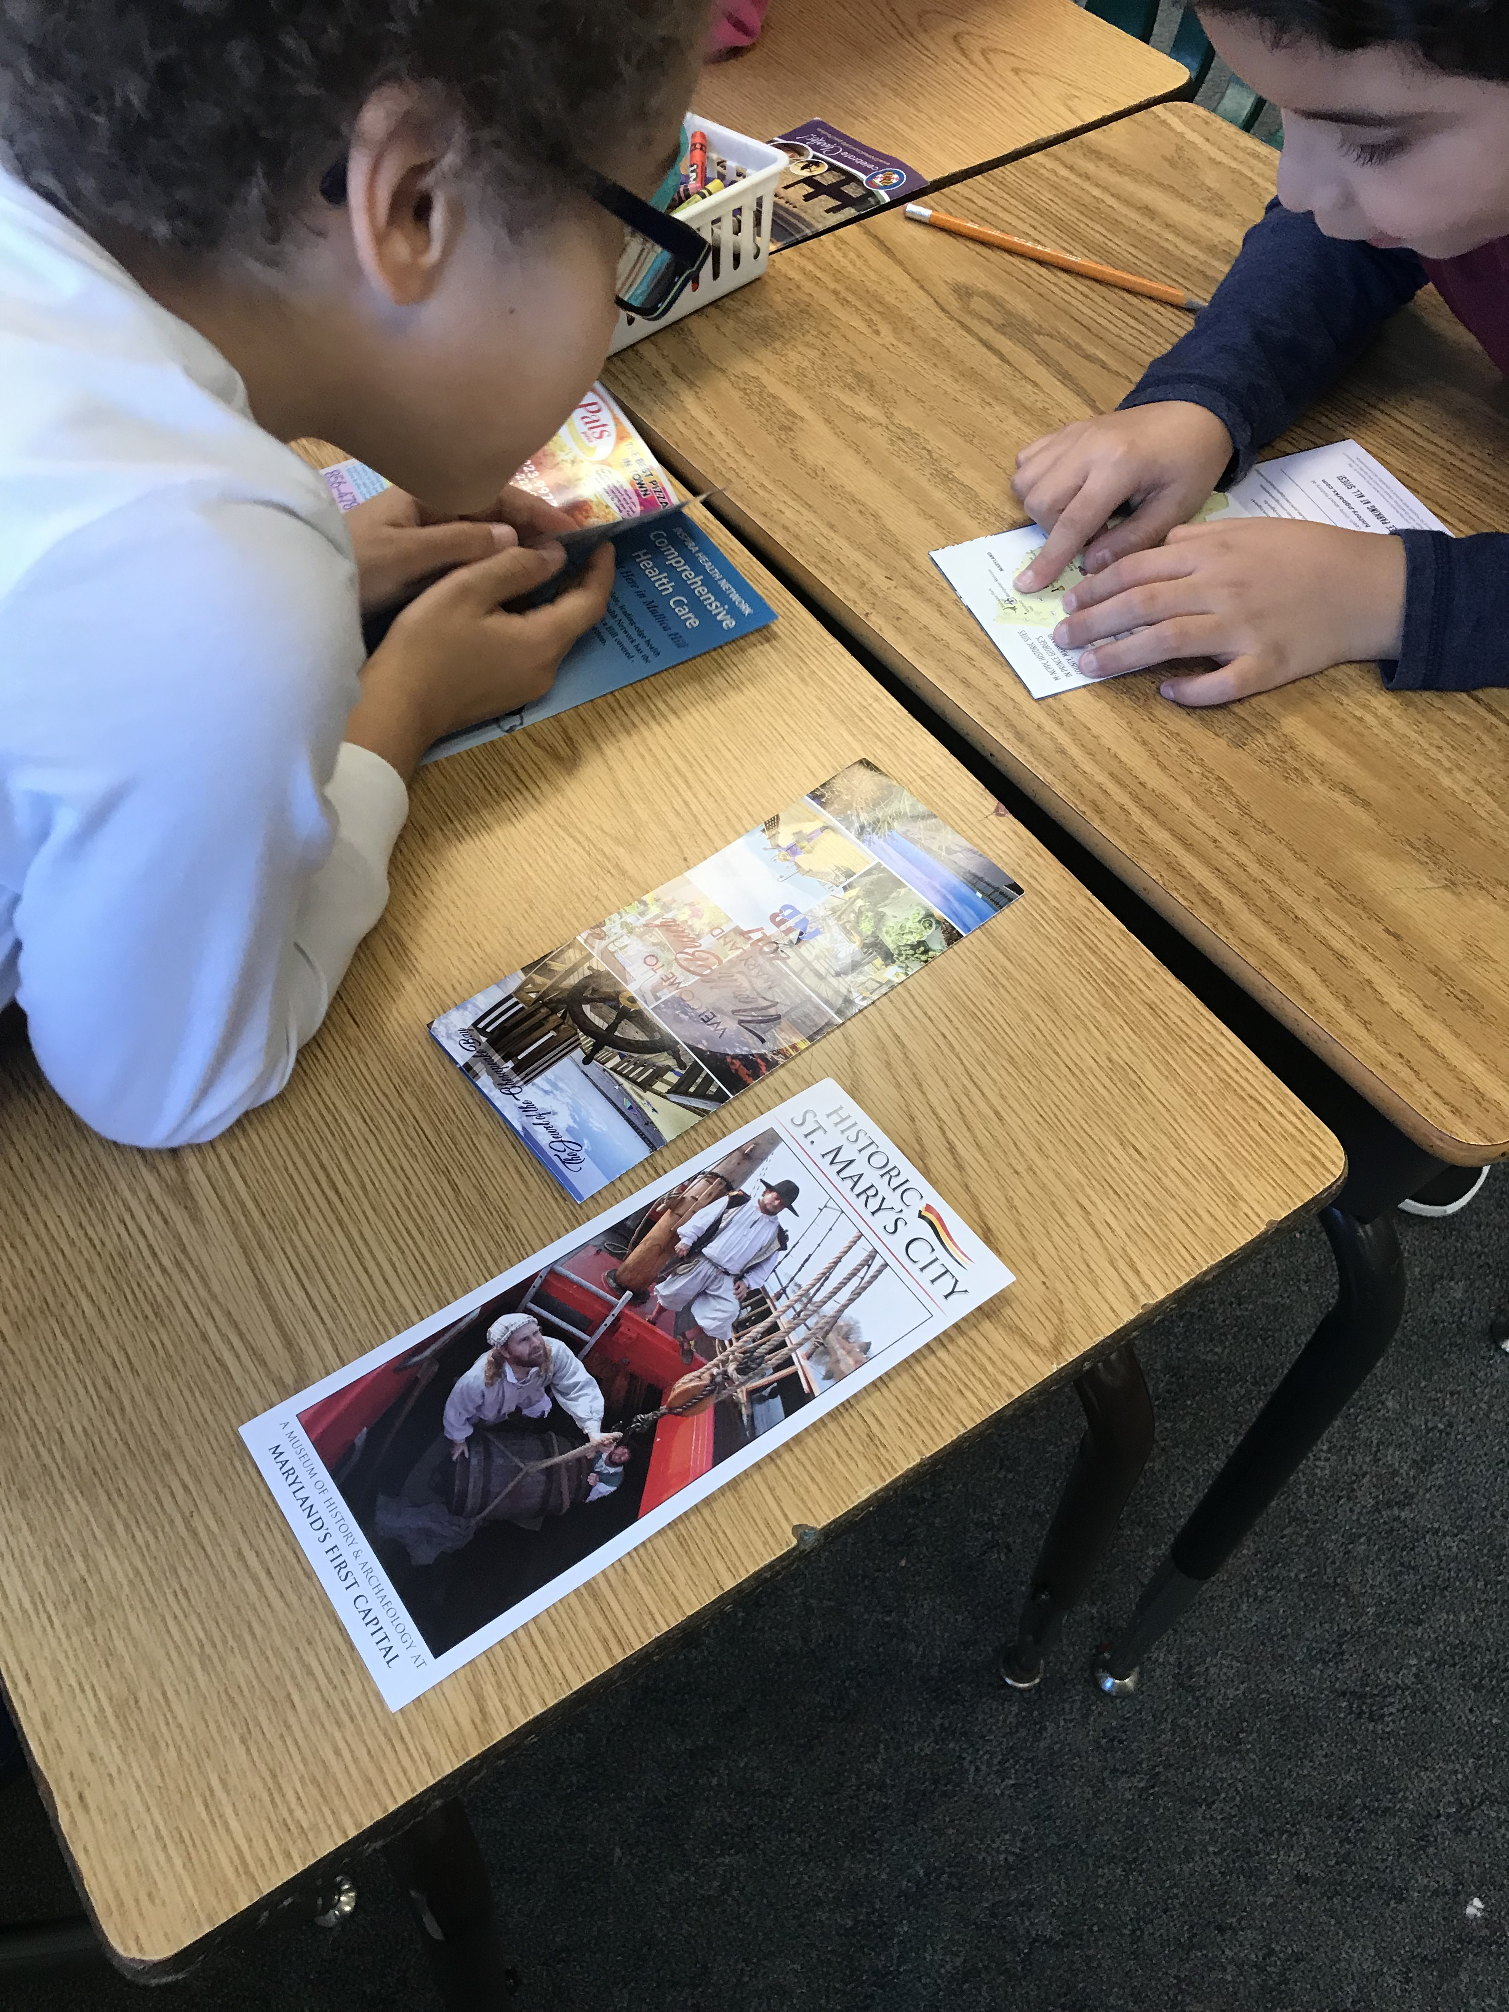
Research
Students then selected which location they would research and create their travel brochure about. They used databases and books to find information about the geography, food and attractions of their seleced location.

Slide 7
Project Creation
The students then took their research and recorded their information on their travel brochures. They also illustrated their brochures, added maps and wrote a persuasive script!

Slide 8
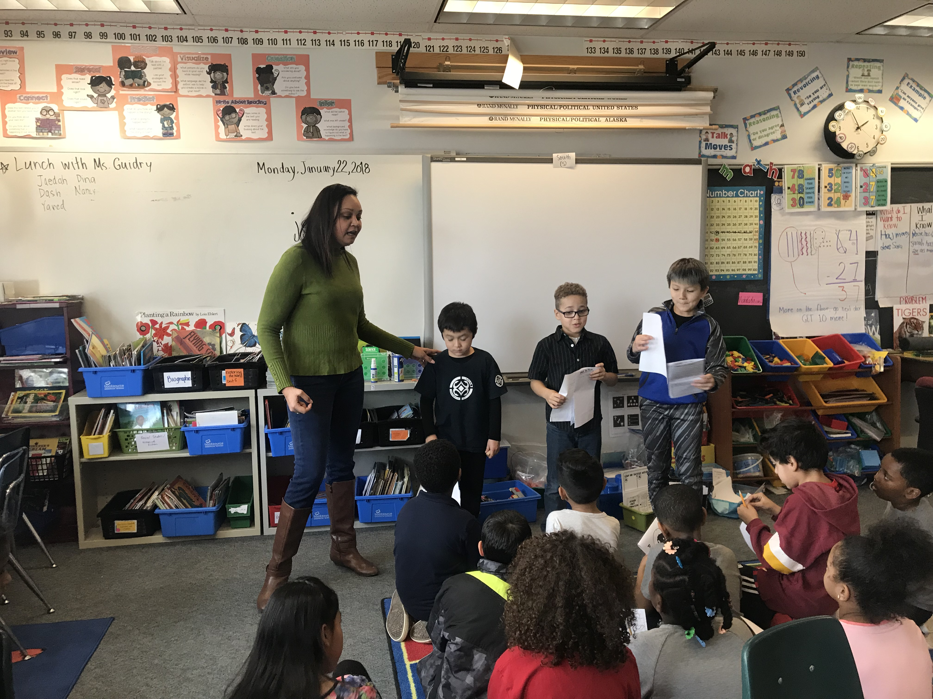
Presentation: Travel Expo
Student meteorologists then shared their travel brochures in a Travel Expo. Visitors received “passport” stamps for visiting different stations and listening to the students present.

