Slide 1
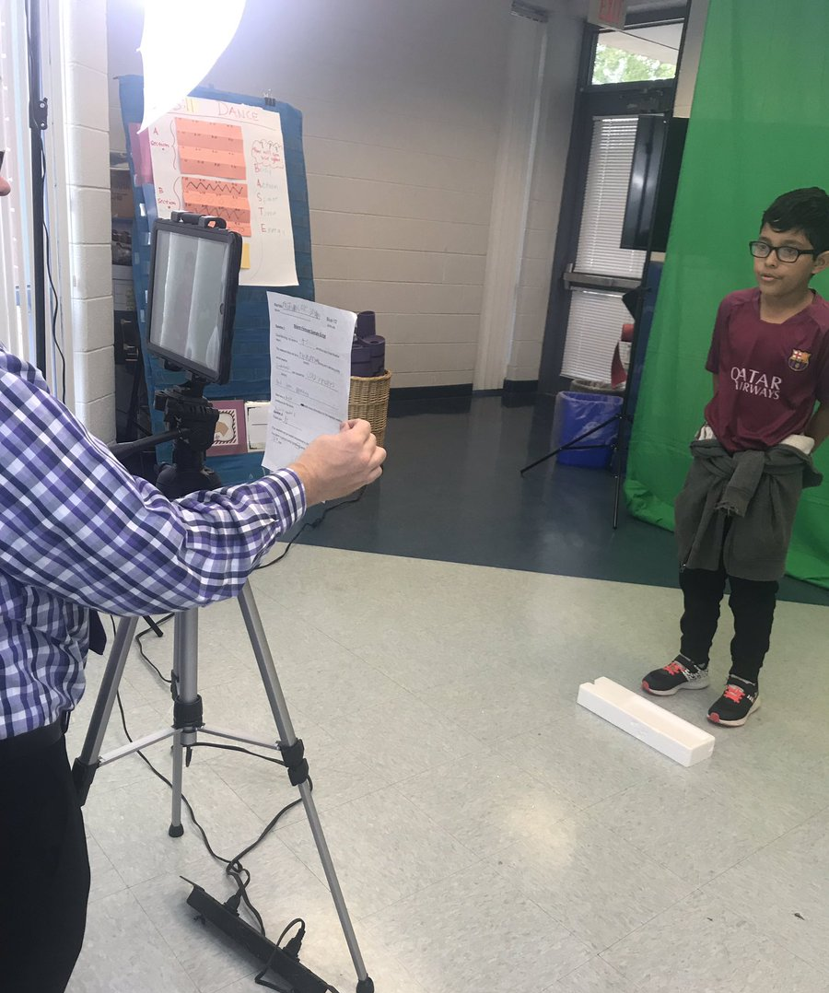
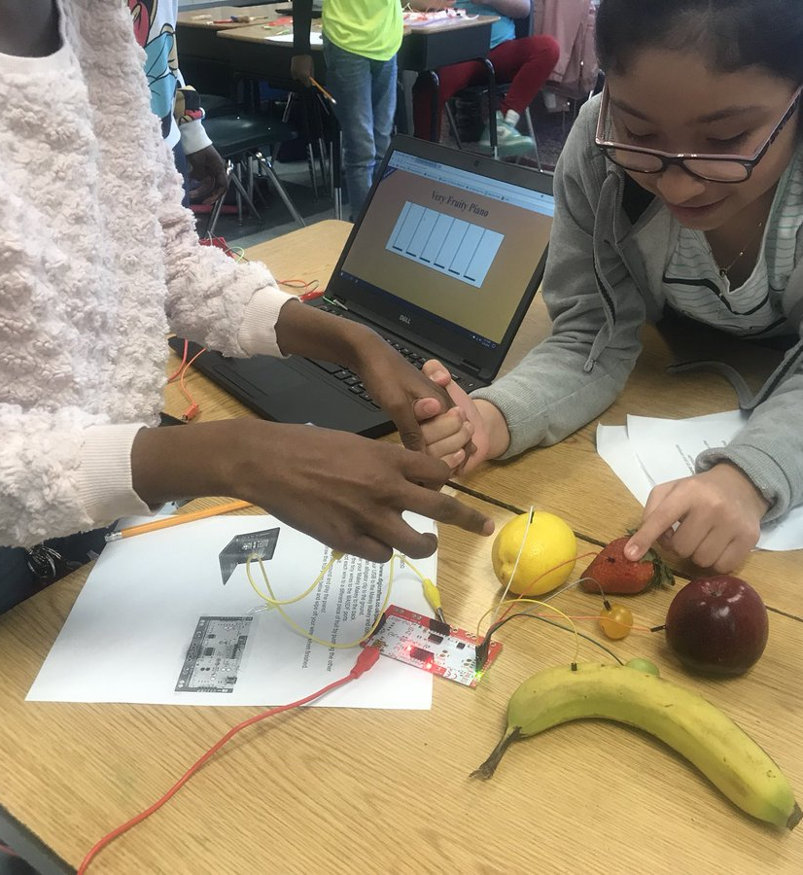
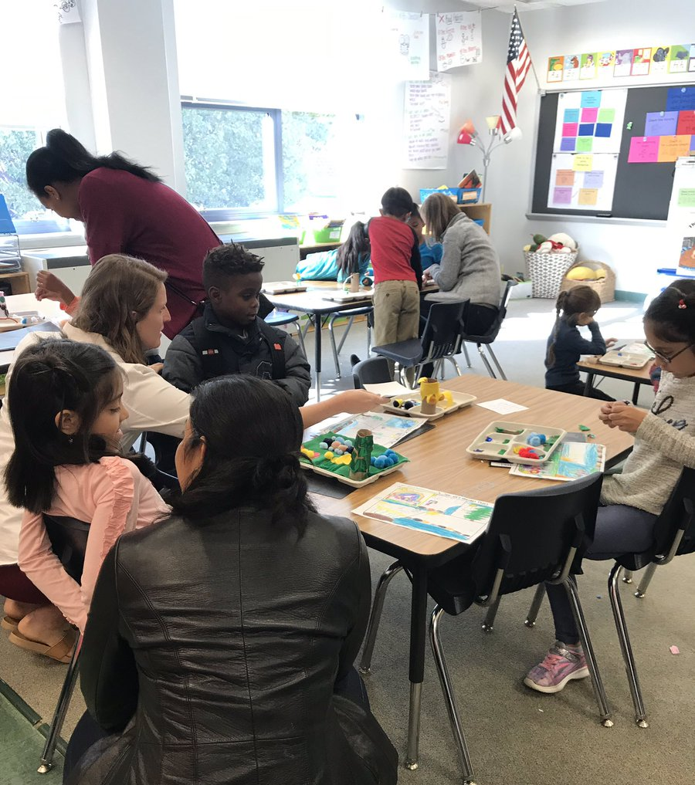
Instructional Focus and Exemplary Program—Science, Technology, Engineering, Arts and Mathematics (STEAM)
Building Our School Community
February 5, 2019

Slide 2
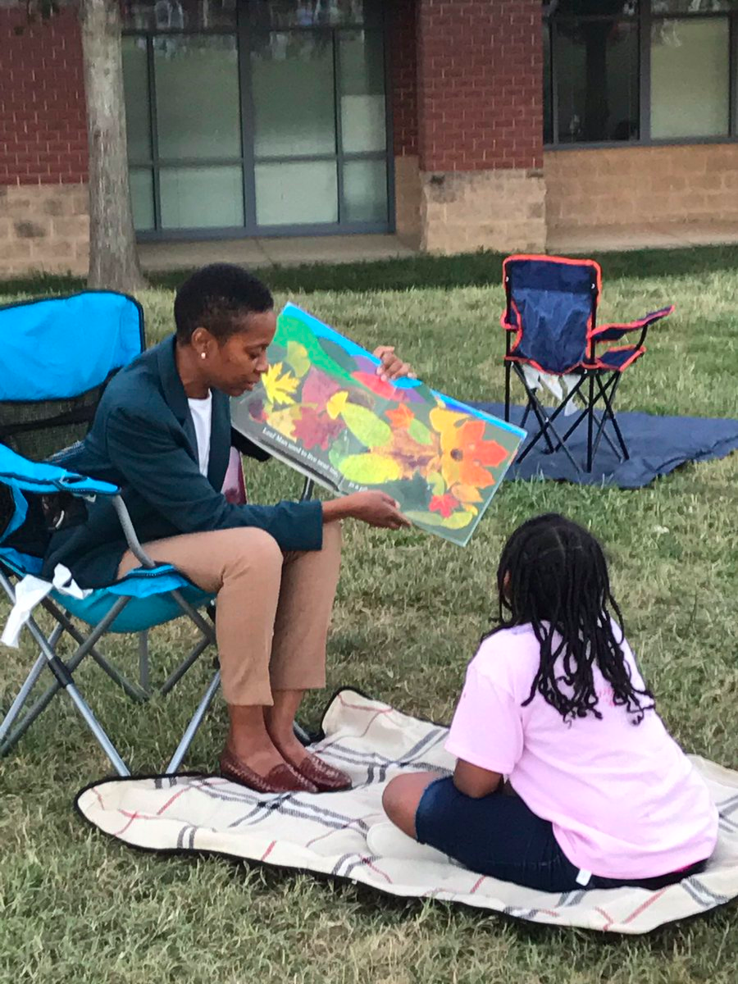
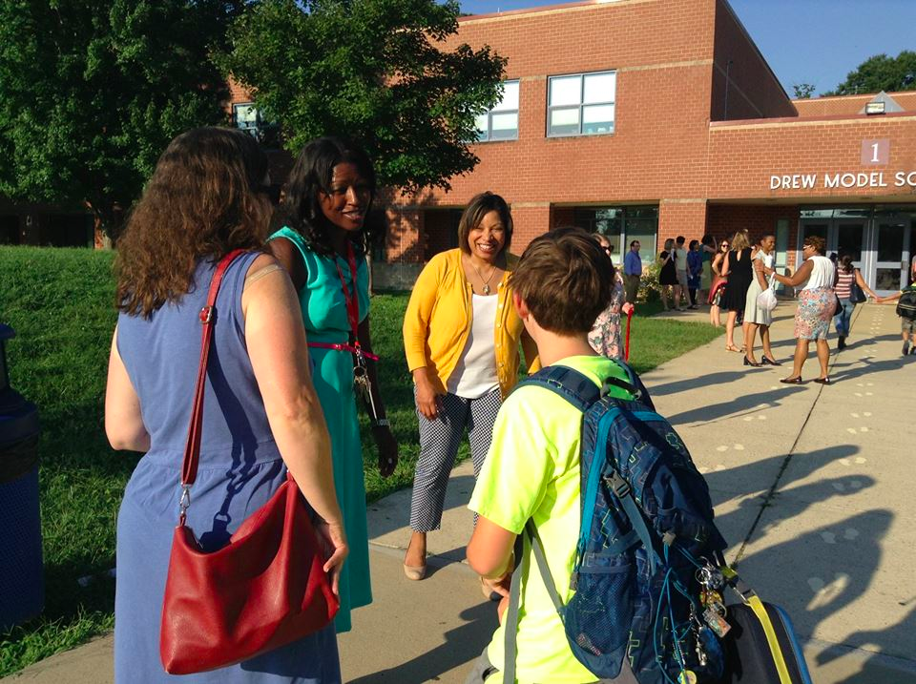
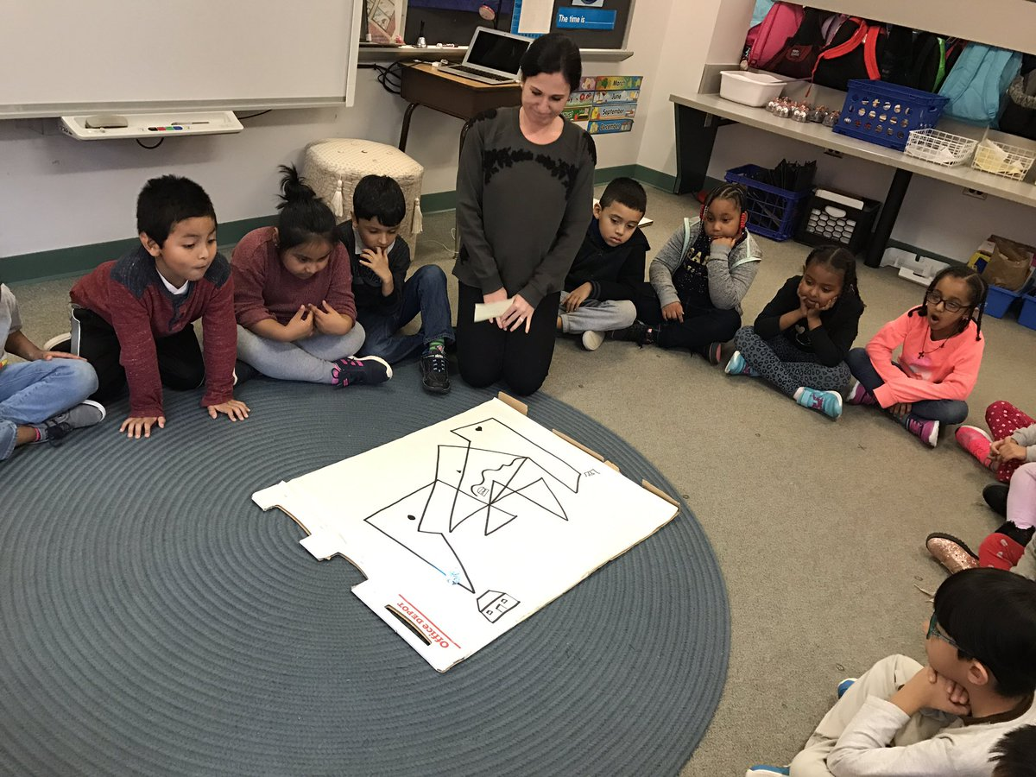
Introductions
Kimberley Graves
Principal
Tracy Gaither
Assistant Principal
Rachel Landry
STEAM Coordinator
Notes:
2 minutes

Slide 3
Agenda
What is STEAM?
What Are we Doing?
Where Do we plan to go?
Notes:
1 minute

Slide 4
What is Drew’s Vision for STEAM?
Strengthening literacy, inquiry, problem-solving, critical thinking, collaboration and creativity
Through
Science
Math
Technology
Interpreted through
Engineering
The Arts
Notes:
2 minutes

Slide 5
Project-Based Learning as the Delivery Model
Students work on a project over an extended period of time that engages them in solving a real-world problem or answering a complex question.
Students demonstrate their knowledge and skills by developing a public product or presentation for a real audience.
Projects are designed based on the standards, integrating areas of STEAM, while strengthening 21st Century Skills (communication, collaboration, creativity)
Notes:
2 minutes

Slide 6
PBL Defined
“In project based learning, students are pulled (as opposed to pushed, as it might often feel) through the curriculum by a meaningful question to explore, an engaging real-world problem to solve, or a challenge to design or create something...
Before they can accomplish this, students need to inquire into the topic by asking questions and developing answers...
To demonstrate what they learn, students create products and make their work public to people beyond the classroom.”
- John Larmer, Buck Institute for Education

Slide 7
What are we doing?
Extensive PBL training with the Buck Institute for Education
Project-Based learning implemented across all grade levels K-5
Student Showcases (innovation Hours)
Inviting community members and beyond to add career-based elements
Introducing principles of engineering with mobile makerspace
Staff PD on technology integration
Family Events such as STEAM at Sunset
2017-2019
Laying the Groundwork
Notes:
3-5 minutes

Slide 8
Project-Based Learning in Action
https://youtu.be/mUtQbhLFyFI
Notes:
5 minutes

Slide 9
Gallery Walk
Notes:
10 minutes

Slide 10
Where will we go next year and beyond?
Grow the STEAM Instructional Focus
New and continuing teachers build mastery of PBL instruction
Expand STEAM curriculum to PreK
Engage the Community
Expand partnerships with families, businesses and organizations to provide authentic “clients” for PBL
Schoolwide PBL Innovation Showcases
Create a Space to Innovate
Redesign instructional spaces to support PBL
Create a STEAM Lab with makerspace
Notes:
3 minutes

Slide 11
Check us out on Twitter
@APSDrewSTEAM

Slide 12
Questions?

